Slide 1
Outreach to International Students
Laura Baker and Jenny Colvin
Furman University
21 October 2015
Notes:
Welcome, intro, our goals –
Informal conversation, have fun, share experiences!

Slide 2
Snapshot
886,052 students
studying at US colleges and universities in 2013/2014
(record high)
  Source: Open Doors Fast Facts, IIE, 2014
Notes:
More than any other country, 4.5 million total worldwide per Institute of International Education.
We’ve seen an increase on our campus, likely there’s been increase at your campus.

Slide 3
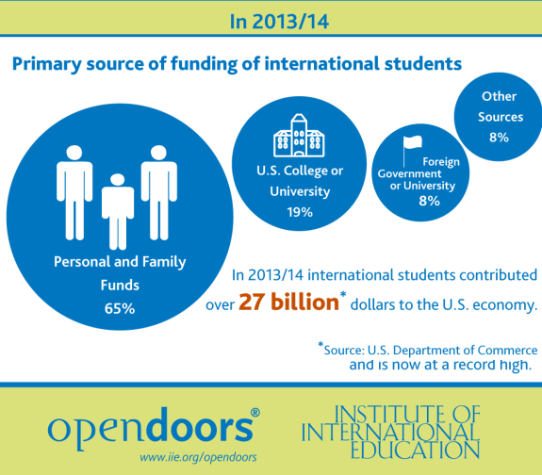
Economic Context
Notes:
For every seven international students enrolled, 3 US jobs are created.
Many are full-pay students – they bring money into our university budget, Money into our economy
Many universities actively seeking diversity, “Recruiting international students remains key to many admissions directors' plans to fill their classes” per 2015 Survey of Admissions Directors,
October 1, 2015 By Scott Jaschik
Many international students believe western education brings more opportunity (financial and job placement)

Slide 4
Challenges
Discussion: What challenges do international students face at your institution?

Slide 5
Challenges
Breaking down barriers – language, culture, religion
Pressure and distance from home
Academic expectations
Community
Legal issues and requirements
Notes:
From On-Boarding Internationals, rephrased
Caveat – Don’t brush with too broad stroke, avoid stereotyping students and/or making assumptions.

Slide 6
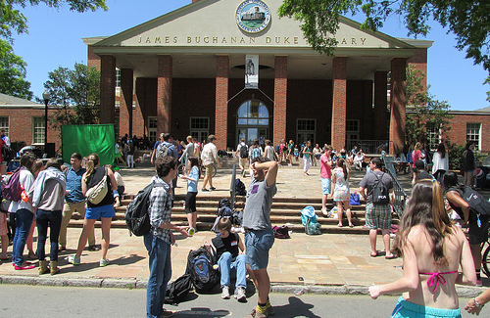
What is it like to be an international student?
Hands on time!

Slide 7
Reflect on Writing Exercise
Challenges
Strategies

Slide 8
Snapshot – International students in the US
Places of origin of international students:
  China 235,597
  India 96,754
  South Korea 70,627
  Saudi Arabia 44,566
  Canada 27,357
Top Fields of Study
  Business & Management
  Engineering
  Math & Computer Science
  Social Sciences
  Source: Open Doors Fast Facts, IIE, 2014
Notes:
This data is nicely packaged in an large Infographic : http://www.iie.org/Research-and-Publications/Open-Doors/Data/International-Students/Infographic

Slide 9
Snapshot – International students in SC
South Carolina ranked #35 (including District of Columbia)
Total students: 5,215
Institutions with the highest # of foreign students
  Clemson 1,967
  USC 1,578
  Trident Tech 289
  Winthrop 211
  College of Charleston 165
  Source: Open Doors Fact Sheet-SC, IIE, 2014
  Furman 138 (2015-2016)
  Source: Furman University, Rinker Center for Study Away and International Education, 2015
Notes:
The SC schools with larger populations may have developed strategies in the library long ago, but it was pretty new to us!

Slide 10
Notes:
Furman also hires Language House Assistants:
Japanese
Chinese
Spanish
German
French
Top places of Furman students:
China
Canada
UK/Vietnam/India
South Korea
Japan/Ghana/Nepal/Germany/Georgia

Slide 11
Notes:
Notable increase in students from China.
1/4 of a million students from China in colleges in the United States, far more than from any other country.
Students from China represent a third of all international students in the country - an almost a fivefold increase since 2000.

Slide 12
Changes at Furman
Notes:
Furman started to grow its international student population in 2011 - The first “large” incoming class had about 20 students.
Beginning in 2012, Furman has received approximately 35 international students each year, so this year is the first that all four classes have approximately 35 students.

Slide 13
Campus Response
August 2012 – Assistant Director of Study Away and International Education hired
Fall 2012 – Laura met with Assistant Academic Dean for Study Away and International Education
Summer 2013 - “Supporting International Students Across the Curriculum” workshop for faculty
August 2013 – Expanded orientation for international students
Fall 2013 – International Connection Program
Notes:
Conversation - how could the library better support growing international student body? Became evident that the question was a broader one for the entire university. Many campus conversations with multiple key players on campus took place.
July 15, 2013 –FYS/FYW ESL workshop, “Supporting International Students Across the Curriculum” . Gigi Taylor, UNC, (Gigi Taylor, Ph.D., one of UNC Writing Center’s ESL specialists; helps writing coaches, faculty, and staff provide effective writing support for ESL students.)
August 2013 – First library orientation for International students!
10-day (vs. 2 day) orientation began in August of 2013. Many campus partners participate.
The International Connection Program --pairs all incoming international freshmen with an upperclassmen student.
COLLABORATION – It takes a campus!!!

Slide 14
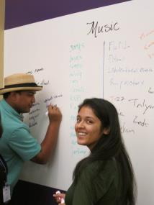
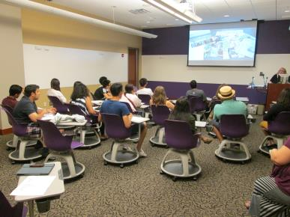
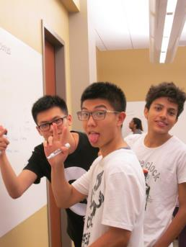
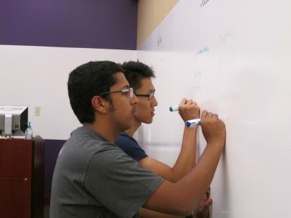
International Student Orientation
Notes:
Rich, Jack & Ahmad, Frank, Jared & Dipendra

Slide 15
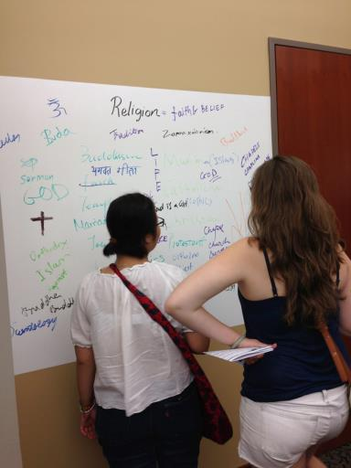
What we do…
Slideshow on the library
LC Brainstorming activity
Browse for a book
“Show & Tell”
Review of library website
Search the catalog
Notes:
Library powerpoint – brief!
LC Brainstorming activity – in groups of 2, students brainstorm keywords in 12 LC areas, 60 seconds per area.
Charge: identify interesting LC area, go to stacks, “browse” for a book & bring it back.
“Show & Tell” - student introduces him/herself, shares home country, & why they chose a particular book.
Review of library website – highlight few, important areas.
Contrast browse v. catalog search - Students search online catalog for a favorite book/author & complete form.

Slide 16
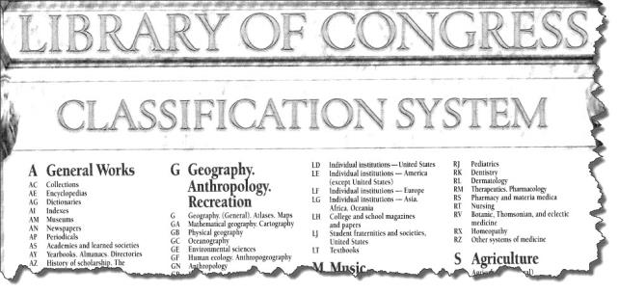
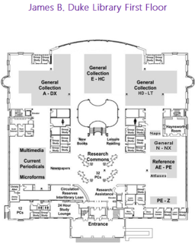
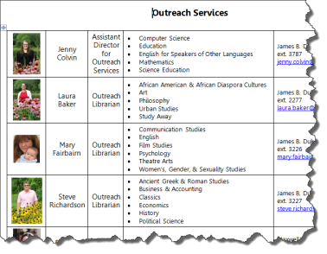
What we give them…
Notes:
Library Maps, LC chart, contact info. w/photo and liaison areas.

Slide 17
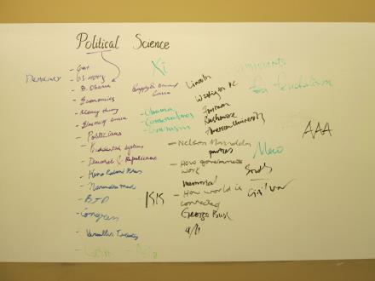
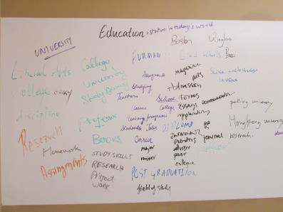
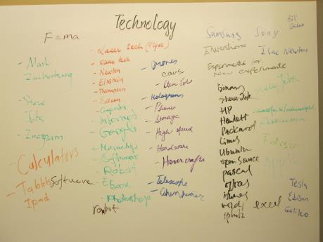
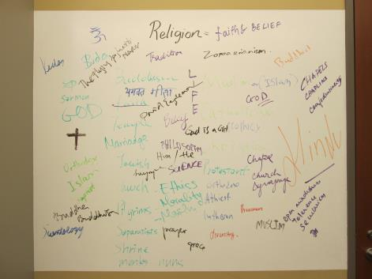
International Student Orientation
Notes:
Our categories (not quite all of LC)
Fine Arts
Social Sciences
Religion
World History
Medicine
Language & Literature
Education
Psychology
Technology
Political Science
Science
Music

Slide 18
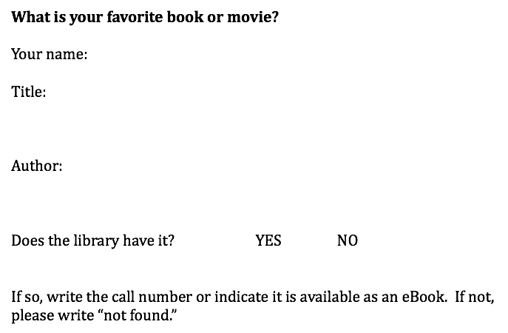
International Student Orientation
Notes:
Students complete. We make a commitment to purchase the item if not in our library.
Collection development!

Slide 19
International Student Orientation
Fall 2015 Survey
Surveyed incoming international students from 2014 and 2015
21 responses
13 - 2015, 8 - 2014
Notes:
13 responses from 2015, 8 from 2014.

Slide 20
How do you use the library (check all that apply!)?
# | Answer | Response | %
1 | Research | 11 | 69%
2 | Computer/software/email | 14 | 88%
3 | Study space | 12 | 75%
4 | Meeting friends | 5 | 31%
5 | I work there! | 3 | 19%
6 | Food | 1 | 6%
7 | Class sessions | 3 | 19%
8 | Help Desk, Academic Assistance | 6 | 38%
9 | Other | 1 | 6%
Notes:
Student use of library space.

Slide 21
How do you rank the topics?
#1 – Overview of the libraries
#2 – Physical organization of the library
#3 – Meeting the librarians
#4 – Library website overview
#5 – Browsing the collection
#6 – Searching the catalog
#7 – Brainstorming subjects
Notes:
Student assessment of most useful activities from the library orientation.
First three pretty close together

Slide 22
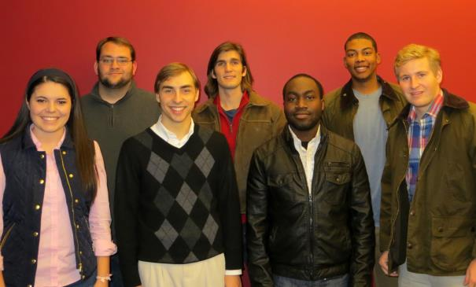
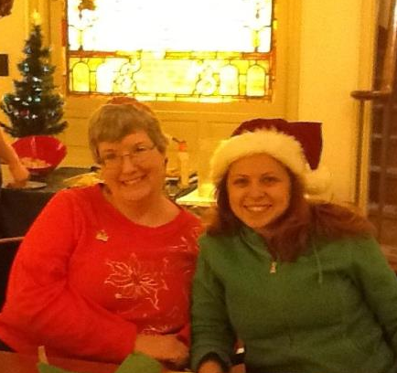
Other Library Connections
Notes:
Library Student Advisory Group (LSAG) consists of 7 students, one is always an international student, started 2012.
Outreach to Language Housing Assistants, courtesy of Bulgarian super student, Eva Kosadinova.

Slide 23
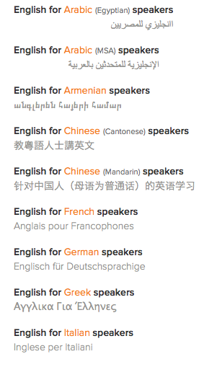
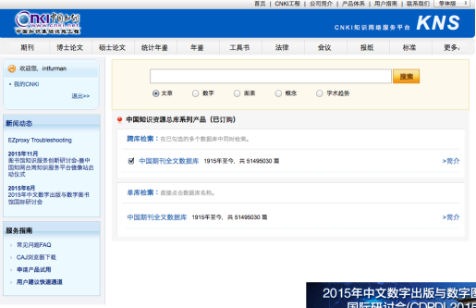

Exploring New Resources
Notes:
Purchasing more resources in languages other than english - Mango, CKNI (Chinese & English Language interface),
There has been a request from students to expand our Leisure Collection to include popular books in other languages.

Slide 24

More discussion
Conversation about international student outreach
November 16-20th
Notes:
In conclusion… It takes a campus to support our international students, not just the responsibility of the Study Away Office. We have responsibility to help
in student transition and student retention. There is a role for the library to play!
Some plans for future include:
Collaboration with Rinker Center for Int. Ed. Week
Ad Hoc student group for ideas/programs to support
Family Weekend event - September

Slide 25
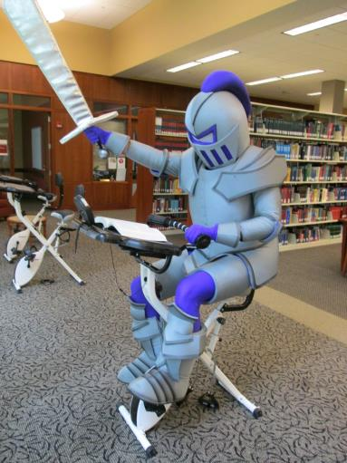
Resources
Bibliography handout
Powerpoint will be posted to SCLA website
Contact:
Laura Baker laura.baker@furman.edu Jenny Colvin jenny.colvin@furman.edu

