Slide 1
Implementing ArchivesSpace at University of South Carolina, Columbia
Teamwork, Membership, and Migration
Ashley Knox
Digital Projects Librarian
University of South Carolina Libraries
knoxam@mailbox.sc.edu
http://library.sc.edu/digital

Slide 2
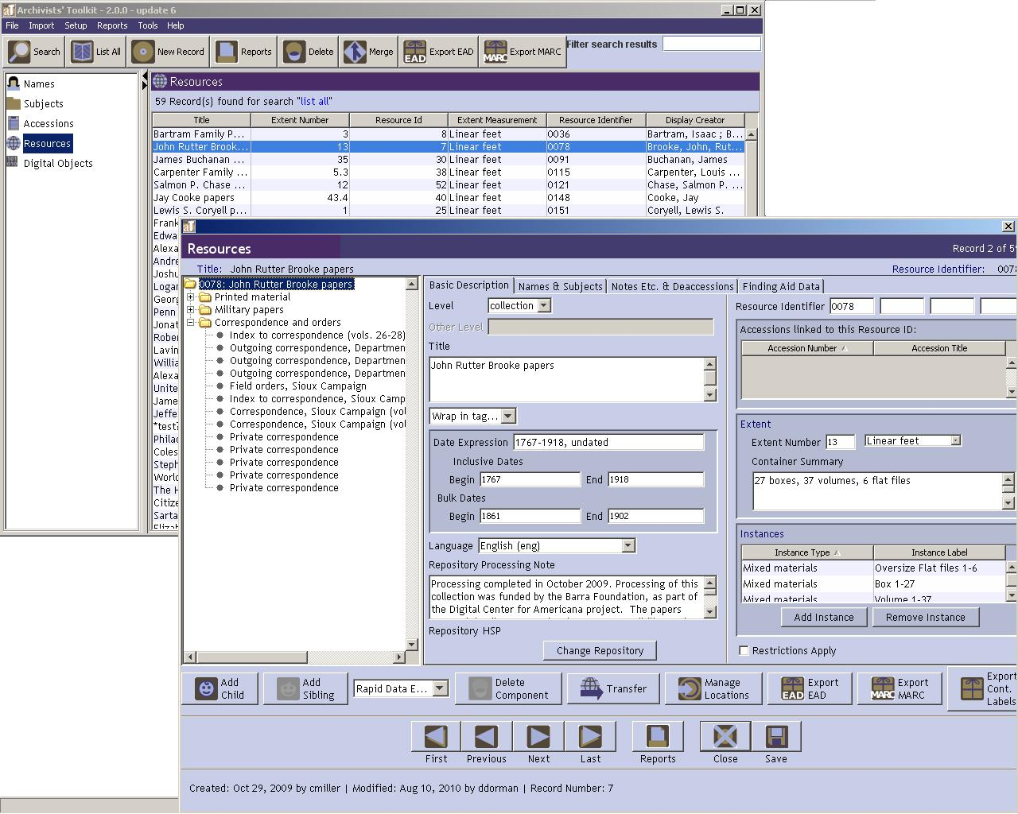
EAD – Archivists’ Toolkit – ArchivesSpace
Increase access
Promote standards
Enables crosswalking
Facilitates aggregation

Slide 3
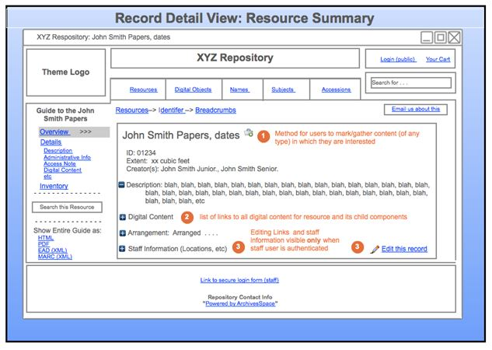
Humble Beginnings
2010 – Archivists’ Toolkit Testing
2011-2012 – Part-time staff and interns enter finding aids from South Caroliniana Library and South Carolina Political Collections
2012 – Investigated interface options. Anticipated release of ArchivesSpace (2013)

Slide 4
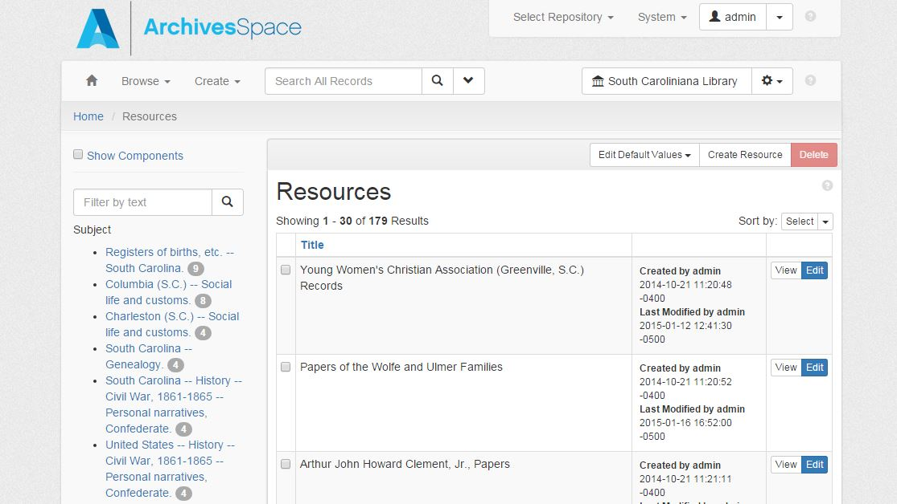
Love at first sight?
Sept 2013
ArchivesSpace version 1.0 released
“It is just so beautiful!”
–my first email after I installed it locally
2014
Jan-March – Server admin installed test instance on server
May – Formed an ArchivesSpace Implementation Team
Oct – 100% successful migration

Slide 5
Team Goals (2014-2015)
Make a plan to migrate Archivsits’ Toolkit finding aids into ArchivesSpace
Gain an understanding of how ArchivesSpace works—staff interface and user interface.
Discuss pros and cons of becoming ArchivesSpace members during the 2014-2015 fiscal year.
Assure that each special collections library has a voice in the implementation of EAD at USC.
Talk about lessons learned from using Archivists’ Toolkit.
Create best practices for USC Libraries. ArchivesSpace in a way, creates a uniformity, but there is room in both systems for redundancy and element misuse.
Discuss a timeline for a launch date.

Slide 6
ArchivesSpace Members (Aug 2014)
User-group listserv
Member representative listserv
Documentation
Migration tools
Training discount

Slide 7
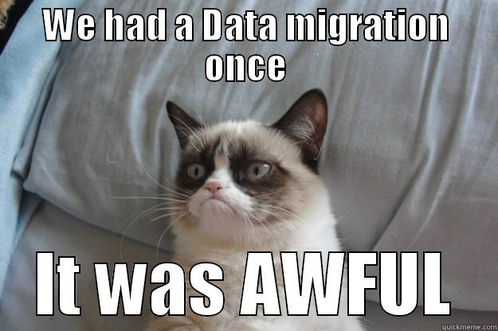
Oct 2014

Slide 8
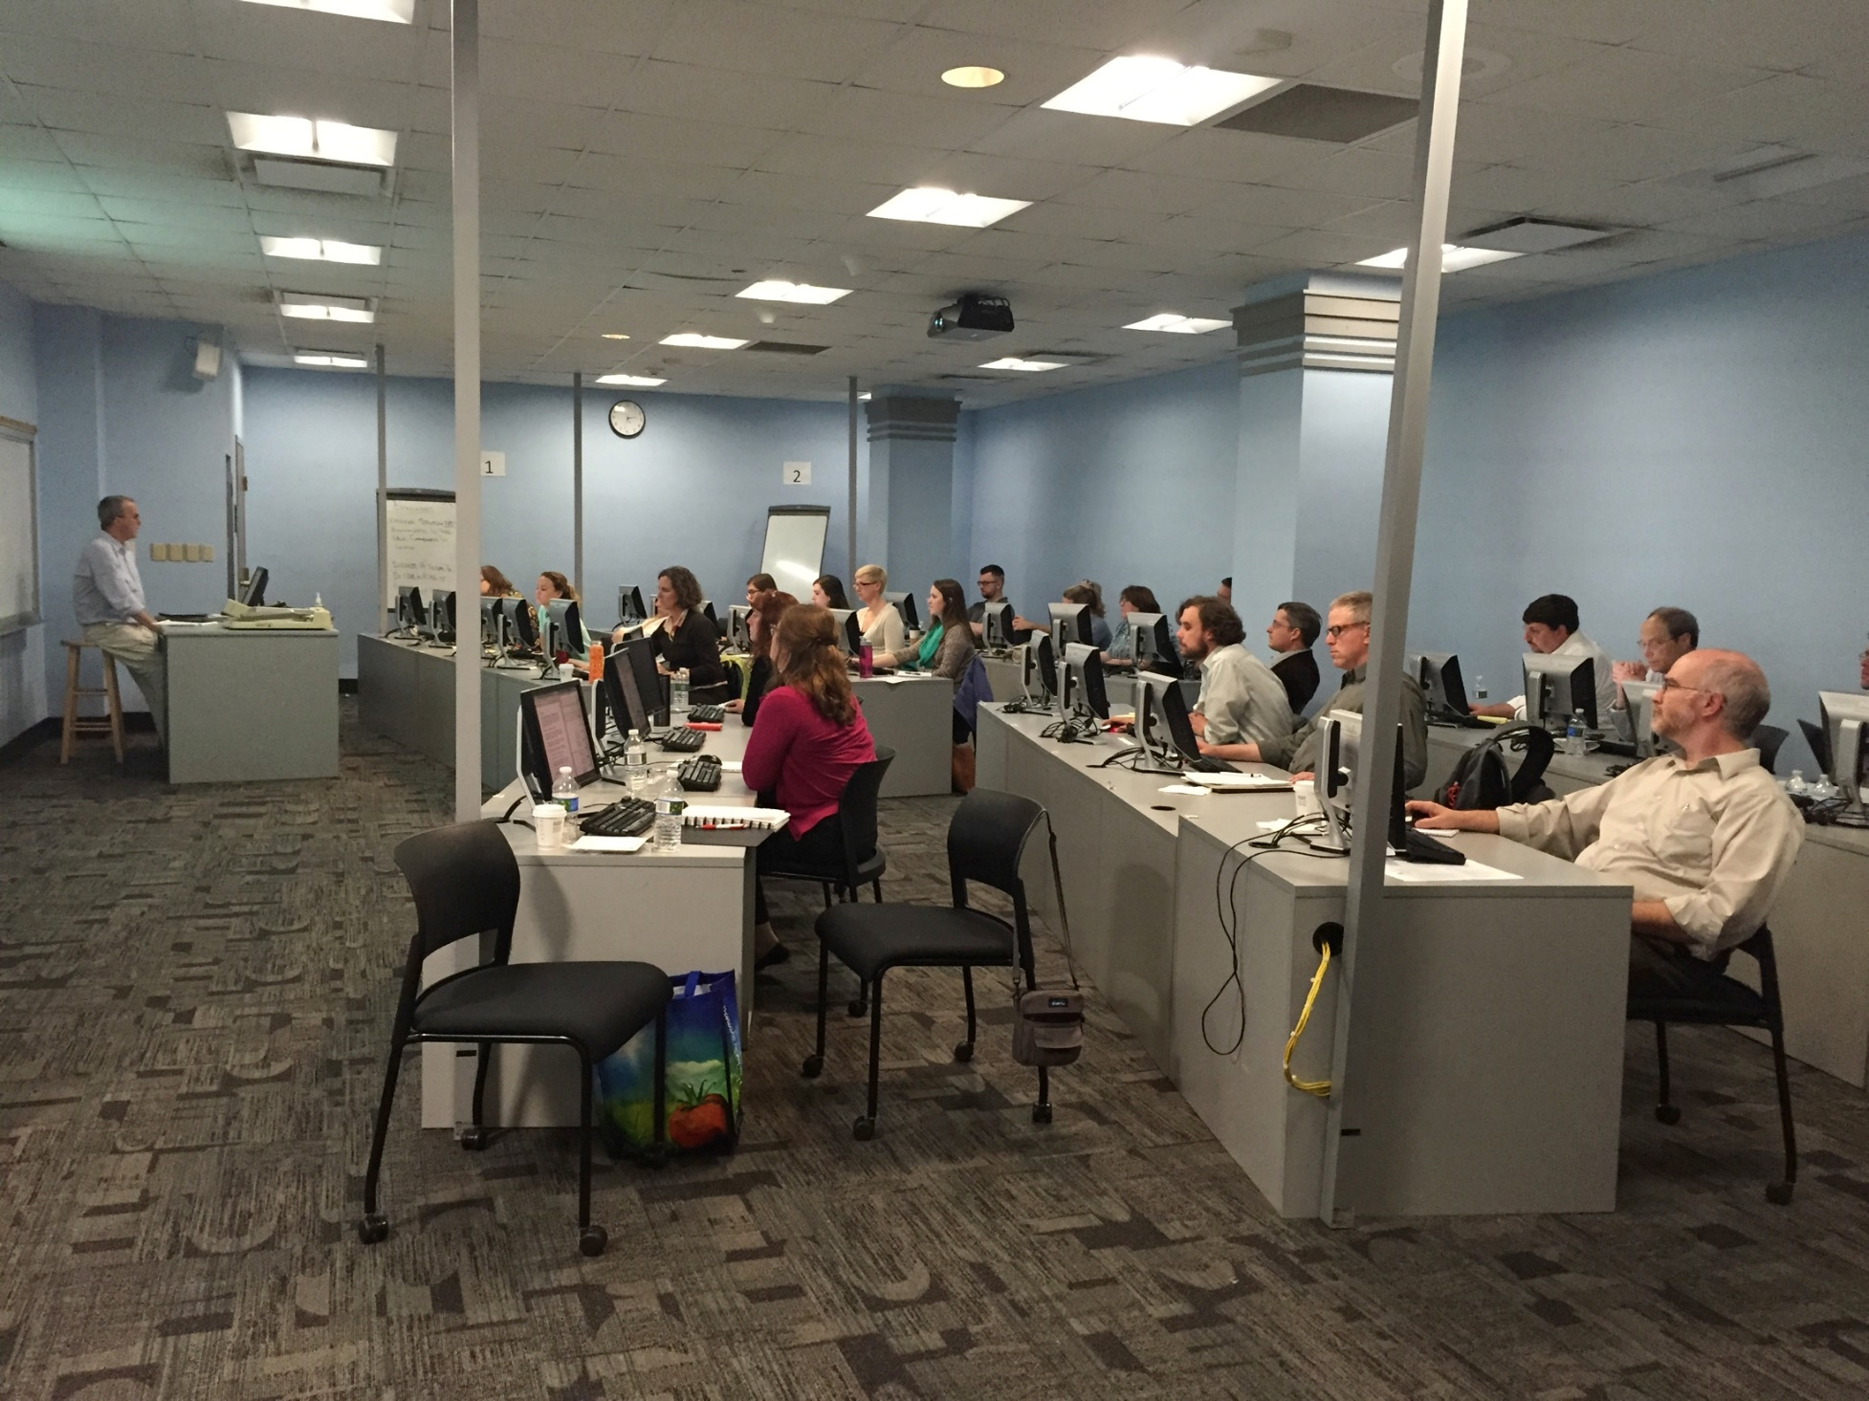
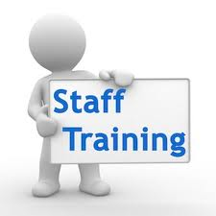
April 2015

Slide 9
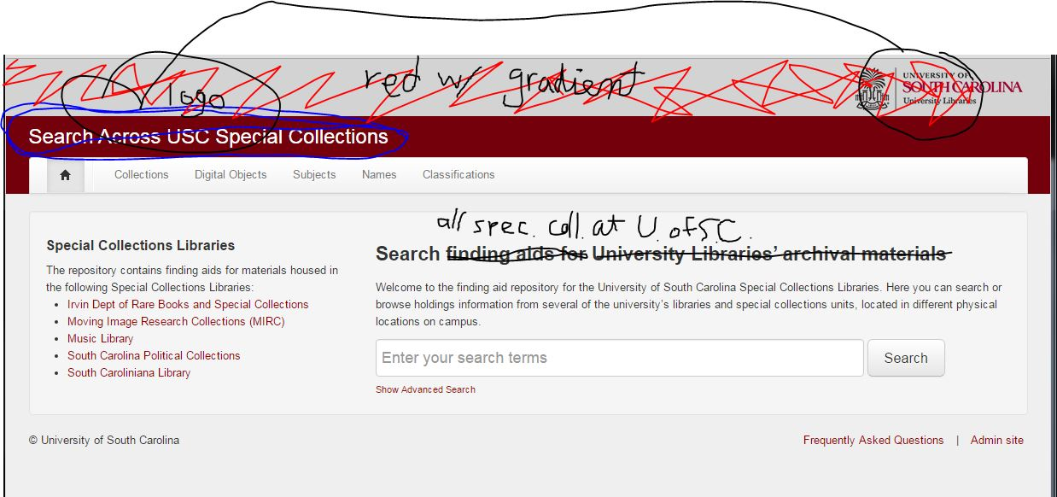
Before

Slide 10
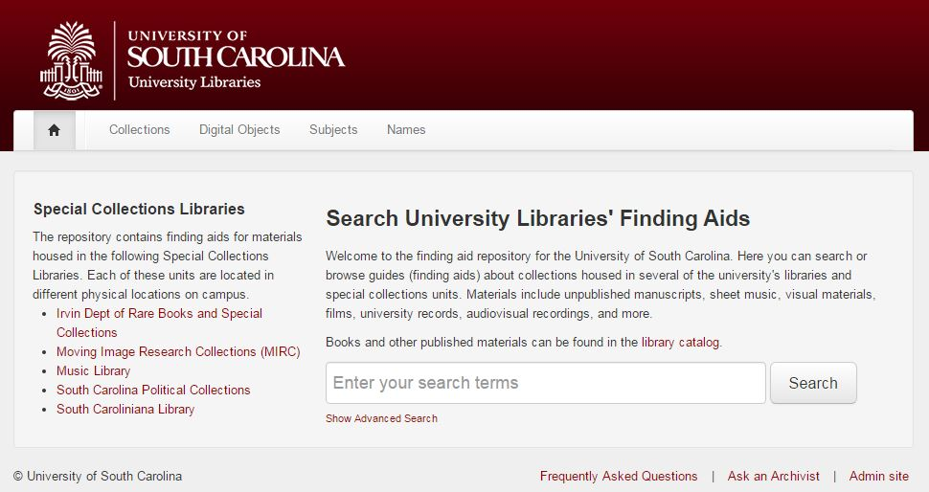
After

Slide 11
Recommendations
Create a team and goals
Migrate your data or start with a clean slate
Get training
Create manuals and best practices
Work with your community
Launch!

Slide 12
ArchivesSpace in the South Caroliniana Library, University of South Carolina Libraries
Using the Accessions Form and
Standardizing Collection Description and Access
Katharine Thompson Allen
Project Archivist
South Caroliniana Library University of South Carolina Libraries
allenkat@mailbox.sc.edu

Slide 13
South Caroliniana Library
Nation’s oldest freestanding college library (1840)
Since 1940 has housed materials pertaining to the history and culture of South Carolina
Circulate around 400,000 items per year
Collection estimates include:
Over 1 million printed volumes
15,000 linear feet of Manuscript and University Archives materials
4000-5000 maps
600 audio materials
25,000-30,000 microfilm reels

Slide 14
Old Accession Method
Purely numerical: number provides no context to date of accession
Two analog forms: notecard with collection information and corresponding entry in a logbook
Issues include:
No searchable database of accessions
Difficult to create reports
No backup for either form

Slide 15
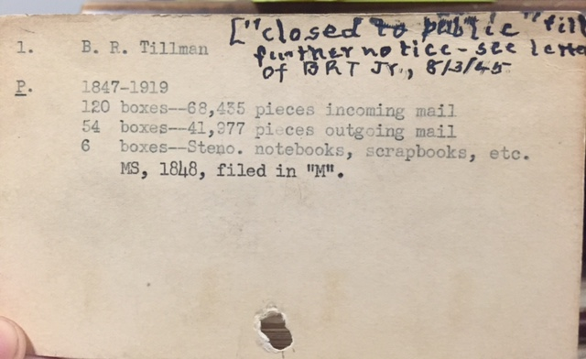
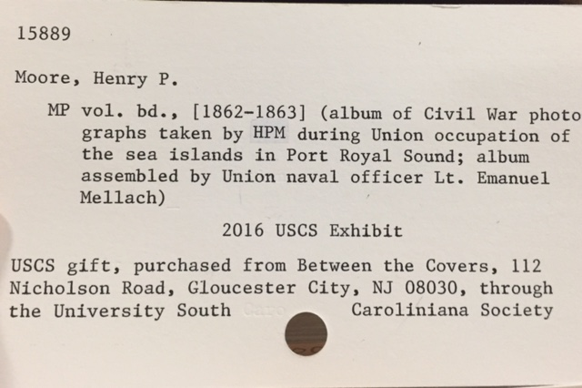
First accession: Benjamin Ryan Tillman’s papers (now at Clemson)
One of last accessions under old method (15889)

Slide 16
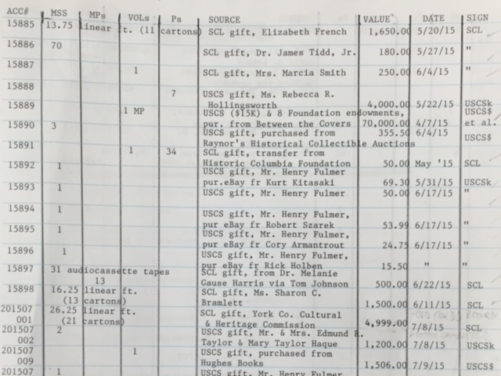
Old Method
New Method

Slide 17
New Accession Method (July 2015)
Accession number contains useful information
201507001 YEARMO + order in which items are received
No more notecards; only created in ArchivesSpace and accession log (as backup now)
Advantages include
Accessions are searchable
Accessions can be converted into Resources
Potential for reports
Continued ability to generate new information

Slide 18
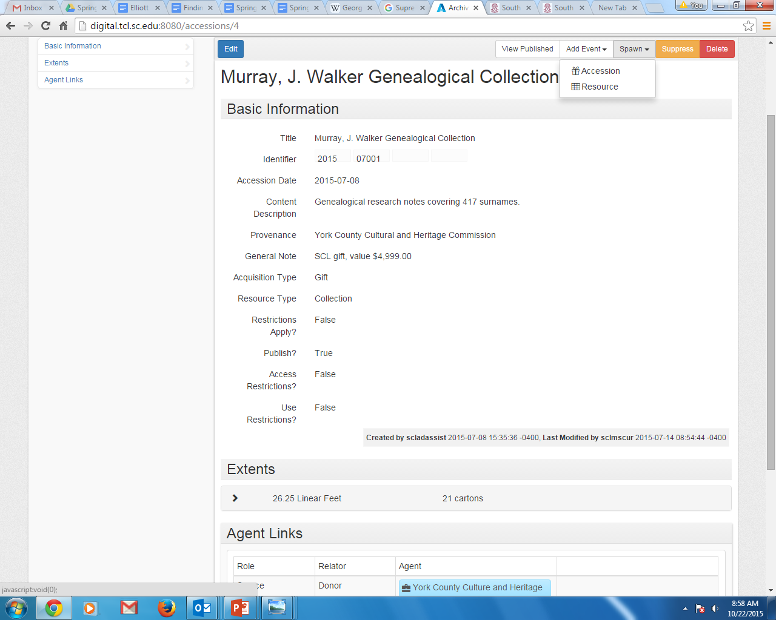
First accession using new method

Slide 19
Standardizing Collection Description and Access
Currently use multiple card catalogs, the OPAC (libcat.sc.edu), the library’s website, and paper finding aids
Creating records for ALL manuscripts collections in ArchivesSpace
Creating records for University Archives, Visual Materials, and Oral History collection areas
Only collecting area not included: Published Materials, which will continue to use OPAC

Slide 20
Standardizing Collection Description and Access
Advantages:
Rely less on institutional knowledge
Find collections across all special collections libraries at USC
Created a manual for ArchivesSpace entry that brings all finding aids in line with DACS
Ability to generate standardized PDFs of all finding aids
Disdvantages:
Time requirements
Figuring out how ArchivesSpace and manuscript collections in OPAC will interact (duplication of work product)

Slide 21
ArchivesSpace in Moving Image Research Collections, University of South Carolina Libraries: Standards, Cooperation, and Modification
Amy Ciesielski
Curator
Moving Image Research Collections
University of South Carolina
ciesiel@mailbox.sc.edu

Slide 22
Moving Image Research Collections
One of University Libraries’ special collections units
USC’s film and video archive
One of the largest film archives in the U.S., including over 7 million feet of nitrate film dating to the early 20th c.
Over 3000 hours of footage
Newsreels and Local TV News, Regional Films, Chinese Film Collection, Science and Nature Films, and the U.S. Marine Corps Film Repository

Slide 23
Establishing Standards
EAD Implementation Team met regularly
Discussed unit and library-wide needs, and how we could meet them in AS.
Established series of standards for each unit to follow to ensure consistency and ease of searching for patrons

Slide 24
Addressing Unique Needs
Each unit has slightly different goals for AS
Example: MIRC hopes to make hidden and uncataloged collections more visible
Resource records most important to MIRC
Will attempt to use Collections Management tab for evaluating processing workflows

Slide 25
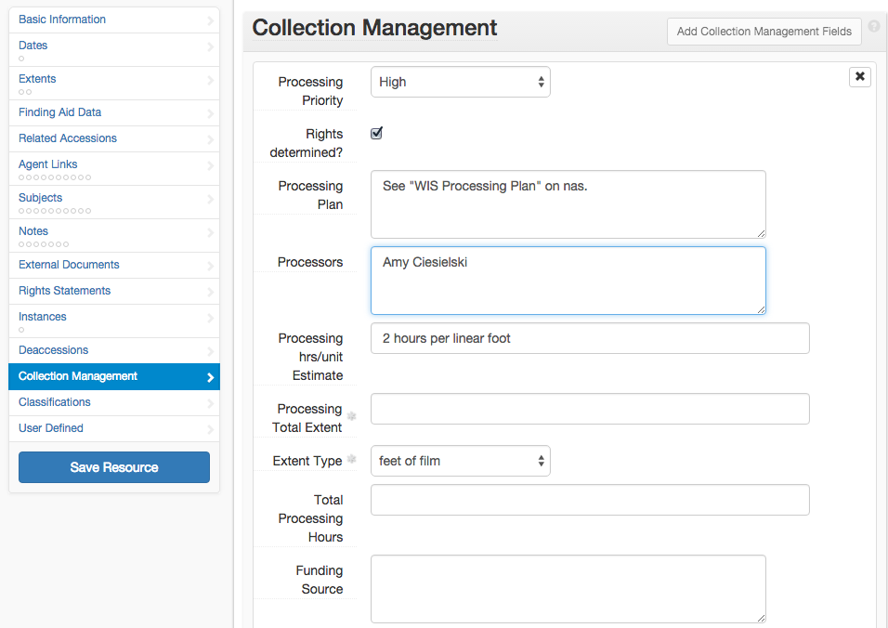
https://docs.google.com/document/d/1NGT6bL8wrIoGA_NtrOxJi1k0ZRvrVx8V1Hlp6LYc0h8/edit?usp=sharing

Slide 26
ArchivesSpace in the Irvin Department of Rare Books and Special Collections, University of South Carolina Libraries
Implementation and User Experience
Jessica Dowd Crouch
Archivist
Irvin Department of Rare Books and Special Collections Ernest F. Hollings Special Collections Library University of South Carolina Libraries
jdcrouch@mailbox.sc.edu

Slide 27
The Irvin Department of Rare Books and Special Collections holdings include approximately 160,000 items and over 50 archival collections, ranging from early medieval manuscripts and incunabula to historical scientific works and modern literature.

Slide 28
Research and Public User Experience:
University of South Carolina’s Public User Interface

Slide 29
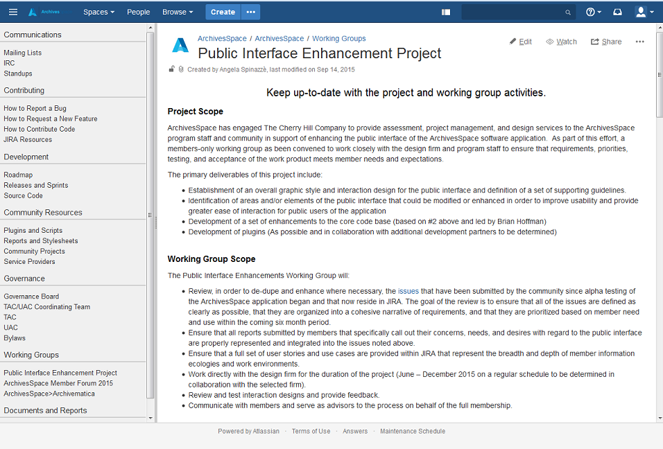
Public Interface Enhancement Project

Slide 30
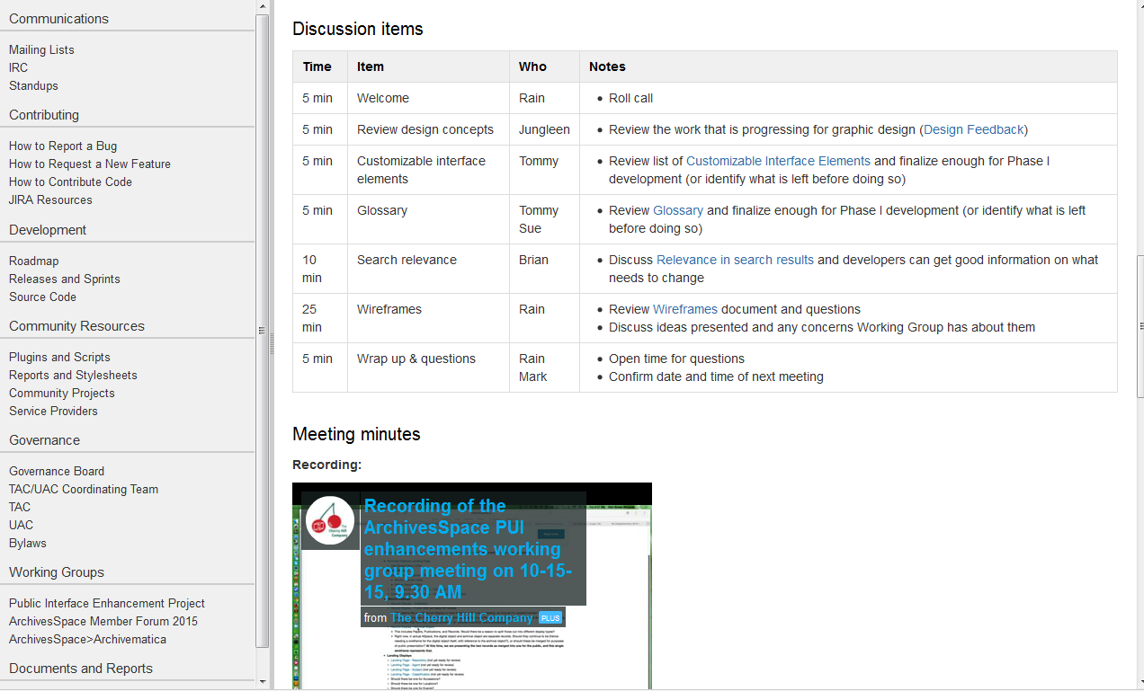

Slide 31
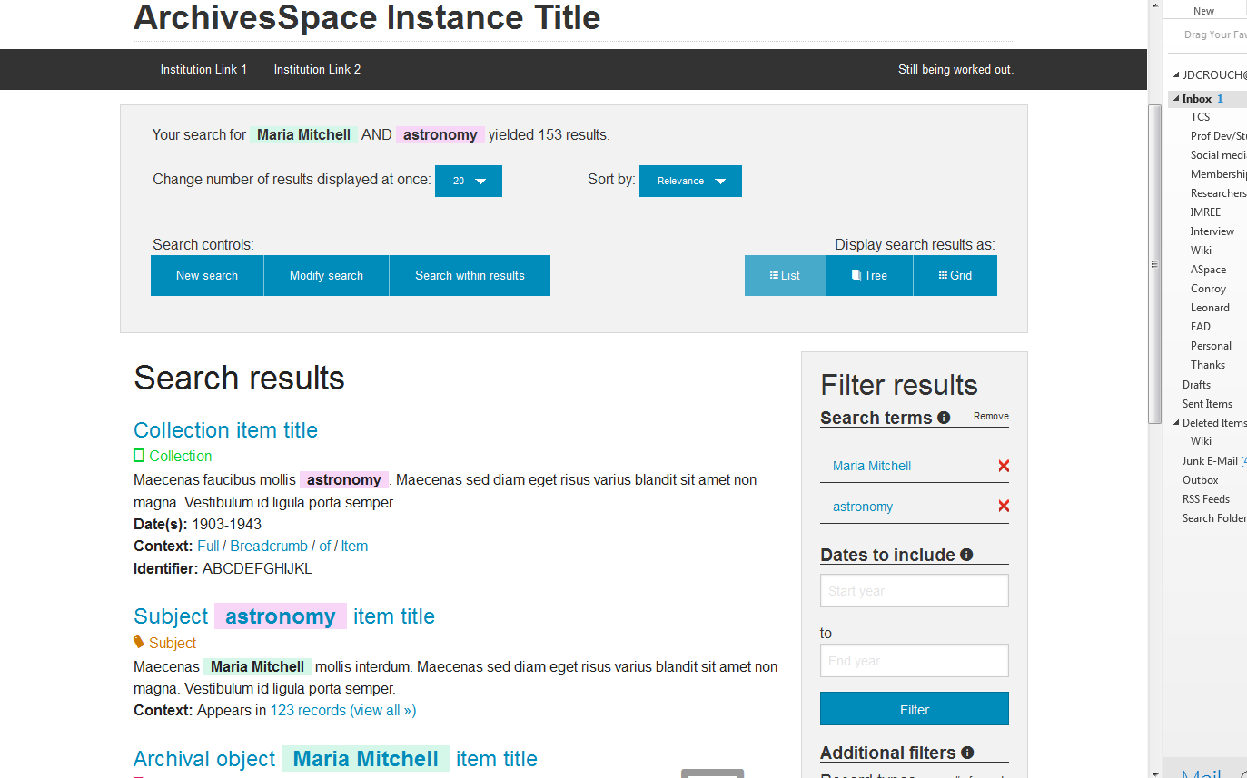

Slide 32
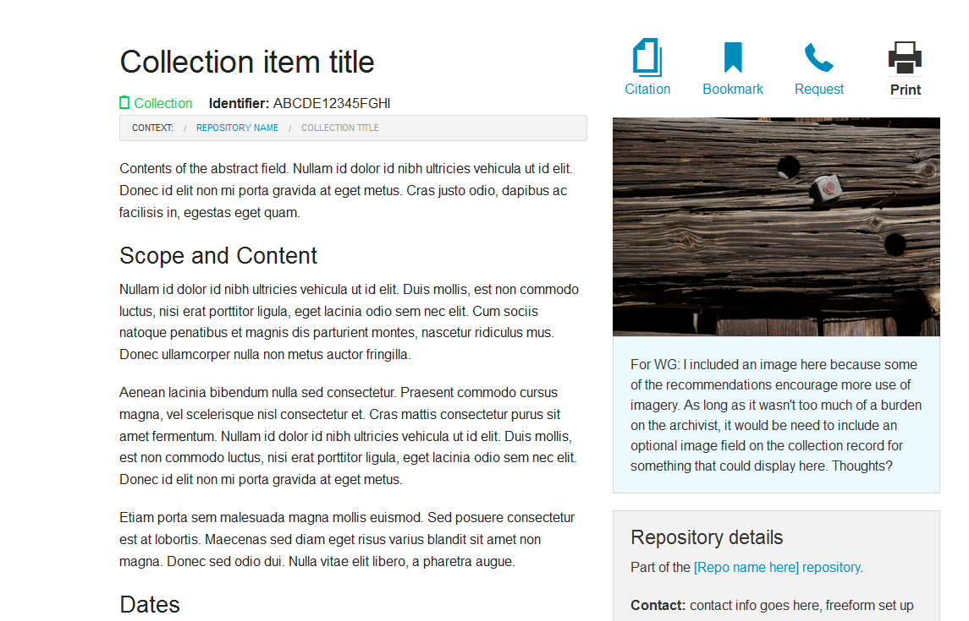

Slide 33
ASpace Implementation Team
Katharine Allen, SCL
Amy Ciesielski, MIRC
Jessica Crouch, RBSC
Brian Cuthrell, SCL
Lance Dupre, Systems
Ashley Knox, Systems
Laura Litwer, SCPC
Nathan Saunders, SCL
Dorothy Walker, SCPC
Jennifer Wochner, Music

