Slide 1
Psyched Out: A Psychology Librarian’s Tale of the Switch from In-Person to Online Instruction
John Siegel, MLS, MEd (he/him/his)
Coordinator of Information Literacy
University of South Carolina Upstate
South Carolina Library Association Conference
October 15, 2020
University of South Carolina Upstate
Up is where we live.

Slide 2
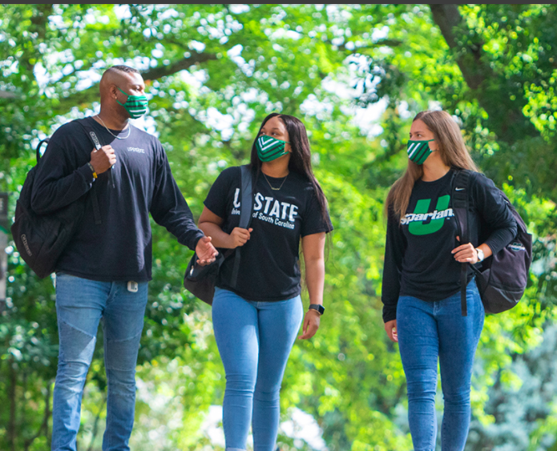
USC Upstate
Regional, comprehensive university
Enrollment: ~6,000 (mainly undergrads)
Psychology is one of the largest majors
Source: USC Upstate

Slide 3
PSYC U325: Research Methods
Required course
Group and individual research projects
Typically: 4 sections, 10-12 students each
Embedded library instruction
Source: Microsoft Stock Images

Slide 4
PSYC U325 Library Instruction (Pre-COVID)
→ In-Person, 75 minutes
Introductory material/Lecture (15 min)
Why the library? – Journals – LibGuide – Get Help
Group Exercise #1 with debrief (15 min)
Empirical vs. Review Articles
Database Overview/Lecture (5 min)
Group Exercise #2 with debrief (35 min)
PsycINFO Searching
Questions/Wrap-Up (5 min)

Slide 5
PSYC U325 Library Instruction (During COVID…after several iterations)
→ Online, Synchronous – 75 minutes
Introductory material/Lecture (15 20 min)
Why the Library? – Journals – LibGuide – Get Help
Group Exercise #1 with debrief (15 min)
Empirical vs. Review Articles
Empirical Articles & Databases/Lecture (5 10 min)
Group Exercise #2 with debrief (35 40 min)
PsycINFO Searching
Questions/Wrap-Up (5 min)

Slide 6
Lessons Learned
Plan for technology ’blips’
Students are anxious and frustrated – reassure
Introductory slides with dial-in phone number and PIN, making an appointment, Ask a Librarian
Students aren’t as tech savvy as you think
They aren’t necessarily familiar with tools
Demonstrate and repeat, demonstrate and repeat
Participation is challenging
Allow for silence and extra encouragement
Anonymity through polls, whiteboard worked best

Slide 7
Lessons Learned
Group work is great, but takes extra time
Sometimes lecture is best for sake of time
Be patient with yourself
Trial and error is the name of the game
Honesty goes a long way with students and faculty
Tell them this is new and you’re learning with them; provides reassurance
Collect as much feedback as you can!
Surveys, polls, etc.
Celebrate your successes – no matter how small!

Slide 8
Questions?
John Siegel, MLS, MEd (he/him/his)
Coordinator of Information Literacy
University of South Carolina Upstate
E-mail: jsiegeL2@uscupstate.edu
University of South Carolina Upstate
Up is where we live.

