Slide 1
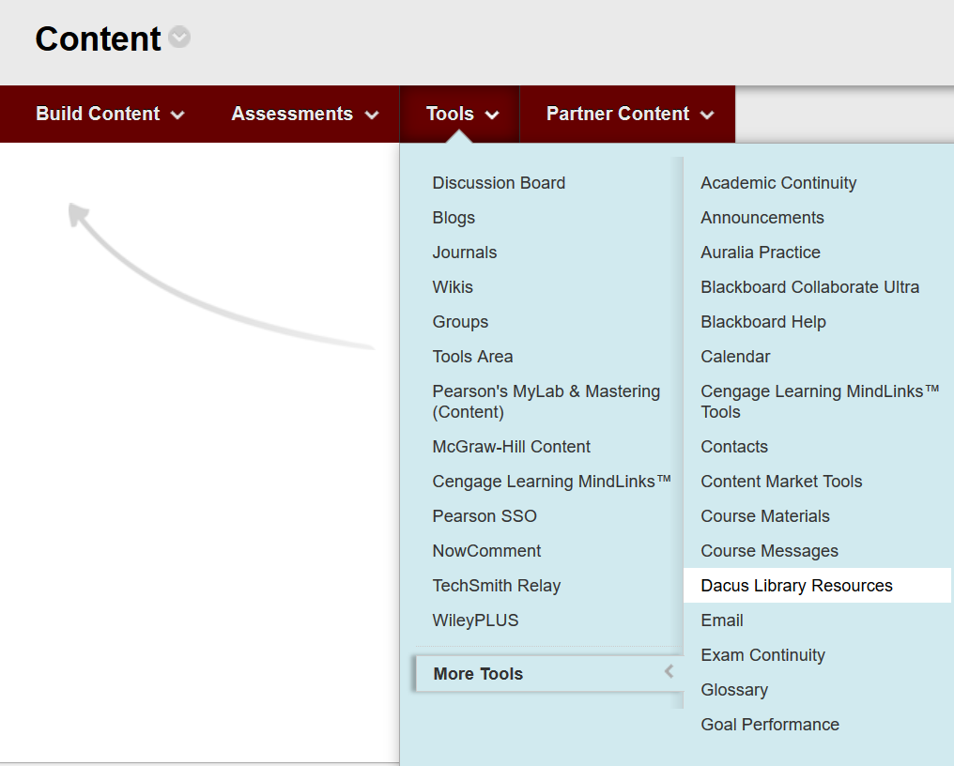
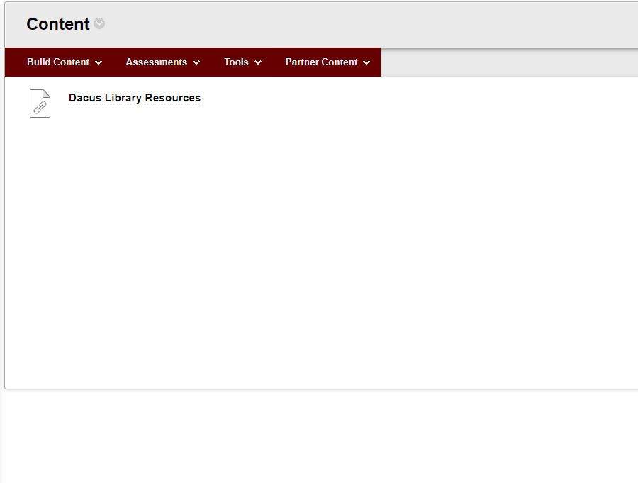
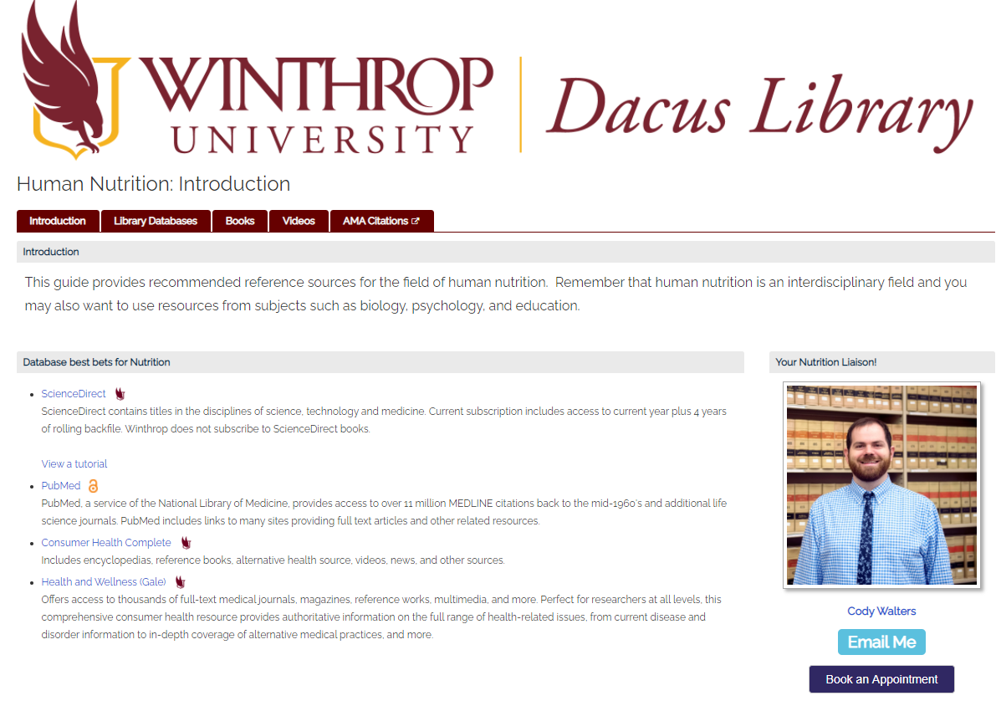
LibApps LTI: Integrating LibApps into Blackboard using the Springshare Automagic Tool
DeAnn Brame Digital Services and Systems Librarian; Emily Deinert, Reference Services Librarian; Amanda McLeod, Government Documents Librarian; Cody Walters, Information Literacy Librarian
Ida Jane Dacus Library
Winthrop University
Getting Started
Creating the LTI metadata
When Winthrop launched its 100% online MSW program, the library liaison to the Social Work Department worked to integrate library content during the course development stage. A successful result from this collaboration was having the Social Work subject guide embedded in all of the online Social Work classes. This integration was very successful, contributing to a substantial increase in total guide views.
Given the success of the embedded Social Work guide, the library Online Learning task force wanted to encourage other faculty to embed library LibGuides into their courses. We needed to a tool that would be easy to navigate and use for our faculty. That tool was the LibApps LTI. To move the project forward, DeAnn connected with the Winthrop Office of Online Learning to collaborate.
First, we worked with our Online Learning department to get the translation table and the four-letter class codes we would use to match guides to classes.
The translation table can be adjusted or changed based on your library's needs but can be time consuming.
Then a librarian matched the codes with applicable guides.
We had 172 four letter codes but only had applicable guides for 123. This showcased a large gap in our library's offerings.
We then connected core classes such as our ACAD 100, WRIT 101, and CRTW 201 with a generic research guide.
Finally we decided what resources would be on a landing page for classes with no guides, multiple connected guides, or subject areas instead of single guides.
Implementation is simple once metadata has been written
Very few clicks for professors
Landing page is not appealing with multiple relevant guides
Implementation and Limitations

