Slide 1
Making a Place at the Table: A Guide for Small, Rural, and Suburban Libraries
Laura Collins, MLIS
Lexington County Public Library System

Slide 2
Growing Communities Everywhere
Communities are constantly growing and shifting in population dynamics, including changes in racial diversity and languages spoken. This can often be in an influx of immigrants from a particular part of the world—refugees as well as people coming to America for work or to join family. While this is nothing new in large cities, smaller communities—such as rural and suburban communities—have also begun to experience these changes. As librarians, we understand the importance of ensuring that there are collections and services available to the newest members of the communities we serve; however, librarians in smaller communities have a disadvantage. While libraries in the cities have implemented different multilingual collections throughout the years, libraries in smaller communities have not. Not only do librarians in smaller communities not know where to begin, they often face obstacles such as lack of funding, space, staff, and—particularly in predominately white communities—a fear of offending the community they are trying to serve.

Slide 3
The Importance of Multilingual Collections
As of 2017, the United States Census Bureau estimates that—out of a population of 325,719,178 people living in the United States—there are over forty-four million people who are foreign born, and a little over half of those are not United States citizens. Asia, Latin America, and Central America continue to be the largest regions for the United States’ foreign born population.¹
Services that libraries provide immigrants today include: collection materials in languages other than English, literacy instruction, English-as-a-second-language courses, and partnerships with the U.S. Citizenship and Immigration Services to promote naturalization and citizenship materials.²
Multilingual collections in public libraries are also beneficial in helping the pre-existing community accept the differences of their new neighbors and increase their knowledge of the world.³

Slide 4
The Measure of Success
RUSA’s 2007 guidelines for multilingual collections and services stress that those collections and services are never seen as “additional” or “extra”, but instead an integral part of the library’s services. How can you ensure that your multilingual collection is integral? Communication.
In a 2002 study by Dilevko and Dali of Canadian public libraries, the researchers found that several of the libraries had multilingual collections that were never touched and deemed “unnecessary” by the multilingual communities they were created for. Why? Because the library created a collection without consulting the multilingual community the collection was created to benefit.⁴
For example, a library may develop a multilingual collection that is largely children’s material, but the multilingual community may have a larger need for adult materials. By not consulting the multilingual community and assuming that community’s needs, the library wasted time, resources, and money without any real benefit.
Notes:
RUSA’s 2007 guidelines for multilingual collections and services stress that those collections and services are never seen as “additional” or “extra”, but instead an integral part of the library’s services. How can you ensure that your multilingual collection is integral? Communication.
In a 2002 study by Dilevko and Dali of Canadian public libraries, the researchers found that several of the libraries had multilingual collections that were never touched and deemed “unnecessary” by the multilingual communities they were created for. Why? Because the library created a collection without consulting the multilingual community the collection was created to benefit.
For example, a library may develop a multilingual collection that is largely children’s material, but the multilingual community may have a larger need for adult materials. By not consulting the multilingual community and assuming that community’s needs, the library wasted time, resources, and money without any real benefit.

Slide 5
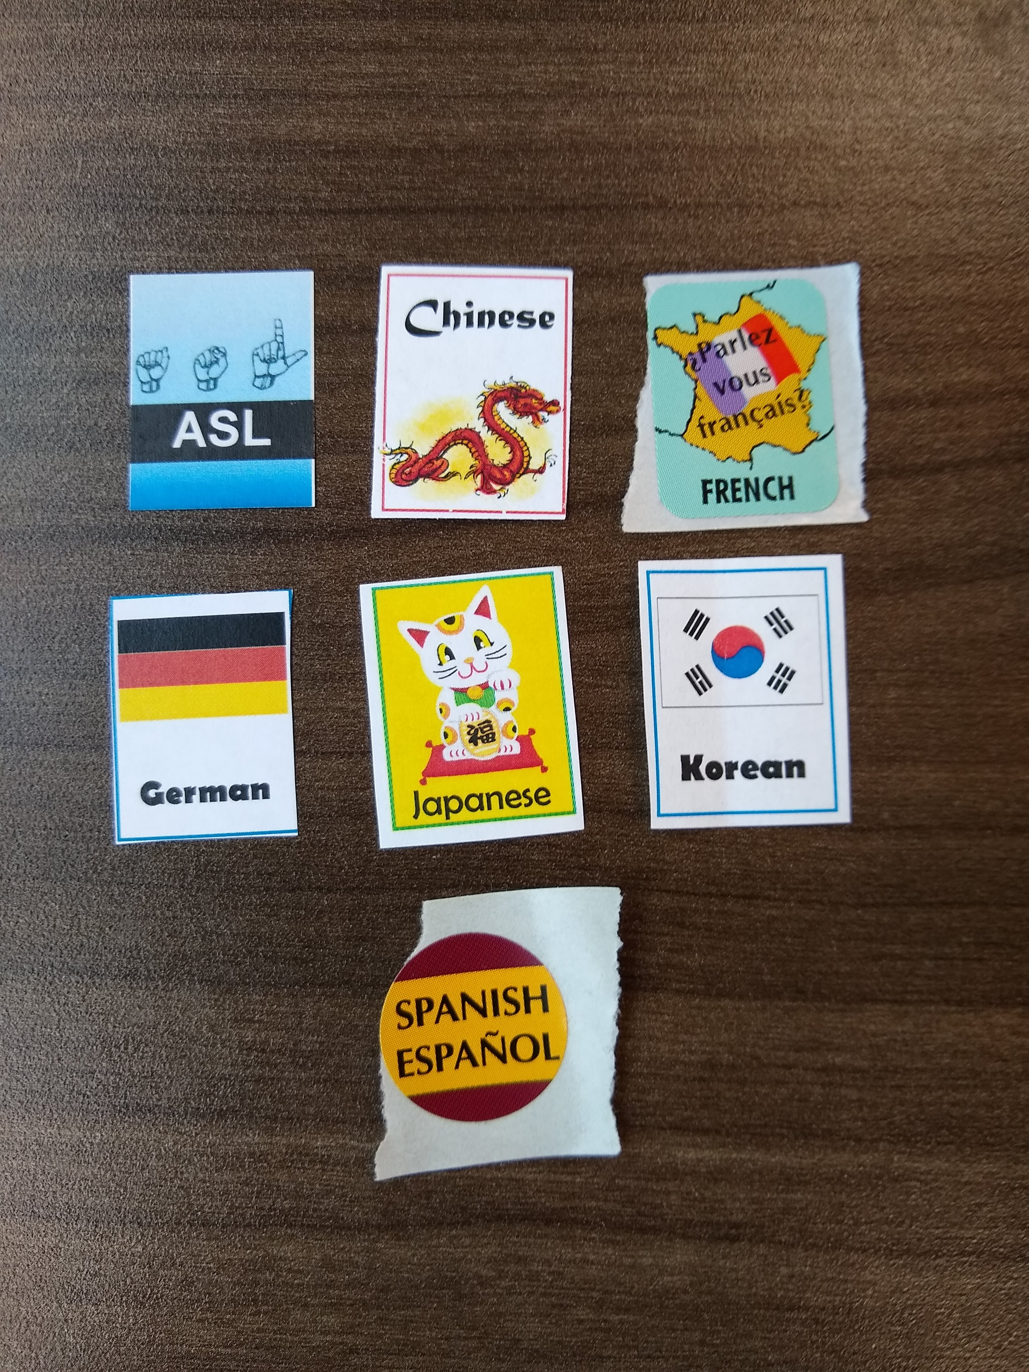
Three Keys to an Integral Multilingual Collection
Understanding the needs of the community through conducting a Needs Analysis,
Finding community partners who already serve and are part of the multilingual community, and
Having clear channels of communication.

Slide 6
Determining Needs
Listen: take note of how often you and your staff are asked about multilingual collections, ESL classes, and other resources. This statistical information will help evaluate what the community needs and what languages are being used in the community. It can also help evaluate for non-multilingual needs, such as access to a particular technology or services like public notories.
Surveys, interviews, and focus groups: This method provides both quantitative and qualitative data, which not only helps determine the exact needs of the multilingual community but support when applying for grants, budgets, and more.
Find community partners.

Slide 7
Finding Community Partners
English as Second Language (ESL) departments of the school districts that the library serves. This is an especially beneficial resource when you have a large number of immigrants in the area from the same country, but one with numerous language groups—such as India or China—thus narrowing down particular language groups. This has the added benefit of providing another opportunity for public libraries and the school system to partner together.
Where are multilingual communities already gathering? Asian and Hispanic Markets, Mosques, Temples, and churches serve as gathering places and places where newcomers can find others who share a language, religion, experiences, and culture. Especially within the religious gathering spaces, there will be leaders who know their communities the best. They will know what newcomers need the most, as well as what can benefit their community in the long run.

Slide 8
ALA Resources
ALA Office for Diversity, Literacy and Outreach Services (ODLOS).
  “Project Welcome”, designed to teach library staff how to meet the information needs of refugees and asylum seekers.
“How to Serve the World @ your library”, which is designed to help libraries start and improve English-language learning programs for adults at the public library.
“New Immigrants”, which is a compiling of a variety of materials for serving new immigrants in a library setting, to include ALA Policy statements, reports, books, and more.
The 2015 “Guidelines for Outreach to Immigrant Populations”. This document serves as another beneficial tool for establishing programs, collections, and mission statements as libraries strive to serve new immigrant populations.

Slide 9
Collection Development Resources
In 2007, the Reference and User Services Association (RUSA) published the Guidelines for the Development and Promotion of Multilingual Collections and Services. These guidelines aid library professionals as they develop their own multilingual collections, from researching what language to add, to formats to acquire, to how to catalog those materials.
The Association for Library Collections & Technical Services (ALCTS) maintains a Foreign Book Dealers Directory. This list of vendors is sortable by region of the world—Middle East, Africa, Asia, etc.—and allows the user to search by where the material is published. There are some limitations to the directory; namely, the directory cannot search by language, nor is there a way to determine which publishers produce books in specific regional languages—which is critical when purchasing for library users from India, China, and other countries that have regional language groups.

Slide 10
Grants
Grants from the Public Library Association:
  The Charlie Robinson Award, a $1,000 grant that is awarded to a public library director who—over a period of seven years—has been an agent for change in the public library.
  The EBSCO Excellence in Rural Library Service Award, a $1,000 honorarium for libraries that serve a population of ten-thousand or less.
  And the Gordon M. Conable Award, a $1,500 award honoring a staff member, trustee, or library that has shown a commitment to intellectual freedom and the Library Bill of Rights.
The American Dream Literacy Initiative: Funded through the Dollar General Literacy Foundation, this $10,000 grant is annually awarded to public libraries that wish to expand their services for adult English language learners or for adult education and workforce development. However, this grant is not for those looking to start a program of either nature; the library must have a preexisting program in order to be eligible.

Slide 11
ALA Affiliate Groups
ALA Affiliate Groups are also a great resources for creating multilingual collections, as well as ensuring that your English language collections represent our diverse world and avoid harmful stereotypes. The following ALA Affiliated Groups are:
American Indian Library Association
Asian/Pacific American Library Association
Black Caucus of the American Library Association
Chinese American Library Association
The National Association to Promote Library and Information Services to Latinos and the Spanish-Speaking (REFORMA)

Slide 12
References
United States Census Bureau (2019) “About Foreign Born” Retrieved from: https://www.census.gov/topics/population/foreign-born/about.html#par_textimage
Burke, S. K. (2008) “Use of public libraries by immigrants.” Reference and User Services Quarterly, 48(2), p. 164-174. DOI: 10.5860/rusq.48n2.164
Du, Y. (2016) Small libraries, big impact: How to better serve your community in the digital age. Santa Barbara, CA: Libraries Unlimited.
Dilevko, J., & Dali, K. (2002). “The challenge of building multilingual collections in Canadian public libraries.” Library Resources and Technical Services, 46(4), 116–137. https://doi.org/10.5860/lrts.46n4.116

