Slide 1
Getting Them Hooked:
Reaching Online Students
in a First-Year Experience Course
John Siegel, M.L.S., M.Ed.
Coordinator of Information Literacy
University of South Carolina Upstate

Slide 2

Overview
  In 2016, the University of Arkansas
  at Little Rock (UA Little Rock)
  began offering an online section of
  the required First-Year Experience
  (FYE) course to accommodate
  students in the growing number of
  distance education programs.

Slide 3
Overview (Continued)
The FYE Coordinator approached
the author about introducing online
students to the library and librarians
in an engaging way, similar to the
scavenger hunt the author developed
for in-person classes.

Slide 4
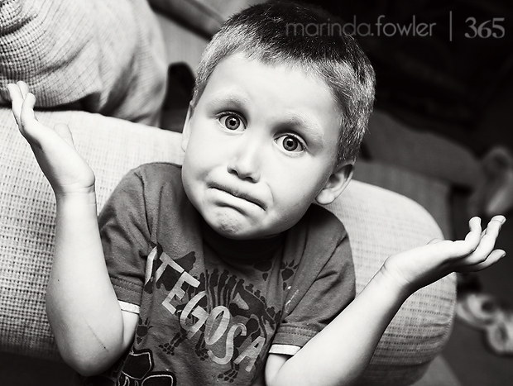
What’s a Library to Do?
Most students in the online
course worked full-time (non-traditional), lived or were stationed (military personnel) out-of-state, or were student athletes.
It was impractical and often
impossible for students to visit the UA Little Rock Library in-person.
Source: Marinda Fowler (Creative Commons)

Slide 5

Library Exploration Assignment
Visit local public/military
base library
Find books and DVDs
Explore other resources
(i.e. study rooms, etc.)
Take 2 “selfies”
- One w/book, another outside library
Source: VectorStock® (Creative Commons)

Slide 6
Library Exploration Assignment
After visit to public/military base library, virtual appointment with
UA Little Rock librarian
    Schedule via YouCanBook.Me
    15-20 minutes via Bb Collaborate
    Interview librarian (questions about education, hobby, role) and debrief
    Introduce student to UA Little Rock resources based on major

Slide 7

Library Exploration Assignment
                Students wrote short reflection as part of assignment.
                What did you learn from
                the library visit and
                librarian appointment?
                How will you use what
                you learned in other
                classes?
Source: Pixabay (Creative Commons)

Slide 8

Student Feedback
Pleasantly surprised by
resources offered at
public library
Enjoyed “getting out
and doing something”
rather than a worksheet
Increased comfort level in interacting
with librarians & using library resources!
Source: Pixabay (Creative Commons)

Slide 9
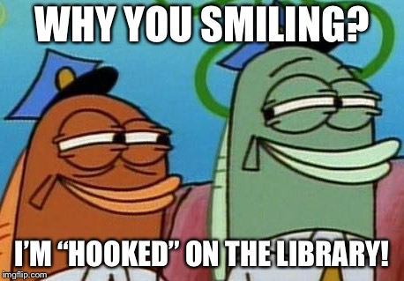

Slide 10
FYE Instructor Feedback
Reported interest and engagement in assignment
Noted that students benefitted from writing and reflection
Remarked students enjoyed seeing each other’s “selfies”

Slide 11
Lessons Learned & Considerations
Scalability - Time commitment is significant
25 students @ 15-20 minutes/each
Must have flexible appointment times (evenings for working students, early morning due to time zone variations)
Make sure students understand appointment requirements at start of semester so they plan ahead
Communication with instructor is critical!

