Slide 1

Shine the Light on
Legal Research
SCLA/SELA Joint Conference
Greenville SC
November 2, 2018

Slide 2
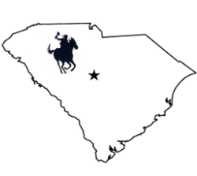
CIRCUIT
RIDERS
BASIC LEGAL RESEARCH TRAINING
University of South Carolina School of Law Library
http://guides.law.sc.edu/CircuitRiders

Slide 3
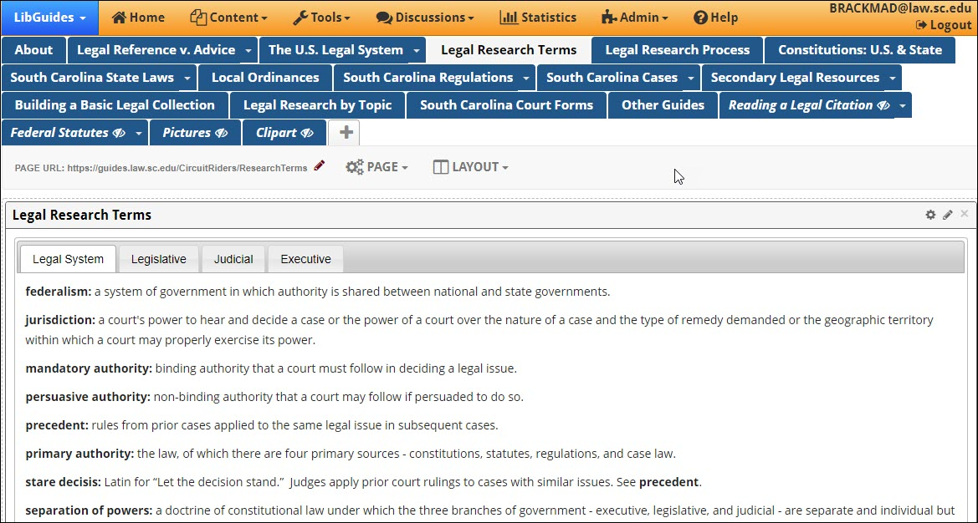
Legal Research Terms
Legal research starts with finding the right terms for the legal issue

Slide 4
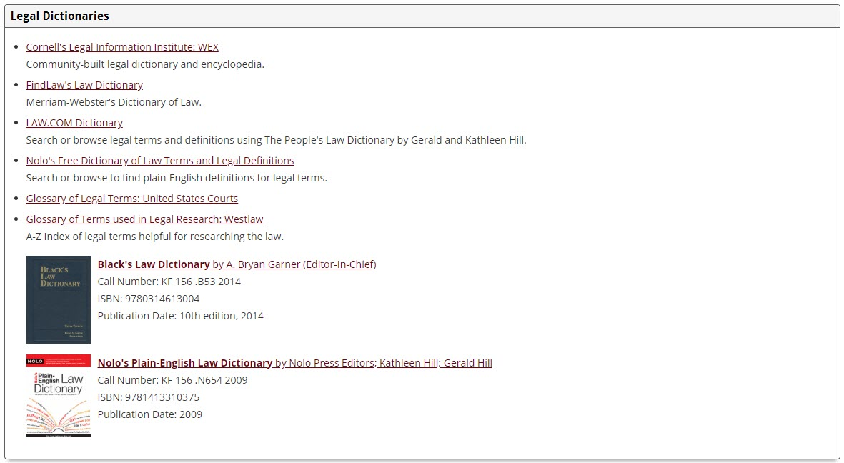
The Circuit Riders LibGuide also has a list of online and print legal dictionaries
Legal Research Terms

Slide 5
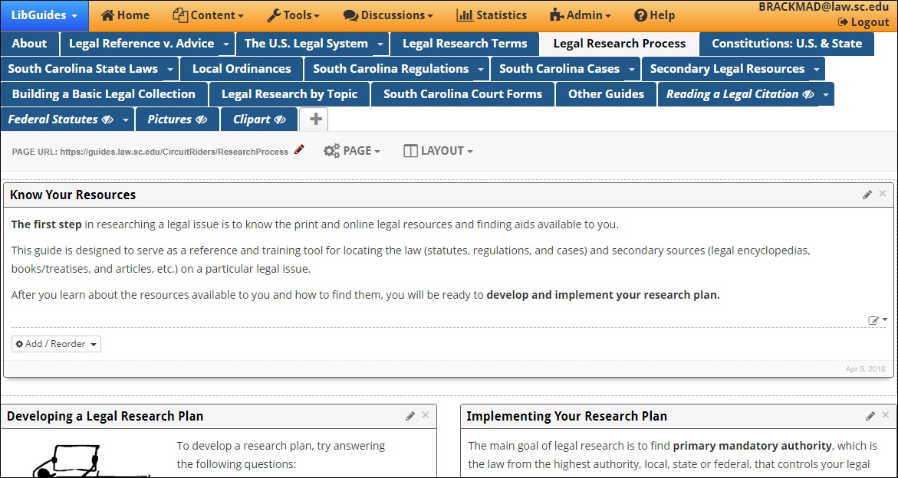
The Circuit Riders LibGuide contains tips and directions for creating a plan for legal research
Legal Research Process

Slide 6
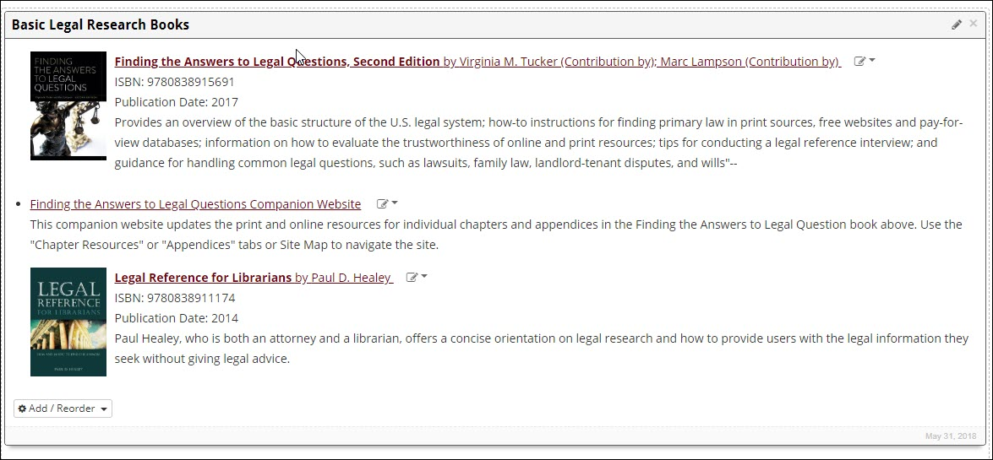
The Circuit Riders LibGuide lists two books for librarians to use as process references
Legal Research Process Resources

Slide 7
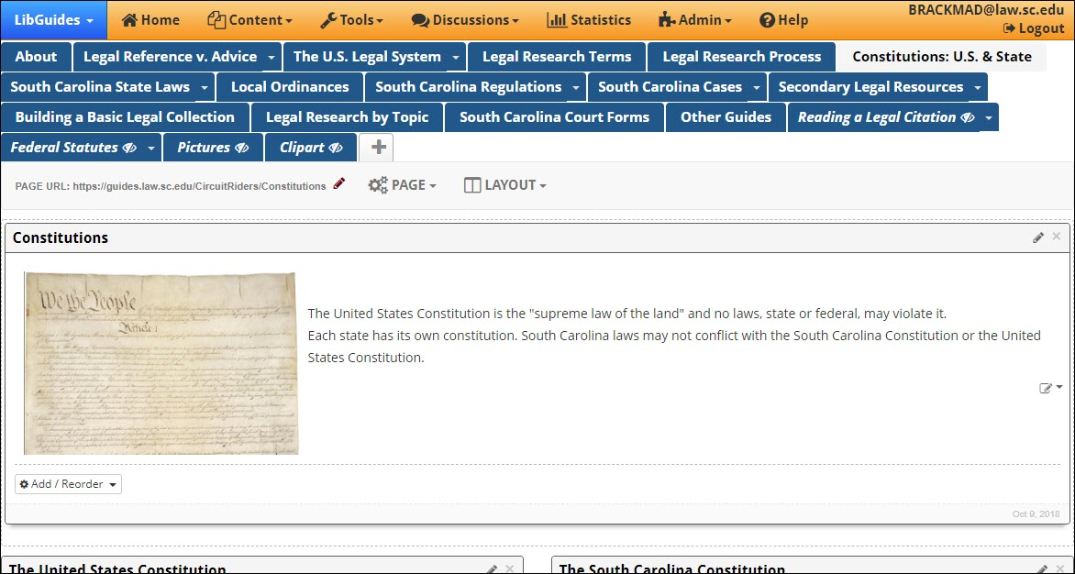
The Circuit Riders LibGuide also helps find links to other states’ constitutions
Constitutions

Slide 8
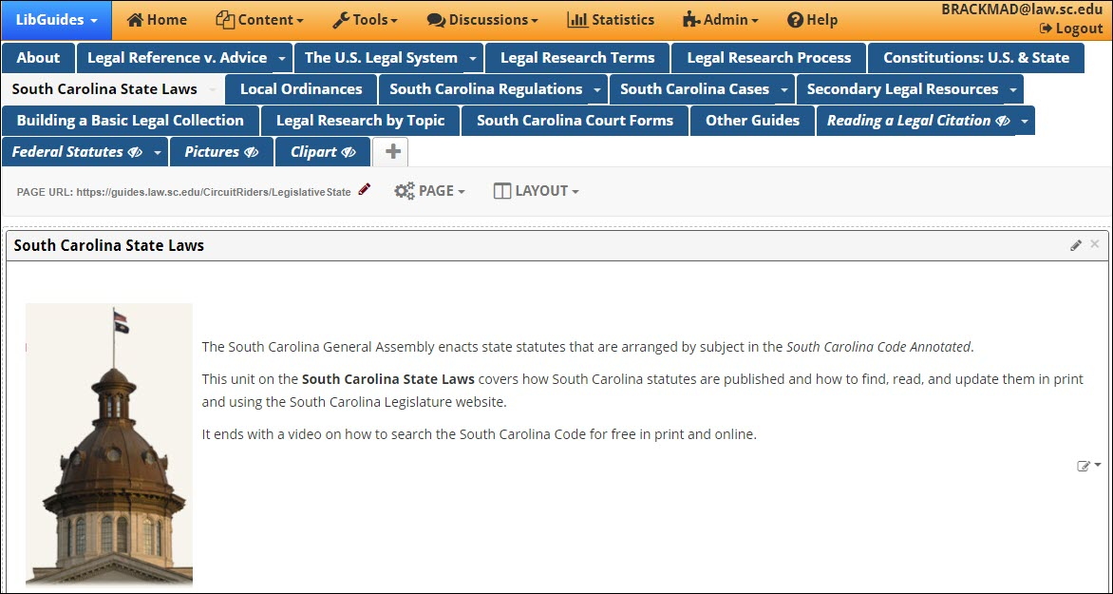
State Statutes
The vast majority of the questions you get are state law questions.

Slide 9
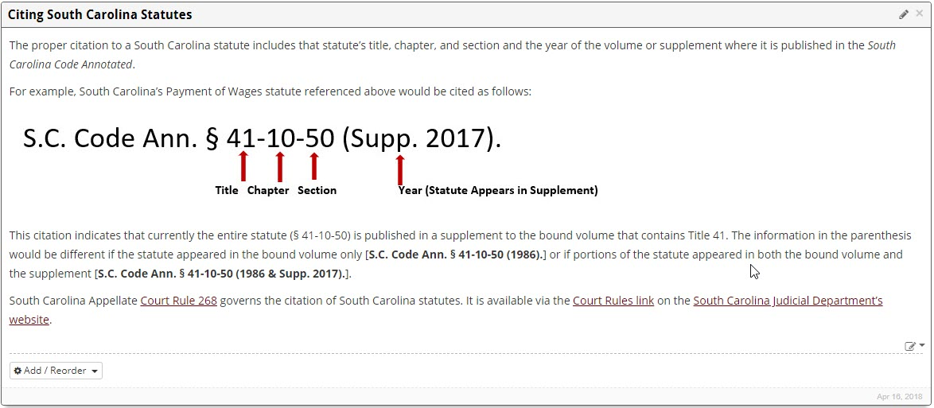
The Circuit Riders LibGuide tells you how to read a citation to a S.C. statute
South Carolina Citations

Slide 10
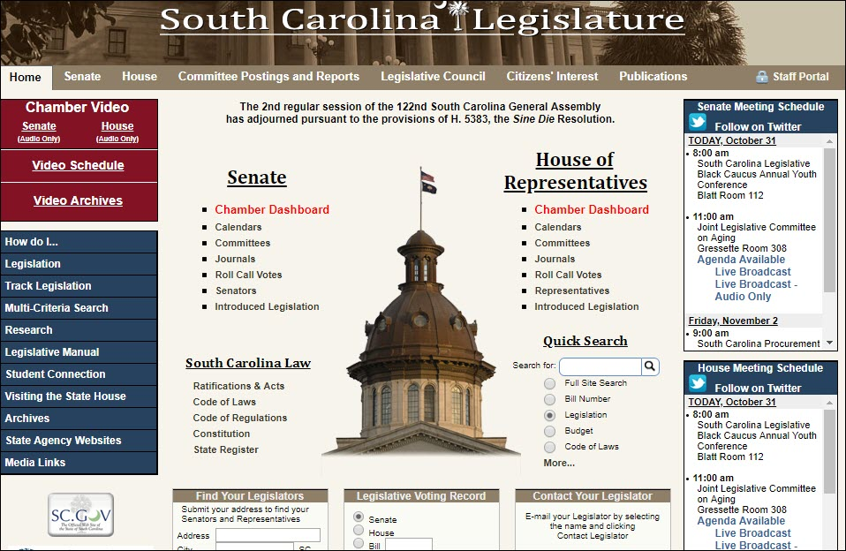
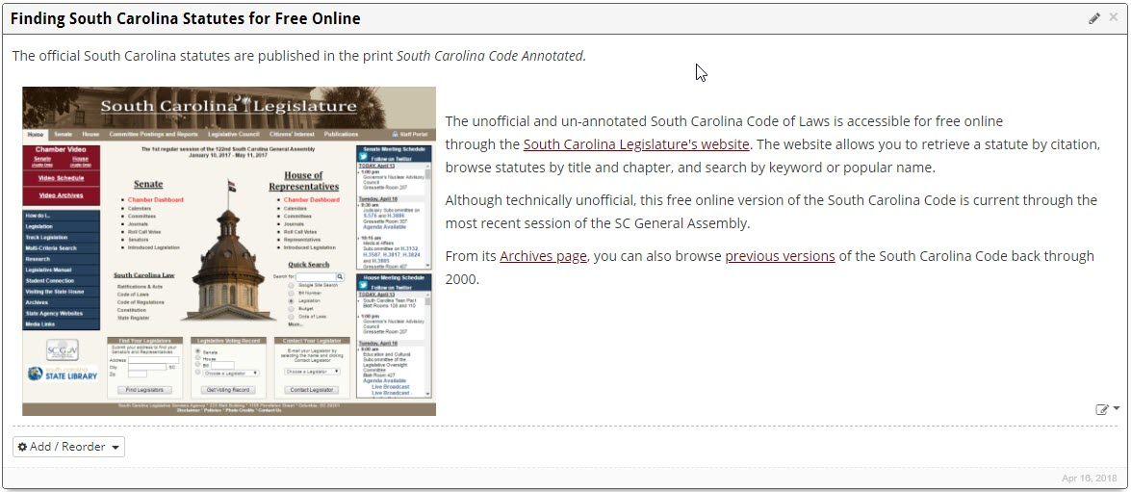
The South Carolina Statehouse web page has our constitution, statutes, regulations, and cases.
South Carolina Statutes Online

Slide 11
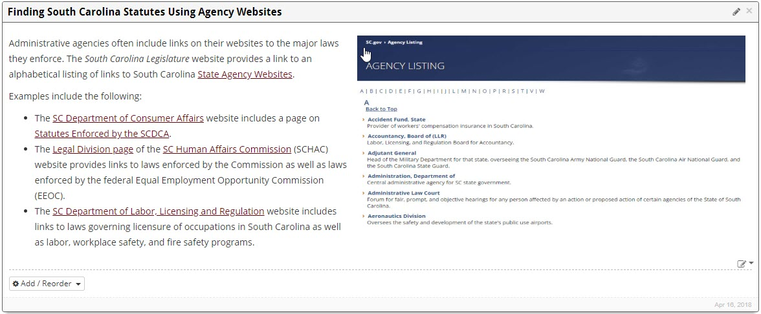
If you know what state agency is involved, it frequently has the statutes on its web page.
S.C. Agency Pages for Statutes

Slide 12
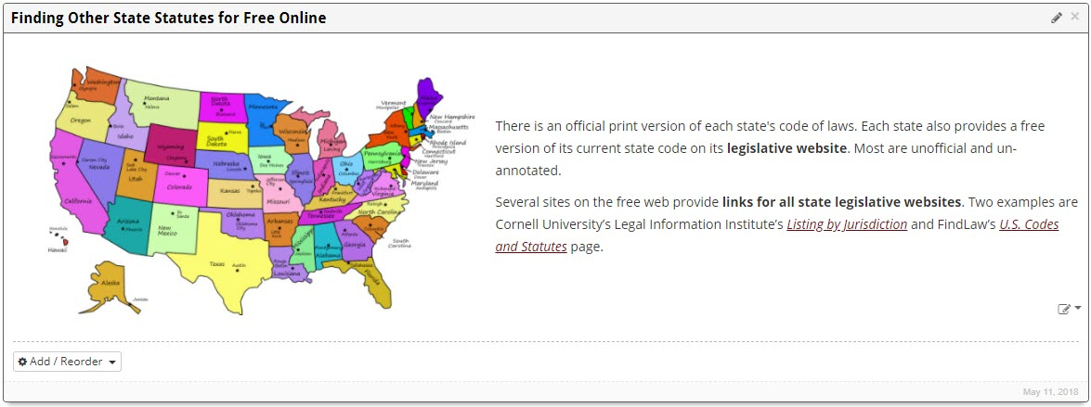
Other States’ Statutes
Most states have their statutes and other legal material online.

Slide 13
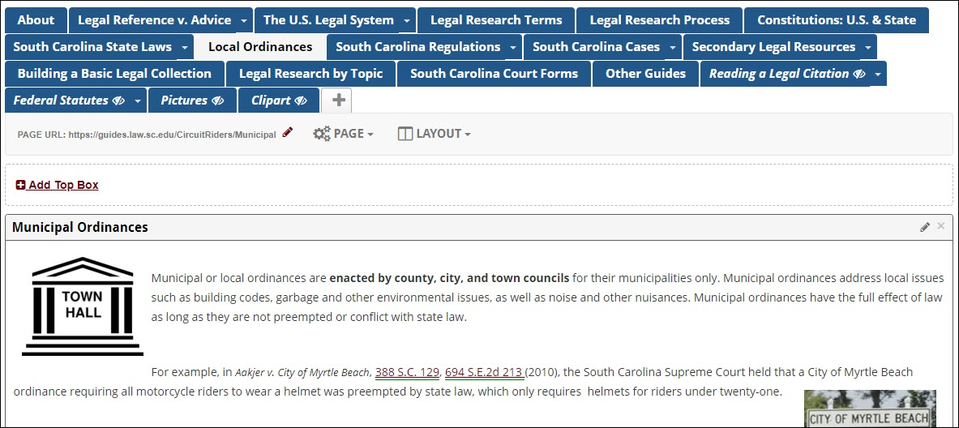
Local Ordinances
(Zoning)
Sometimes, the only way to get an ordinance is to call that local government

Slide 14
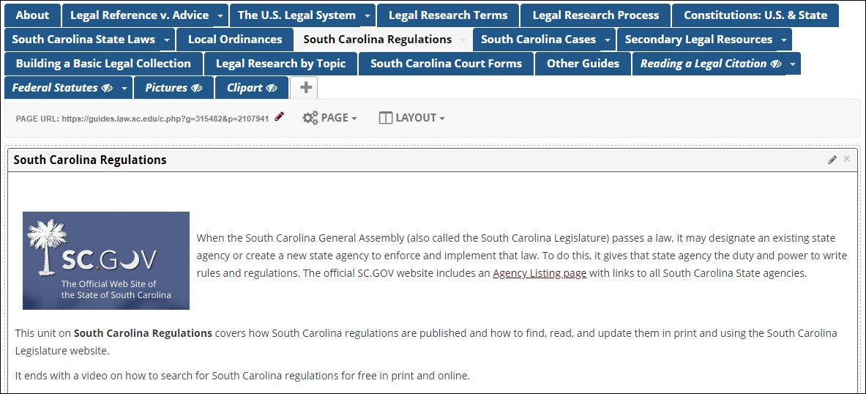
South Carolina Regulations
Regulations are more common than you think.

Slide 15
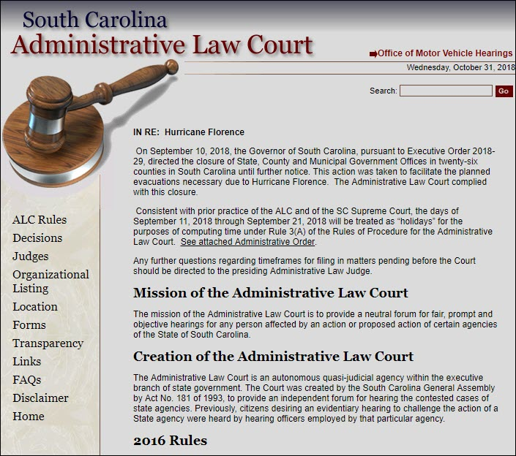
South Carolina
Administrative Law Court
Agencies have their own courts to hold hearings.
Find most of those decisions here.
http://www.scalc.net/

Slide 16
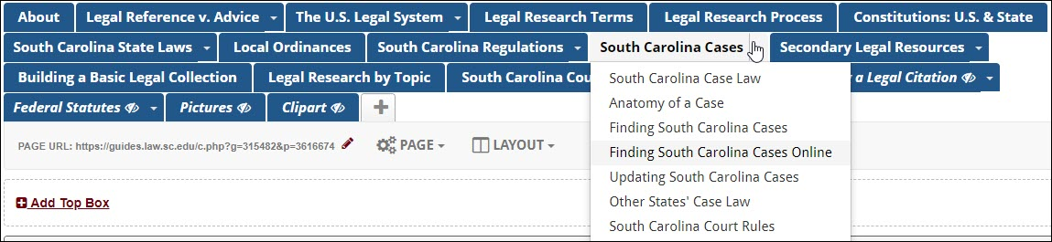
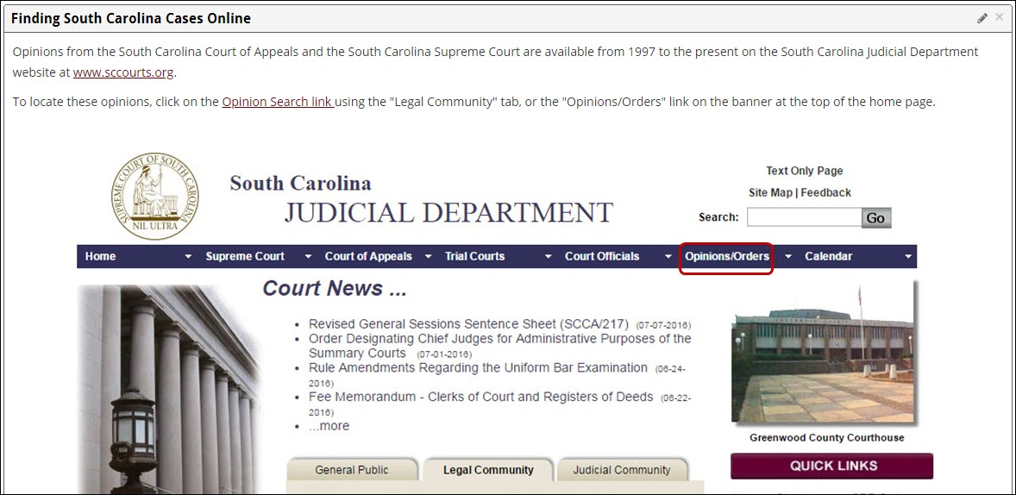
South Carolina Cases
The Circuit Riders LibGuide provides sources to find cases online

Slide 17
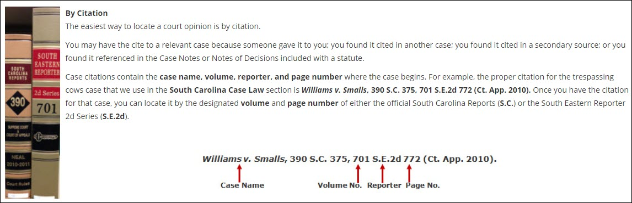
The Circuit Riders LibGuide tells you how to read a legal citation
South Carolina Case Citations

Slide 18
Secondary Legal Resources, Building a Basic Legal Collection, Topical Guides and Other Resources

Slide 19
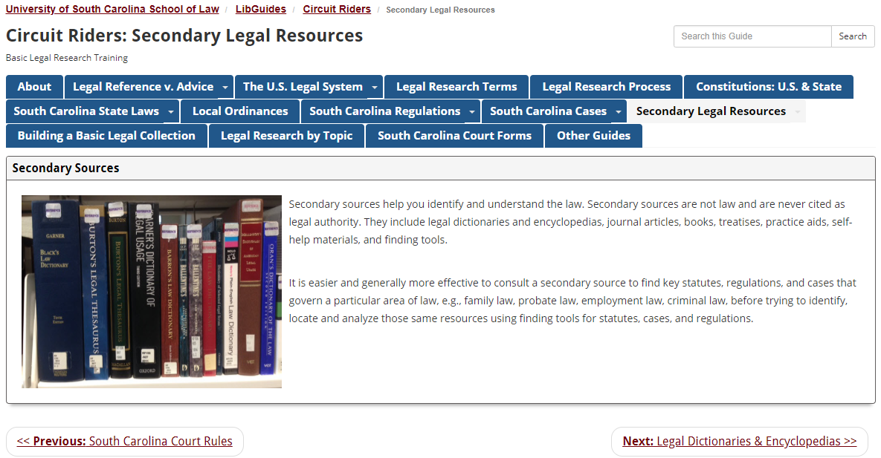
Secondary Legal Resources (1)
http://guides.law.sc.edu/CircuitRiders/secondarysources

Slide 20
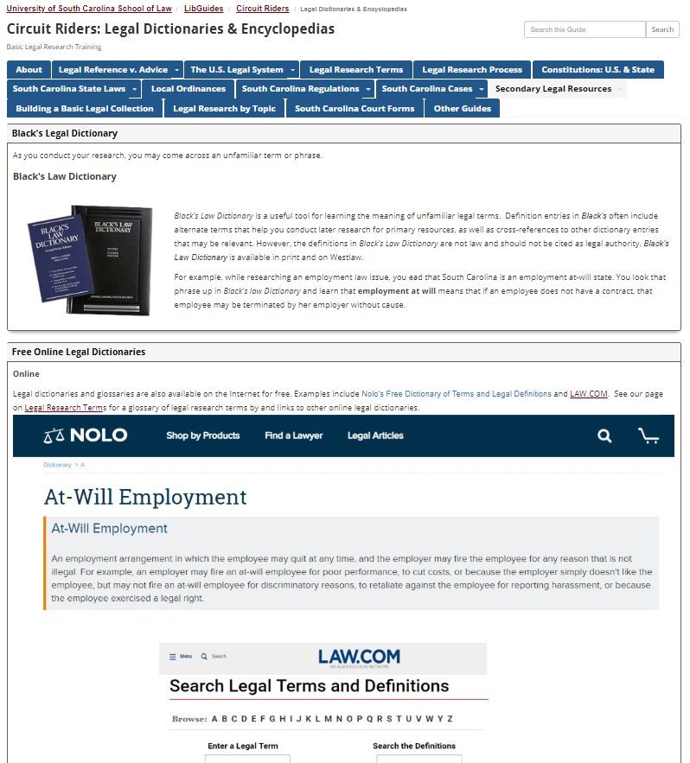
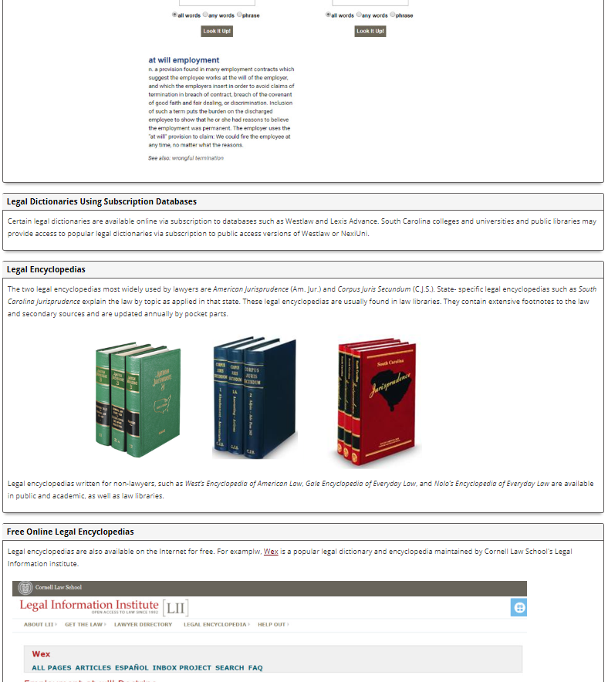
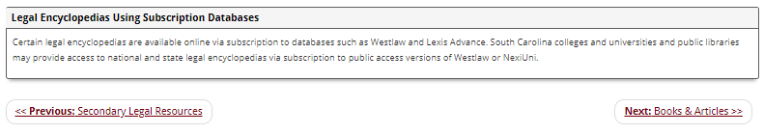
Secondary Legal Resources (2)
https://guides.law.sc.edu/CircuitRiders/DictionaryEncyclopedia

Slide 21
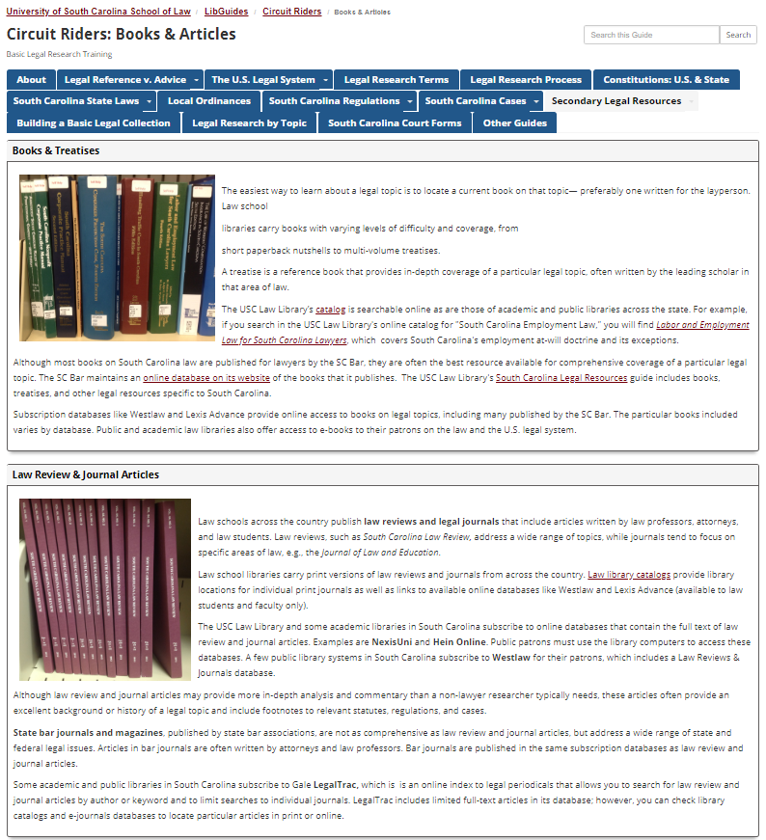
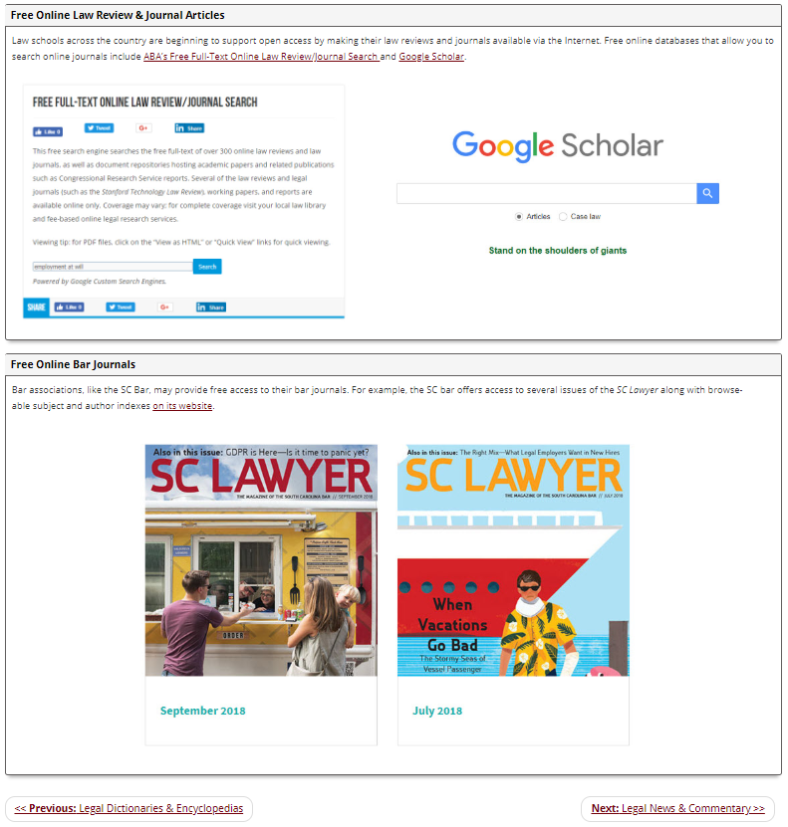
Secondary Legal Resources (3)
https://guides.law.sc.edu/CircuitRiders/BooksArticles

Slide 22
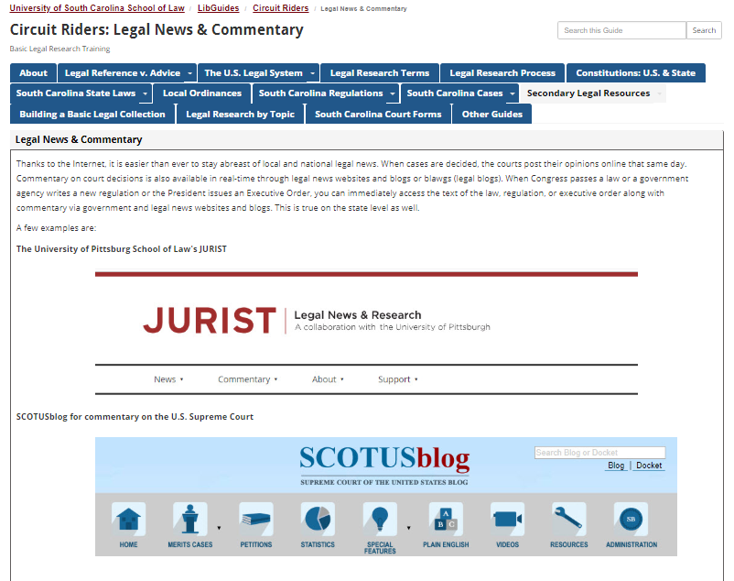
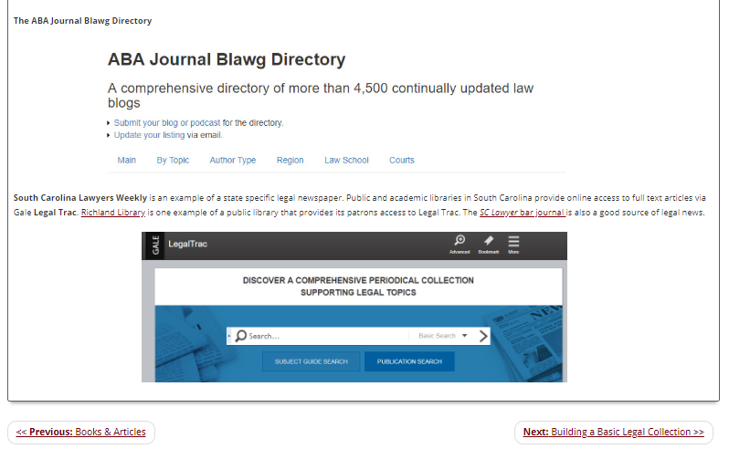
Secondary Legal Resources (4)
https://guides.law.sc.edu/CircuitRiders/NewsCommentary

Slide 23
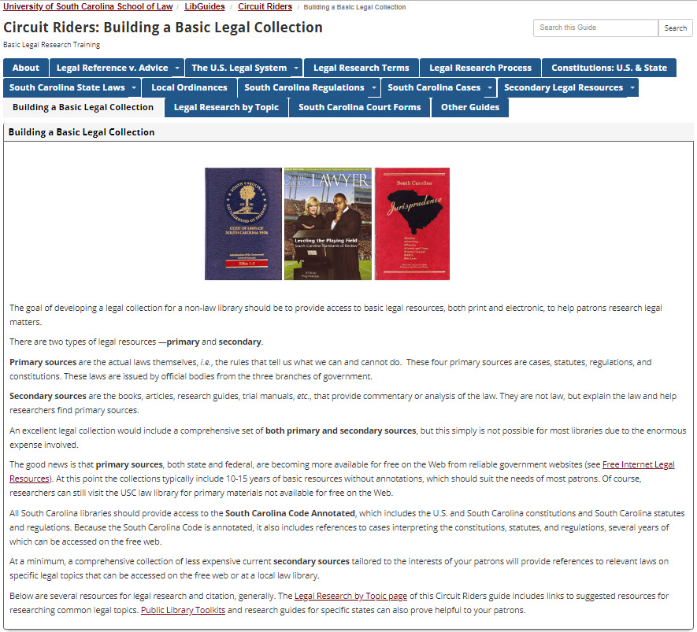
Building a Basic Legal Collection (1)
https://guides.law.sc.edu/CircuitRiders/LegalCollection

Slide 24
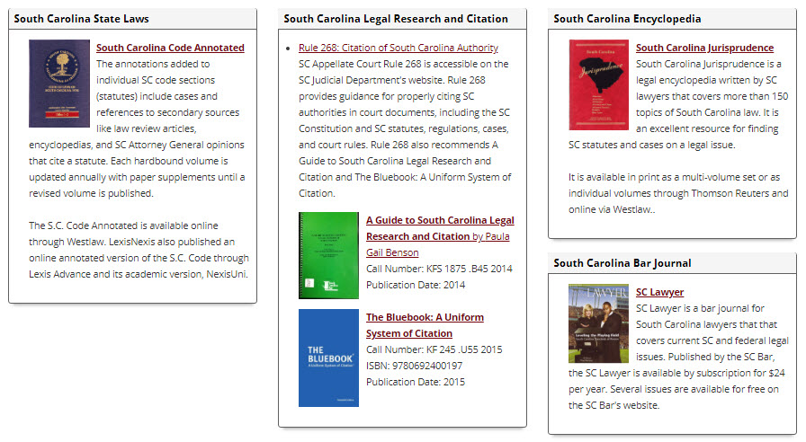
Building a Basic Legal Collection (2)
https://guides.law.sc.edu/CircuitRiders/LegalCollection

Slide 25
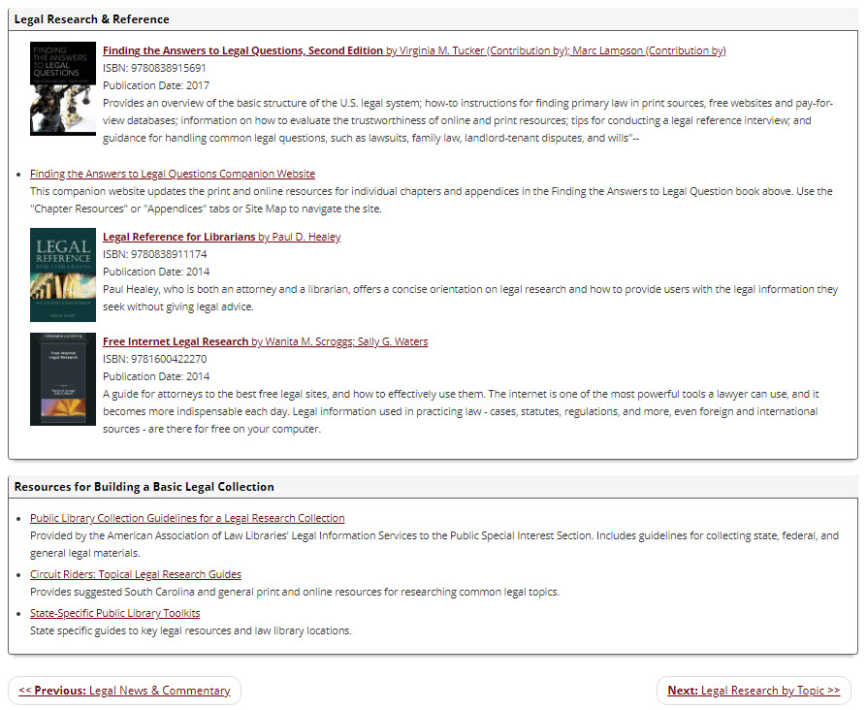
Building a Basic Legal Collection (3)
https://guides.law.sc.edu/CircuitRiders/LegalCollection

Slide 26
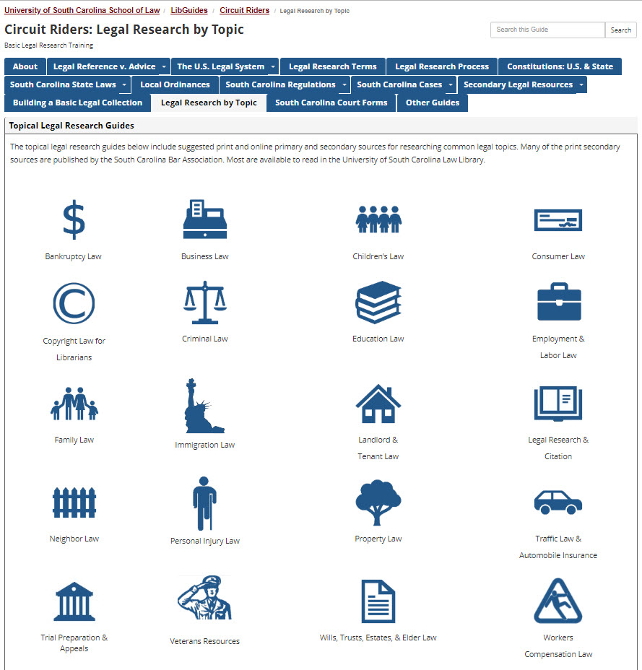
Legal Research by Topic
https://guides.law.sc.edu/CircuitRiders/TopicalGuides

Slide 27
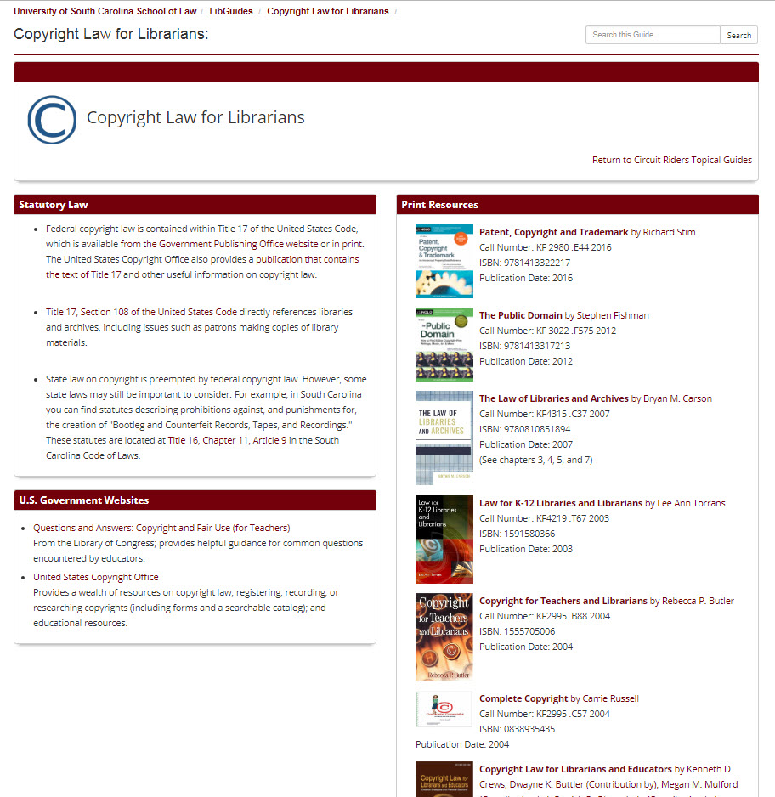
Topical Guides: Copyright Law for Librarians
https://guides.law.sc.edu/CopyrightLawforLibrarians

Slide 28
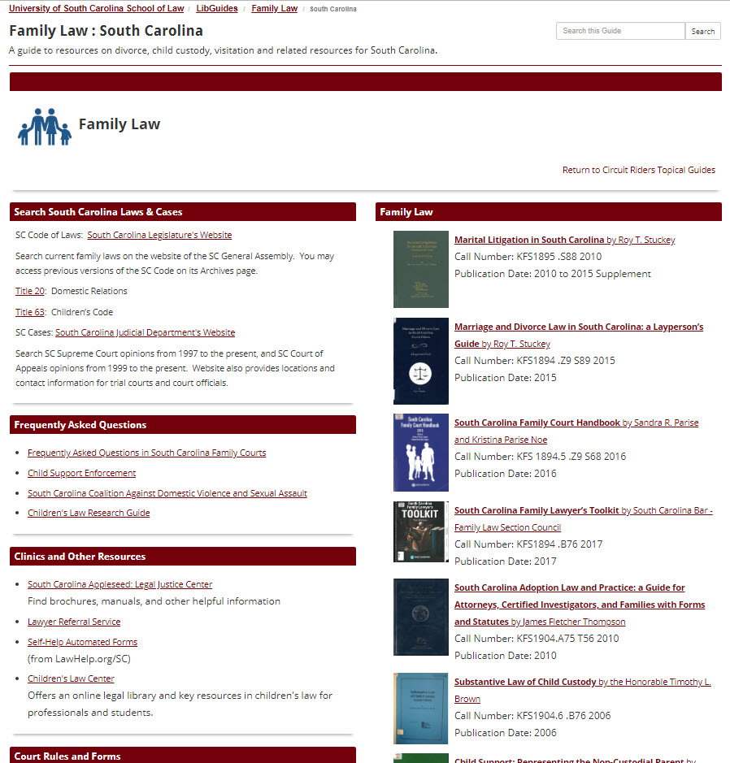
Topical Guides: Family Law
http://guides.law.sc.edu/FamilyLawResources

Slide 29
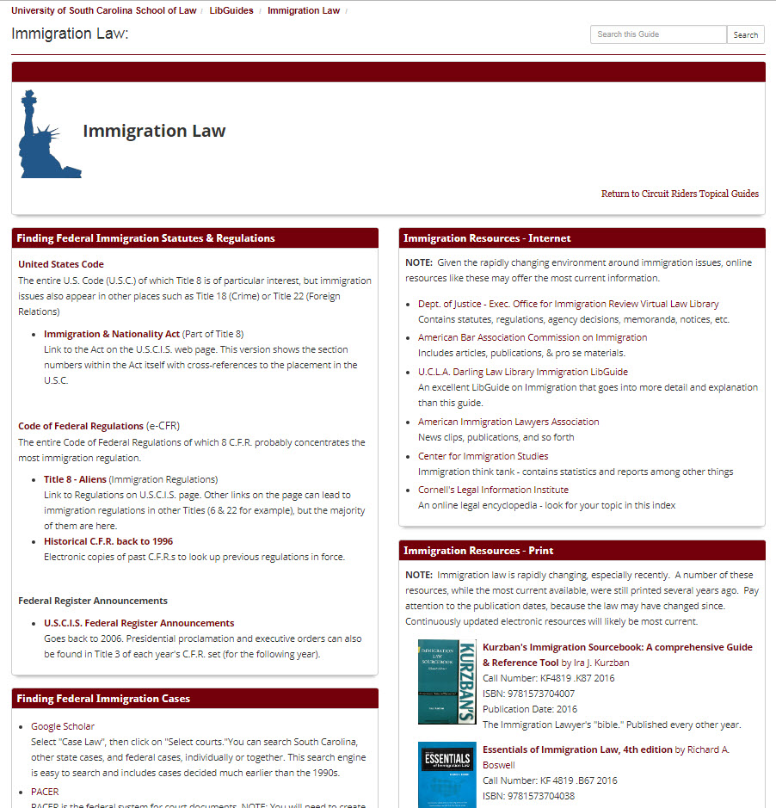
Topical Guides: Immigration Law
http://guides.law.sc.edu/CircuitRiderImmigration

Slide 30
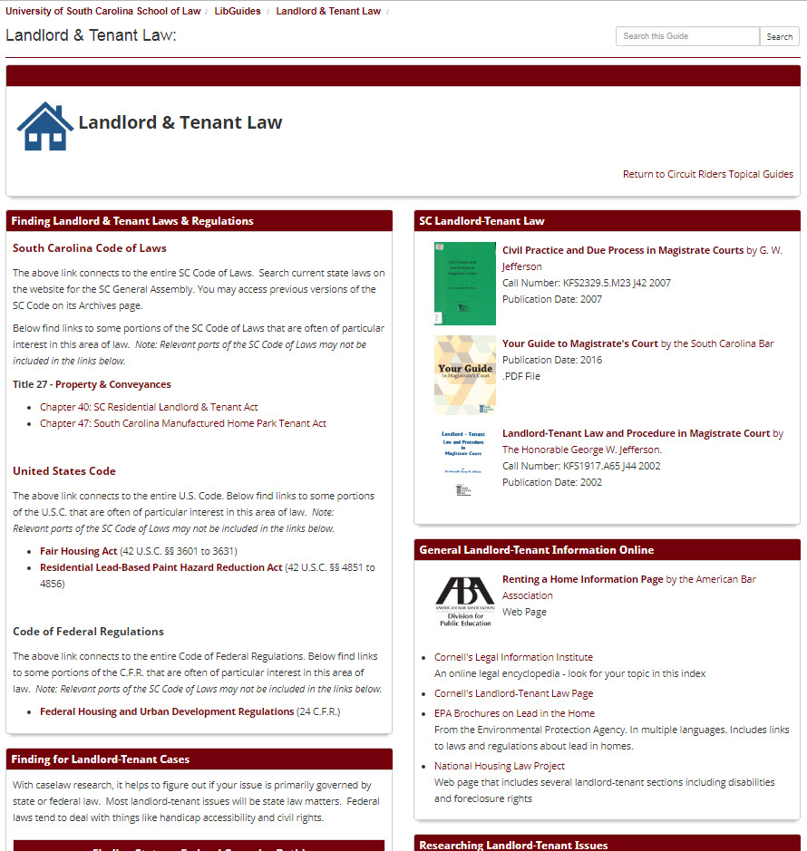
Topical Guides: Landlord & Tenant Law
http://guides.law.sc.edu/LandlordTenant

Slide 31
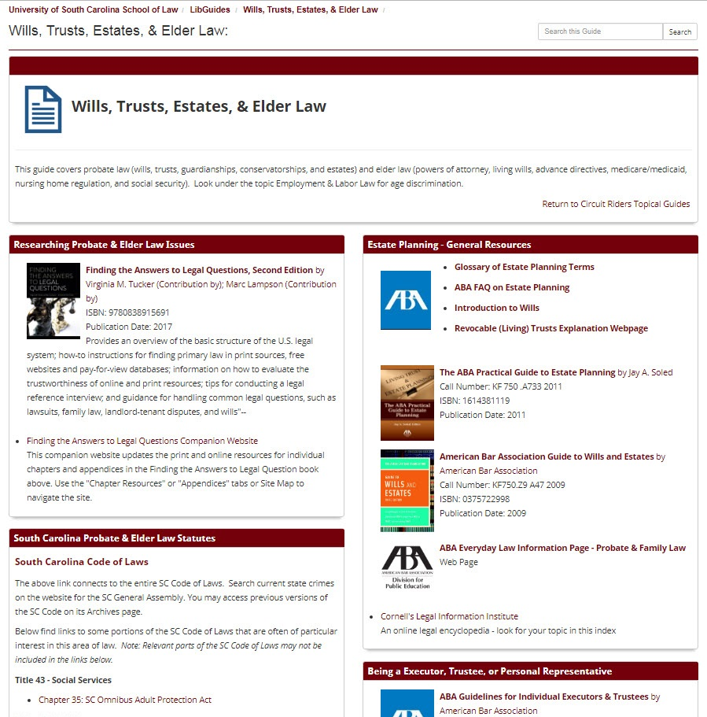
Topical Guides: Wills, Trusts, Estates, & Elder Law
http://guides.law.sc.edu/WillsTrustsEstates

Slide 32
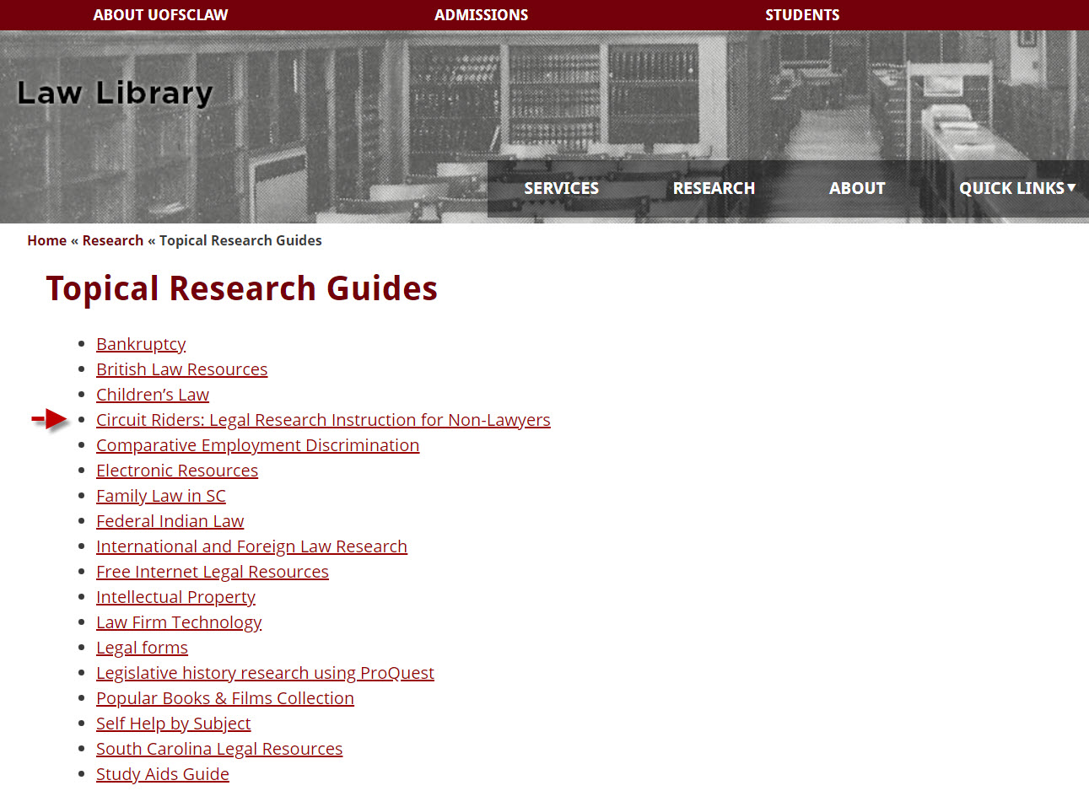
Other Topical Guides
http://law.sc.edu/library/research/research-guides.shtml

Slide 33
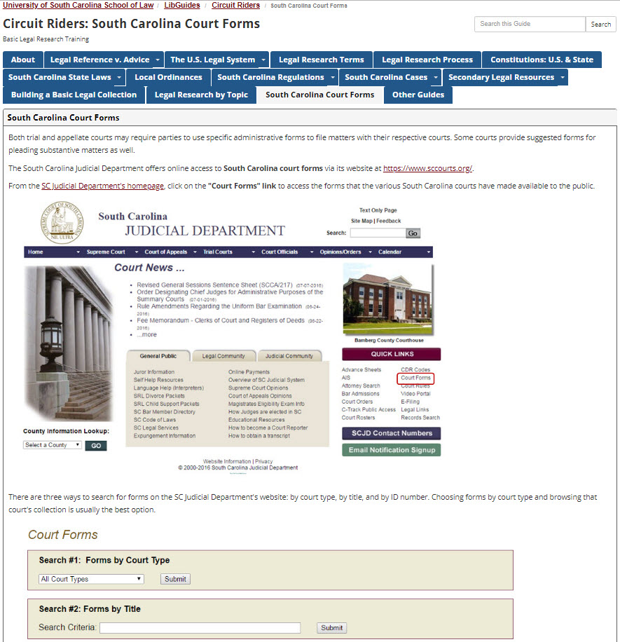
South Carolina Court Forms (1)
https://guides.law.sc.edu/CircuitRiders/SCCourtForms

Slide 34
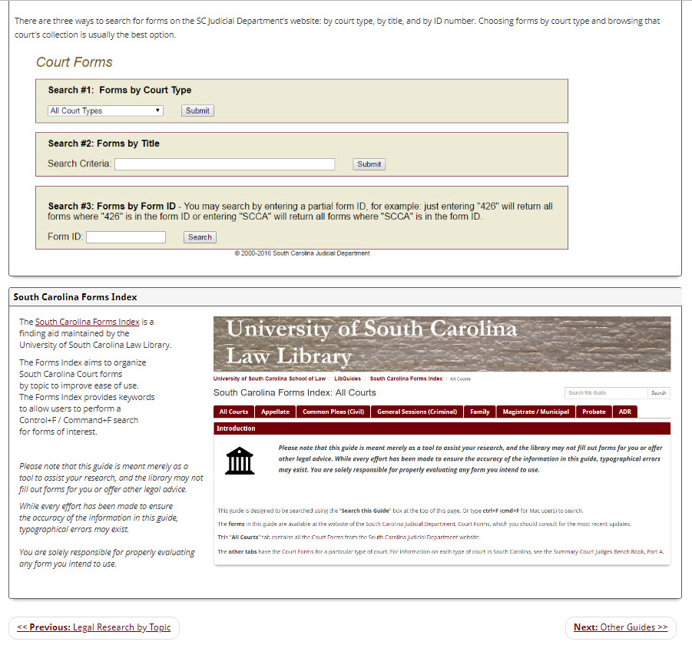
South Carolina Court Forms (2)
https://guides.law.sc.edu/CircuitRiders/SCCourtForms

Slide 35
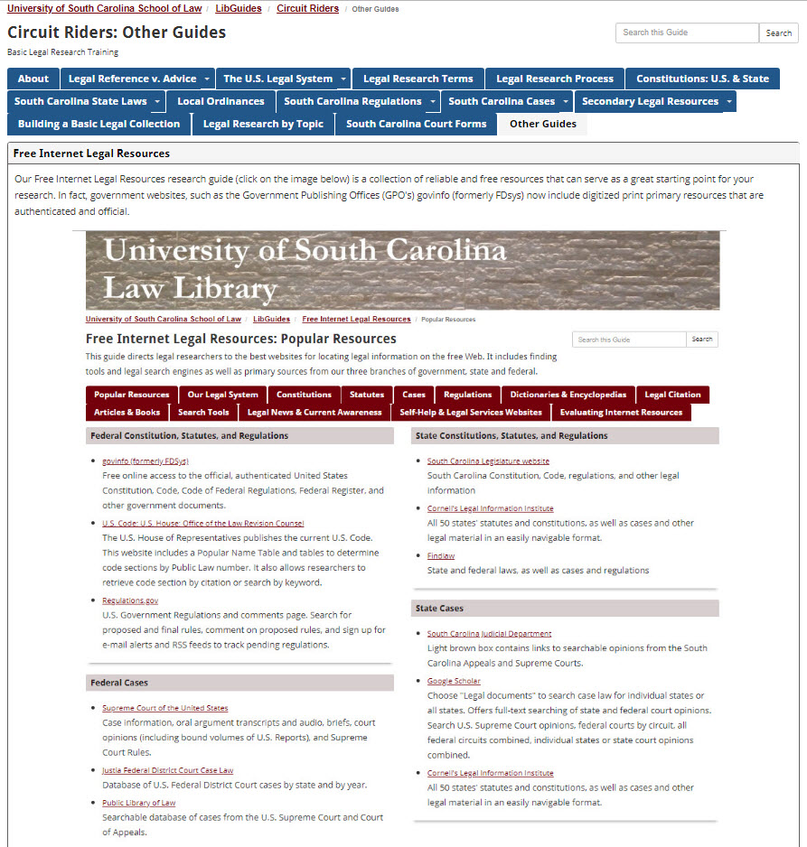
Other Guides (1)
https://guides.law.sc.edu/CircuitRiders/OtherGuides

Slide 36
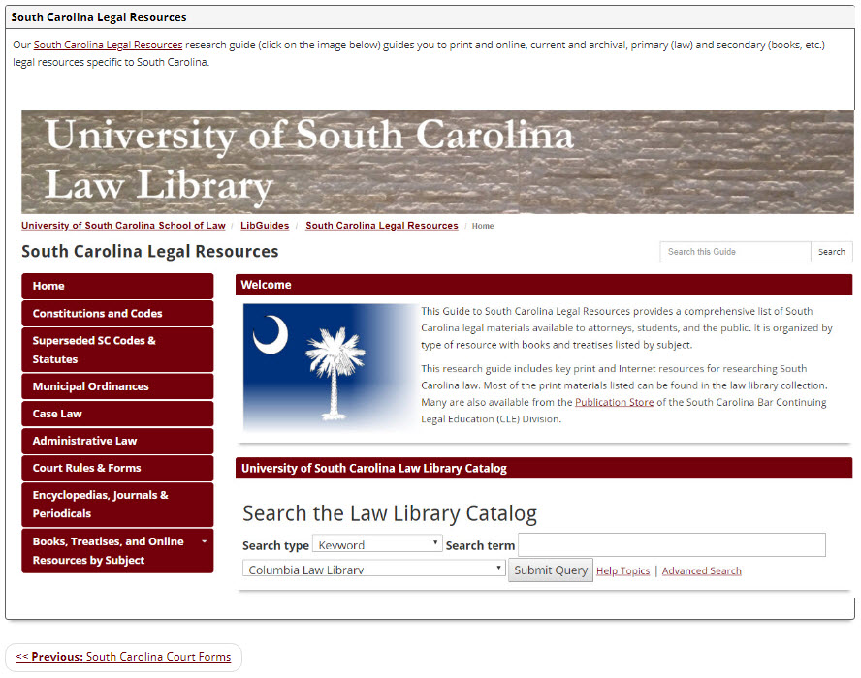
Other Guides (2)
https://guides.law.sc.edu/CircuitRiders/OtherGuides

Slide 37
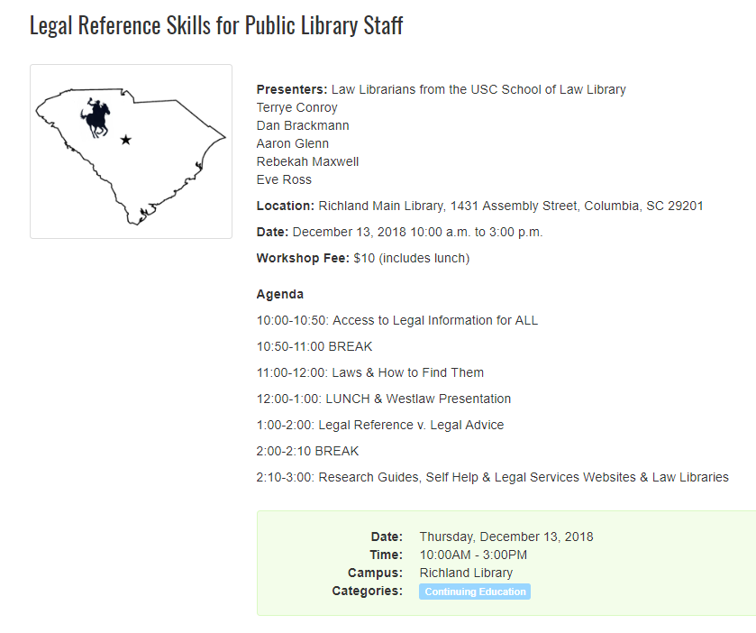
https://statelibrary.sc.libcal.com/event/4242703

Slide 38
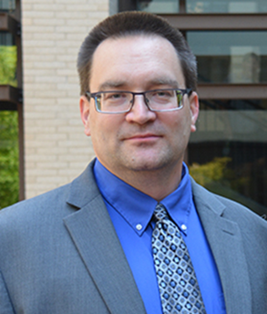
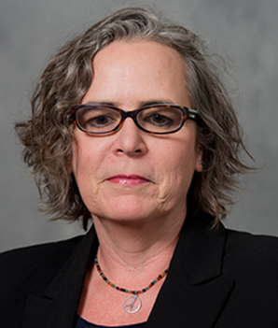
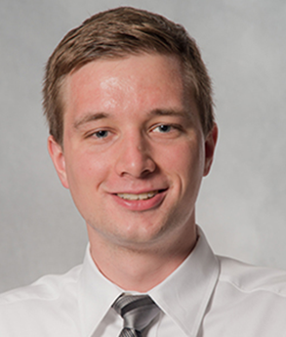
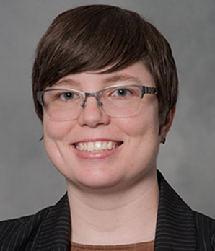
CONTACT US
brackmad@law.sc.edu | conroyt@law.sc.edu | glennaj2@law.sc.edu | rossea@law.sc.edu
Reference Desk: www.lawref@law.sc.edu 803-777-5902

