Slide 1

Shine the Light on
Legal Research
SCLA/SELA Joint Conference
Greenville SC
November 2, 2018

Slide 2
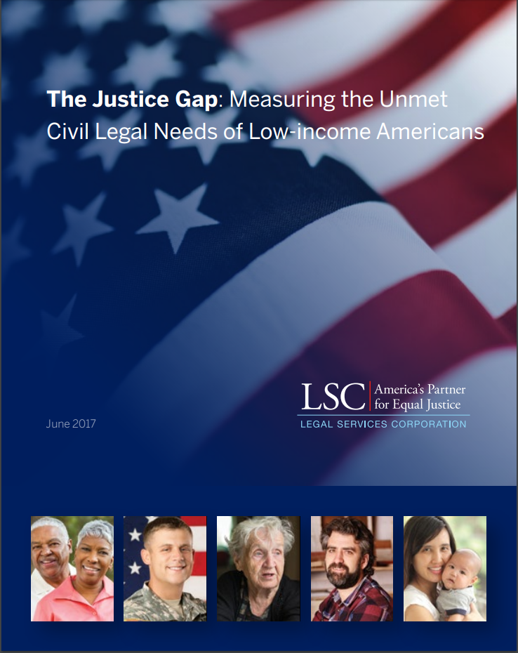
Unmet Civil Legal Needs
  Eighty-six percent of civil legal needs faced by low income Americans receive inadequate or no legal help in a given year.
Low-Income Americans
  A family income below 125% of the Federal Poverty Level (FPL) corresponds to $30,750 per year or less for a family of four.
  Based on recent estimates from the Census Bureau, nearly one in five Americans (19%) have family incomes below 125% of FPL.
  This comes to about 60 million people, including approximately 19 million children (0-17 years), 35 million adults aged 18-64 years old, and 6.4 million seniors (65+ years).
2017 Justice Gap Report by LSC: https://www.lsc.gov/media-center/publications/2017-justice-gap-report

Slide 3
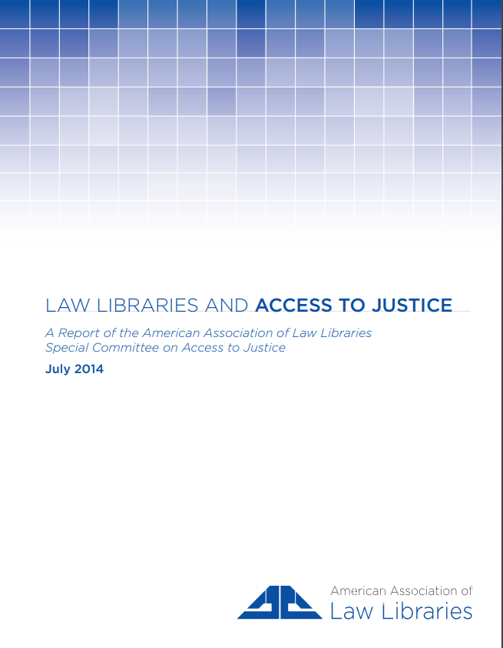
Access to Justice begins with Access to legal Information
  Academic law librarians appreciate the difficulties non-law librarians face when assisting patrons with legal research. Academic law librarians are expert legal researchers and enjoy sharing their knowledge about legal research strategies and resources. One very effective way they can promote access to justice is to teach public and academic non-law librarians basic legal research skills and advise them on how to provide legal reference without giving legal advice [p. 37].
  https://www.aallnet.org/wp-content/uploads/2018/01/AccessToJusticeSpecialCommittee2014LawLibrariesAndAccessToJustice.pdf
U.S. Supreme Court Justice Hugo Black stated in 1964 that “there can be no equal justice where the kind of trial a man gets depends on the amount of money he has.”

Slide 4
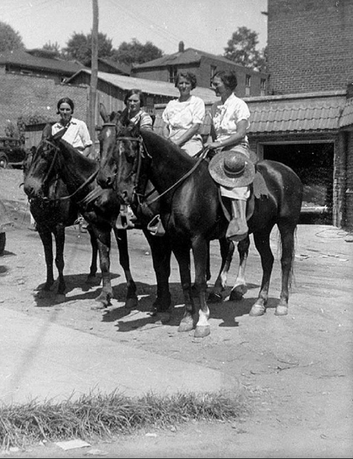
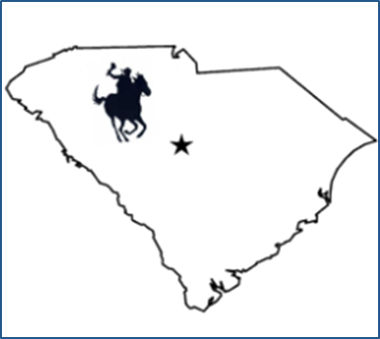
How Circuit Riders Began
Folks traveled to the law school library from around the state
  Unaware of:
    resources in their area
    great free online legal materials
So, we decided to become Circuit Riders
  To travel the state
  Training the trainer
  To the places where people go for help---to LIBRARIES
    Public
    Academic
Kentucky Pack Horse Librarians: https://www.smithsonianmag.com/history/horse-riding-librarians-were-great-depression-bookmobiles-180963786/

Slide 5
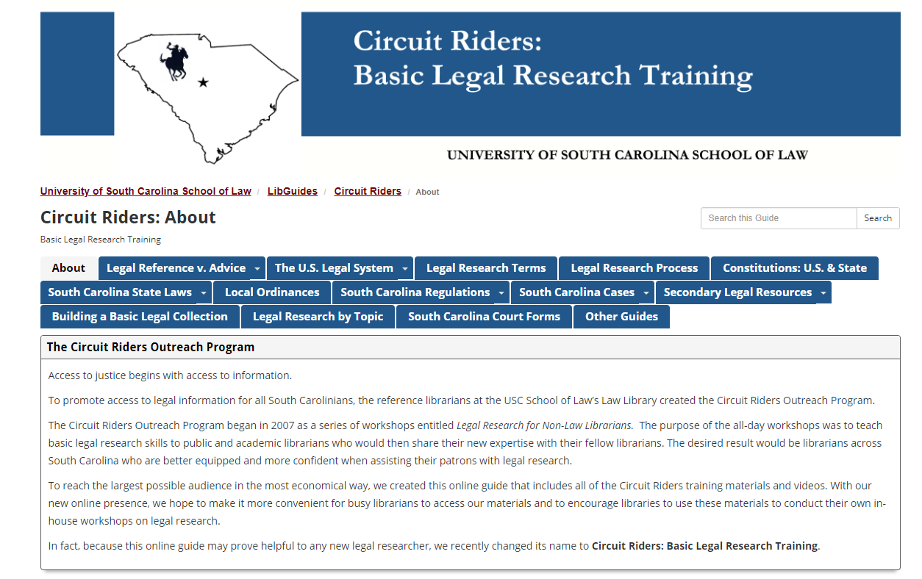
https://guides.law.sc.edu/CircuitRiders

Slide 6
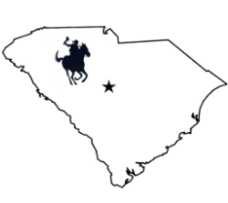
Who conducts legal research?
Lawyers
Students of all ages
Interested Citizens
Persons representing themselves
  In non-litigation matters
    Starting a business, drafting a will, drafting a contract or lease, etc.
  In litigation (court proceedings)
    Self represented litigants (SRLs)

Slide 7
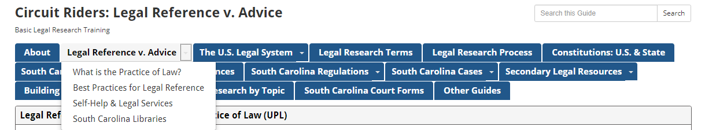
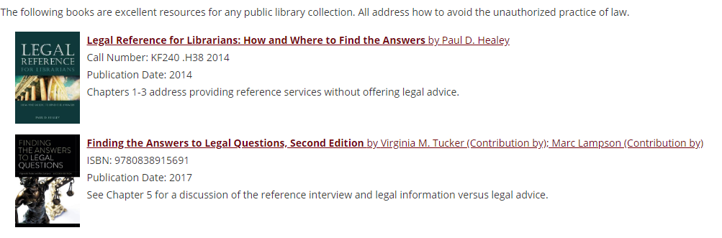
Read all about it:
https://guides.law.sc.edu/CircuitRiders/UPL

Slide 8
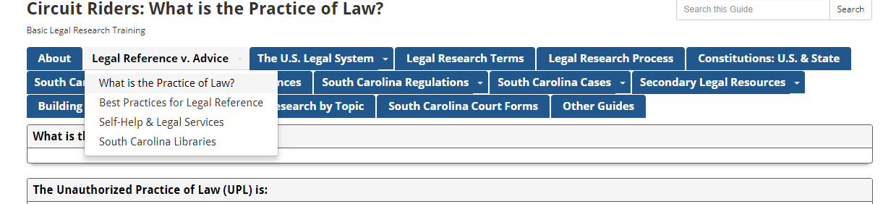
According to the South Carolina Supreme Court:
  Preparing Legal Documents
  Giving Legal Advice
  https://guides.law.sc.edu/CircuitRiders/UPLPrracticeofLaw

Slide 9
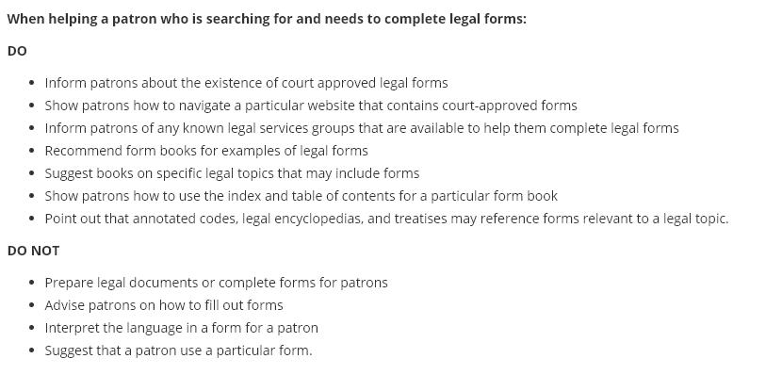
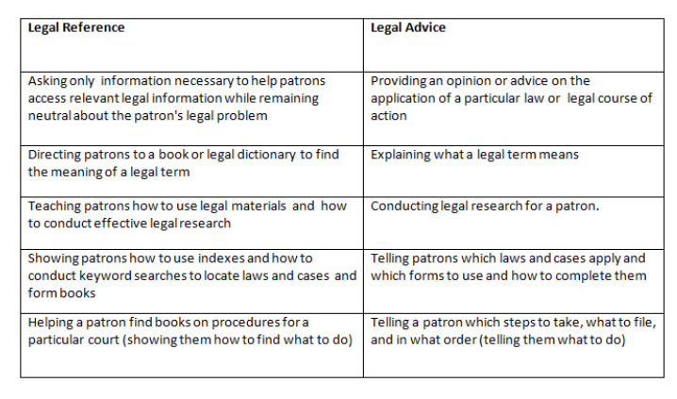

Slide 10
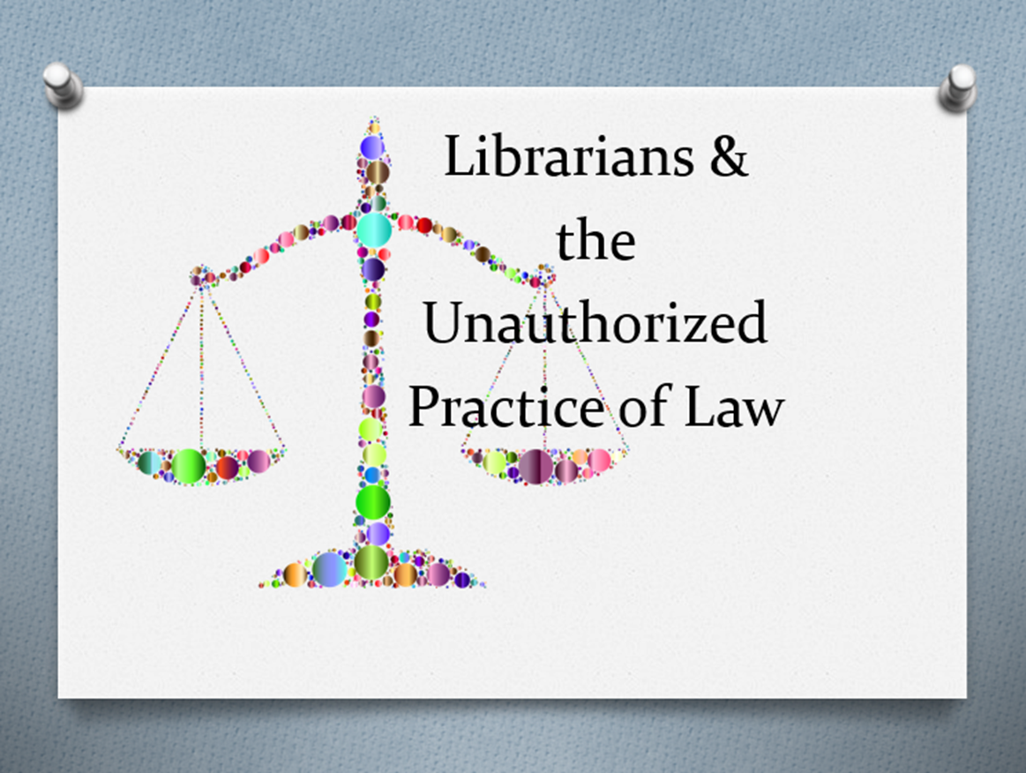
Legal Reference Library Scenarios
https://guides.law.sc.edu/CircuitRiders/UPLPrracticeofLaw

Slide 11
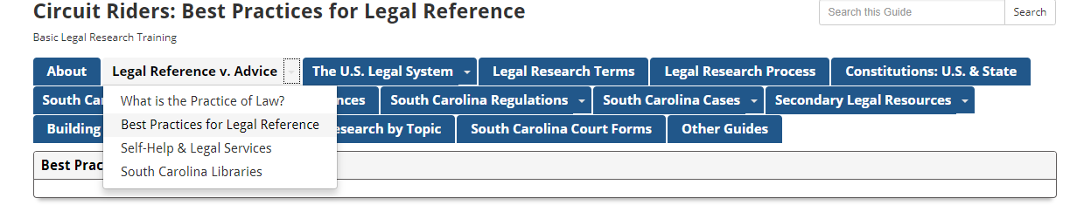
Do what you do best:
  help patrons find information and resources
Disclaimers
Collaborate & Partnerships
Refer to legal experts
  https://guides.law.sc.edu/CircuitRiders/UPLLegalReference

Slide 12
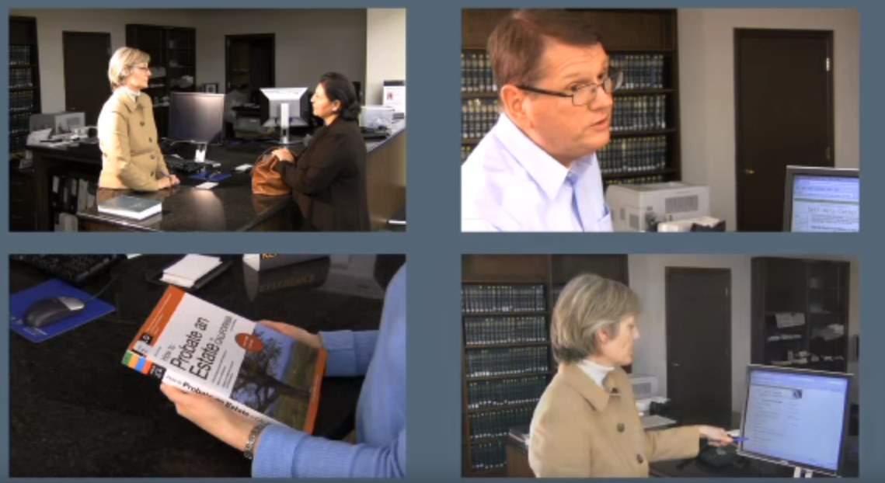
Legal Reference Library Scenarios
https://www.youtube.com/watch?time_continue=5&v=YMs0FMUPXJg

Slide 13
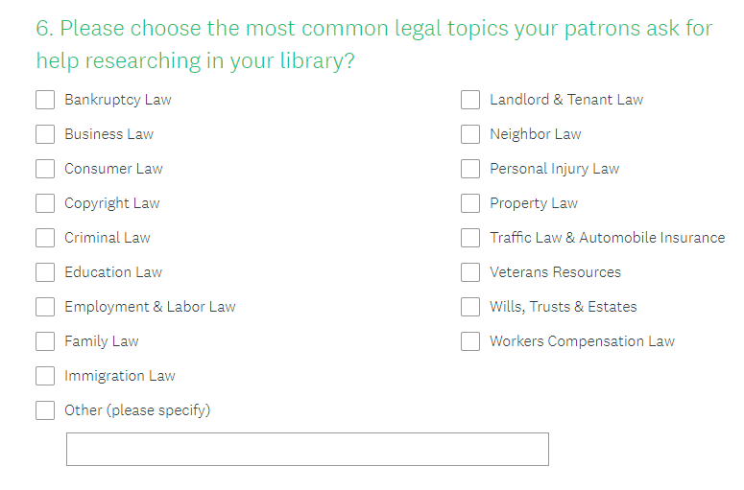
Please complete our quick 6-question survey @ https://www.surveymonkey.com/r/75LJXTM

Slide 14
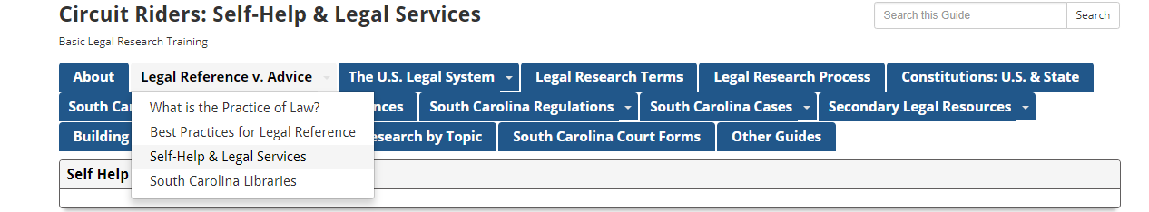
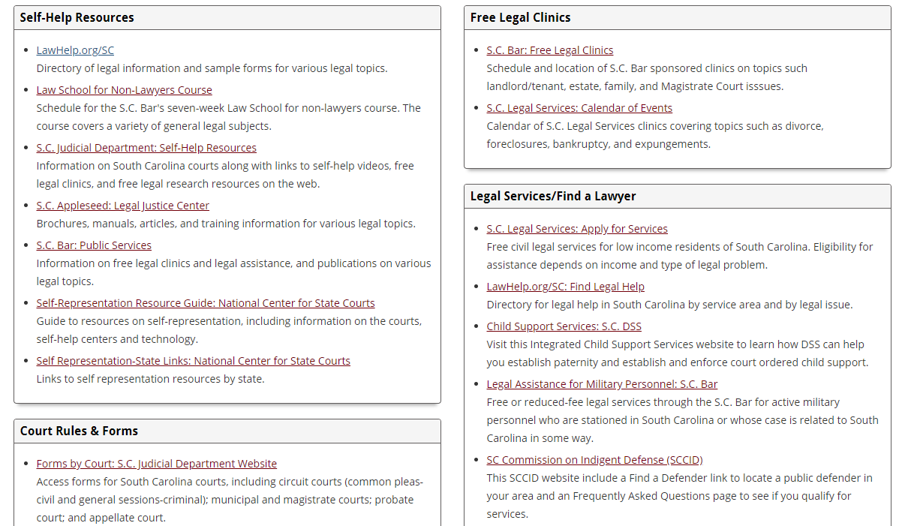
https://guides.law.sc.edu/CircuitRiders/SelfHelp

Slide 15
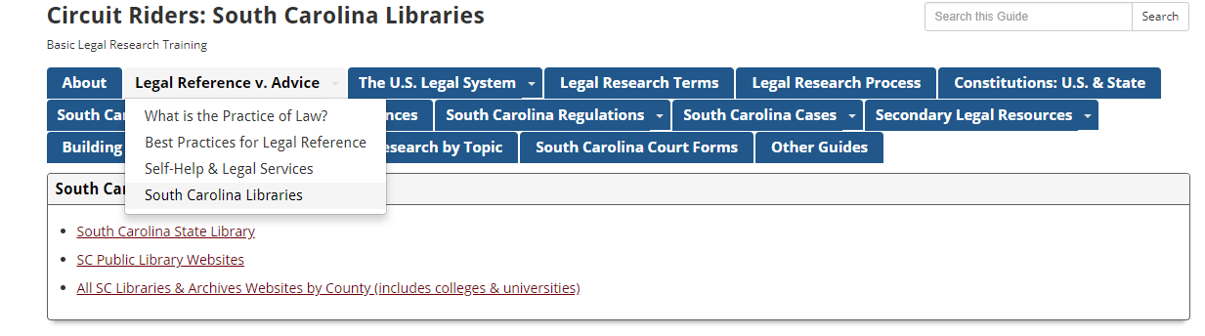
https://guides.law.sc.edu/CircuitRiders/LawLibraries

Slide 16
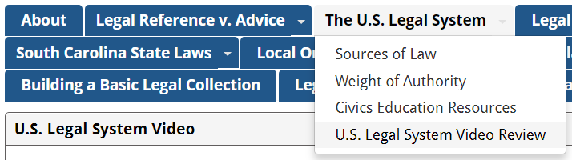
THE U.S. LEGAL SYSTEM
-Federal and State
-3 Branches
WHY CIVICS?

Slide 17
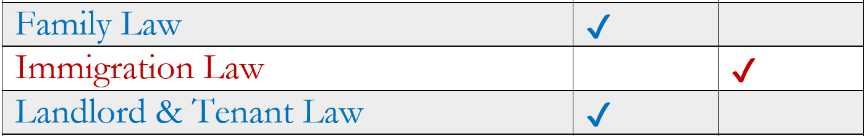
WHY
CIVICS?
starting
point
FEDERAL OR STATE?
handout

Slide 18
WHY
CIVICS?
starting
point
FEDERAL OR STATE?
Patron: I’ve been looking at usa.gov and can’t find anything about my landlord situation.
Librarian: Let’s try some South Carolina law resources.

Slide 19
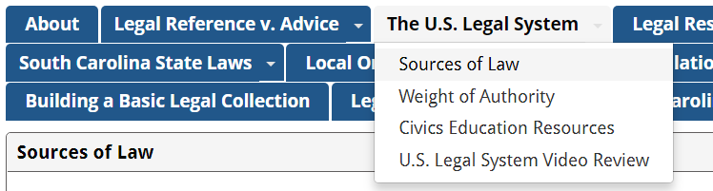
WHY
CIVICS?
SOURCES OF LAW

Slide 20
WHY
CIVICS?
where to
look next
SOURCES OF LAW
authorize
constitutions
statutes
regulations
case law
Federal & State
Legislative
Executive
Judicial
enact .
implement .
interpret .

Slide 21
WHY
CIVICS?
where to
look next
SOURCES OF LAW
Patron: I don’t understand this statute. What does it mean?
Librarian: Have you looked for regulations implementing it,
or case law interpreting it?

Slide 22
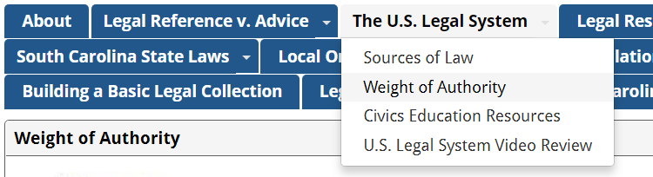
WHY
CIVICS?
WEIGHT OF AUTHORITY

Slide 23
WHY
CIVICS?
which
resources
to suggest
WEIGHT OF AUTHORITY
Patron: I’m curious / doing academic research / seeking general info …
Librarian: feels free to suggest any legal resource, regardless of weight of authority . . .

Slide 24
WHY
CIVICS?
which
resources
to suggest
WEIGHT OF AUTHORITY
Patron: I need to make my case in court and don’t qualify for legal aid.
Librarian: Take a look at this Weight of Authority webpage to help you choose the most authoritative sources.

Slide 25
WHY
CIVICS?
which
resources
to suggest
WEIGHT OF AUTHORITY
Is it PRIMARY or SECONDARY AUTHORITY?
PRIMARY
=
LAW
Is it MANDATORY or PERSUASIVE?
Constitutions
Cases
Statutes
Regulations
Ordinances
SECONDARY
≠
LAW
Legal encyclopedias
Legal dictionaries
Bibliographies
Treatises
Law review articles
PERSUASIVE
MANDATORY
Both:
In your jurisdiction
and
A higher court
Either:
Outside jurisdiction
or
Same or lower court
PERSUASIVE
NOT controlling
NOT controlling
CONTROLLING LAW

Slide 26
WHY
CIVICS?
know the
value of
resources
WEIGHT OF AUTHORITY
common errors & how to correct
Error: Secondary sources are always persuasive, so the legal encyclopedia I found will definitely persuade a judge.
Correction: Judges are only required to follow mandatory authority.

Slide 27
WHY
CIVICS?
know the
value of
resources
WEIGHT OF AUTHORITY
common errors & how to correct
Error: I found a great case from the Supreme Court of Wyoming! It will convince the judge in SC that I’m right!
Correction: Judges are not required to follow cases from another jurisdiction.

Slide 28
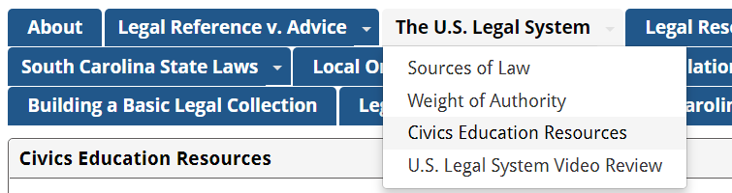



CIVICS EDUCATION
RESOURCE RODEO

Slide 29
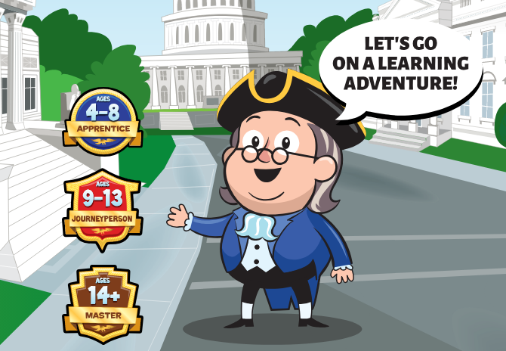
FEDERAL CIVICS
Ben’s Guide to the U.S. Government

Slide 30
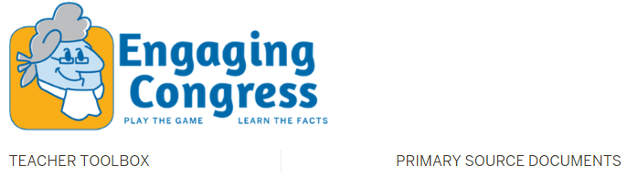
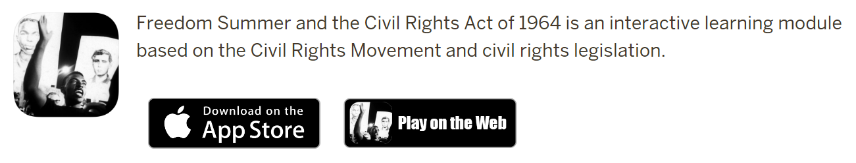
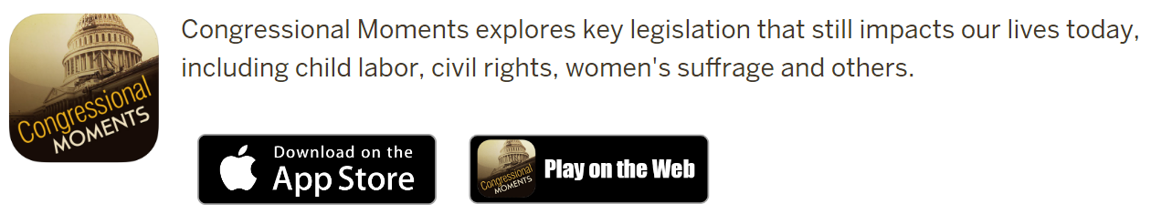
FEDERAL CIVICS
Center on Representative Government

Slide 31
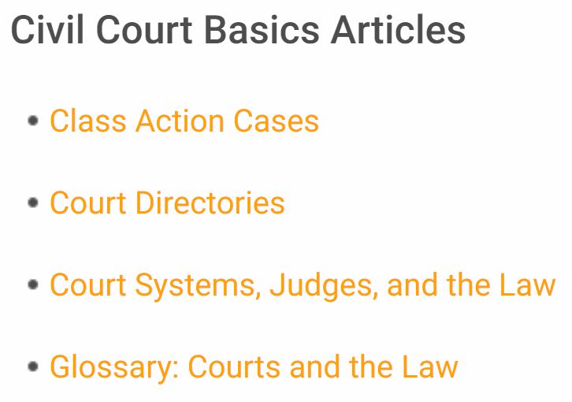
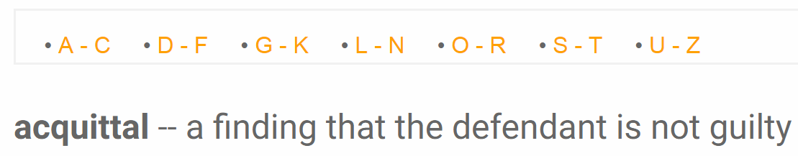
FEDERAL CIVICS
FindLaw: Intro to the U.S. Legal System

Slide 32
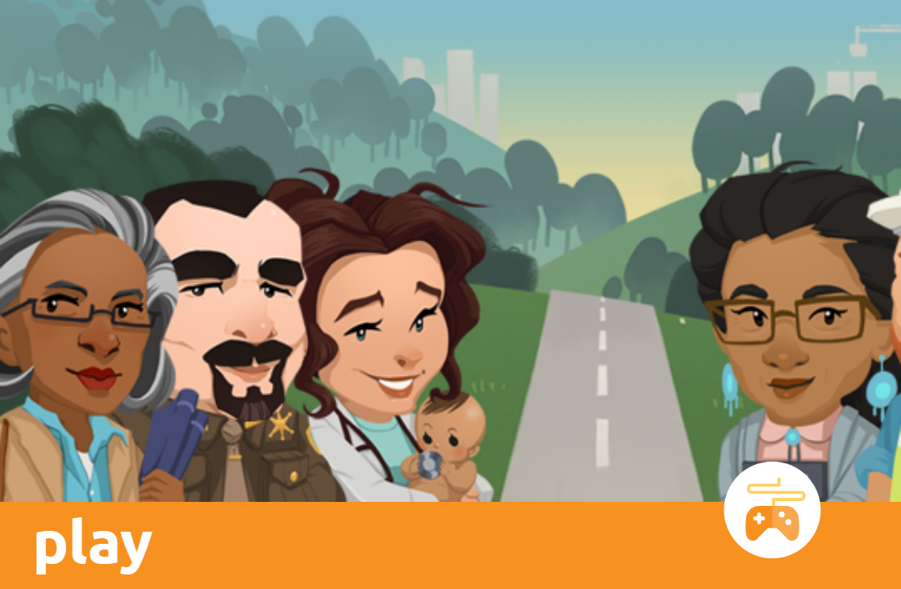
FEDERAL CIVICS
iCivics

Slide 33
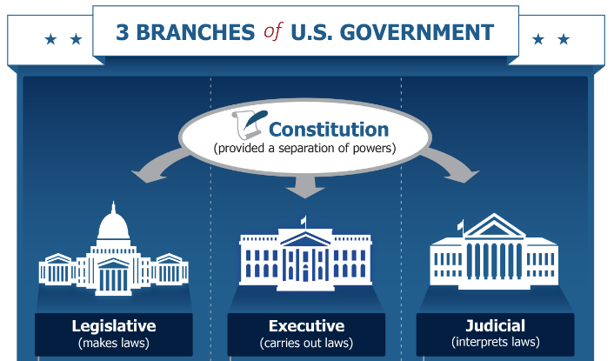
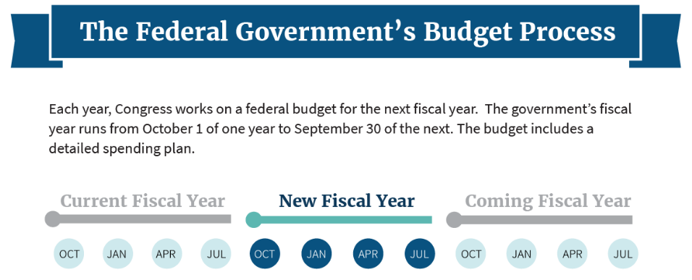
FEDERAL CIVICS
usa.gov

Slide 34
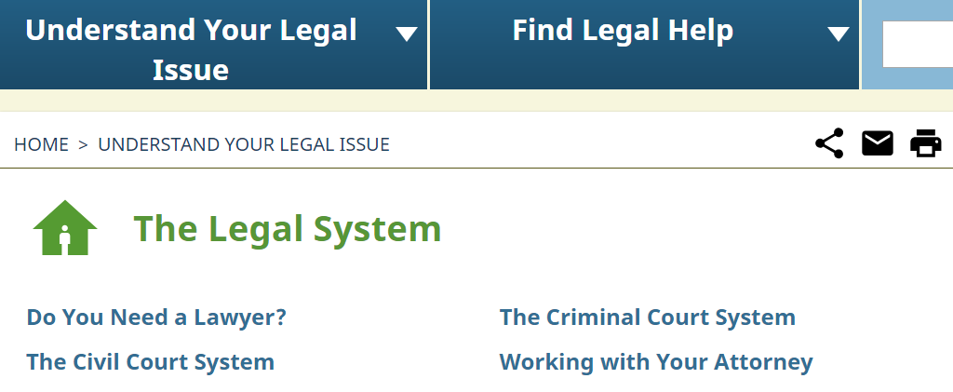
STATE CIVICS
lawhelp.org/SC

Slide 35




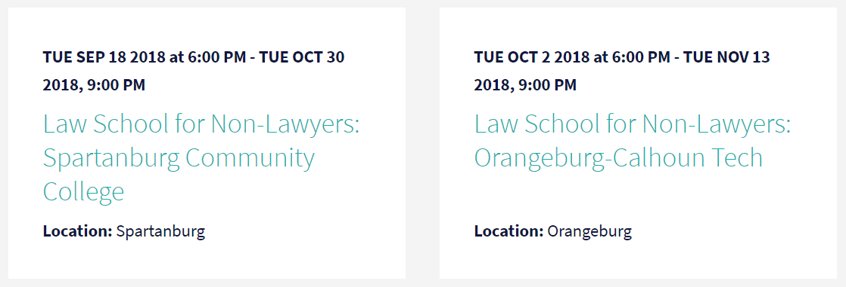
STATE CIVICS
Law School for Non-Lawyers

Slide 36
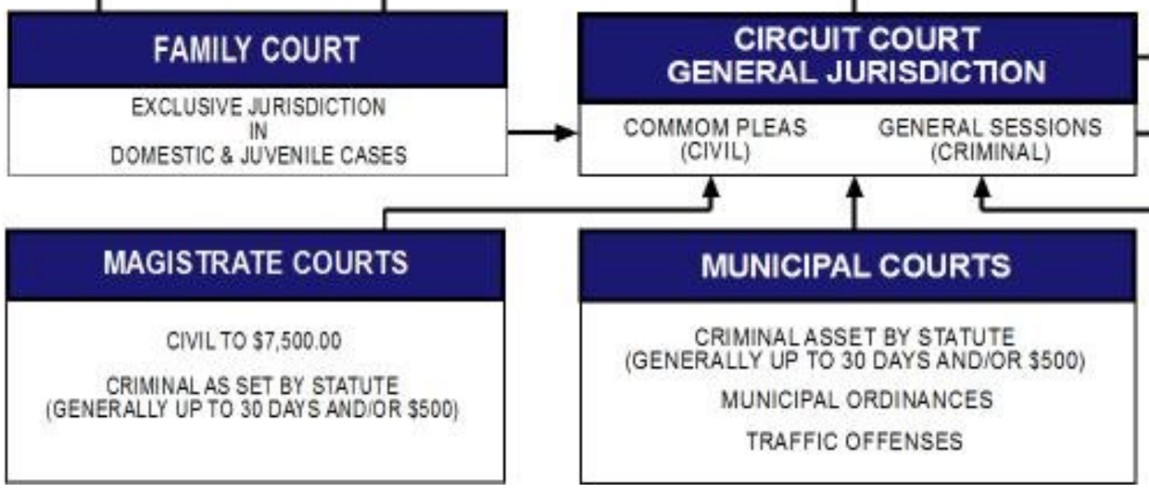
STATE CIVICS
Overview of SC Judicial System

Slide 37
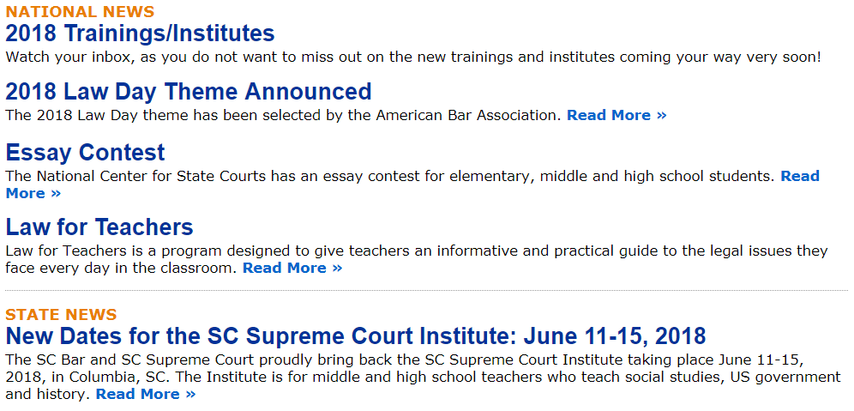
STATE CIVICS
SC Bar – Law Related Education

Slide 38
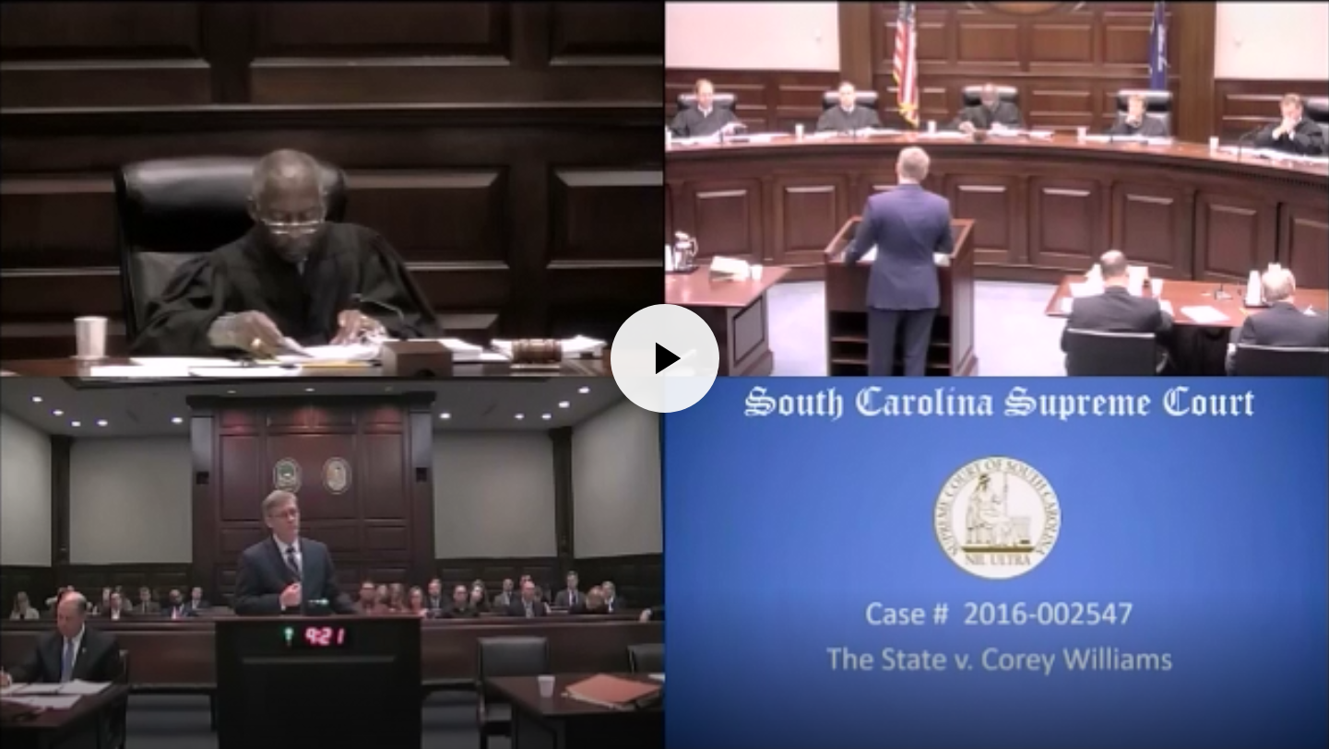
STATE CIVICS
SC Judicial Department:
Educational Resources

Slide 39
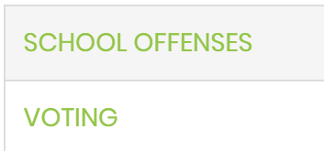
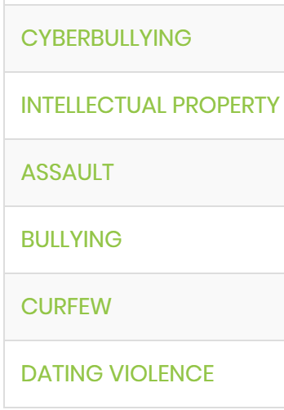
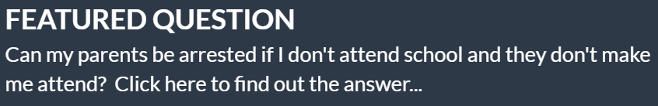

STATE CIVICS
SC Law for Kids

Slide 40
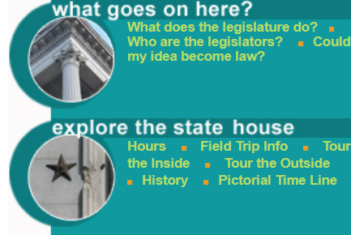
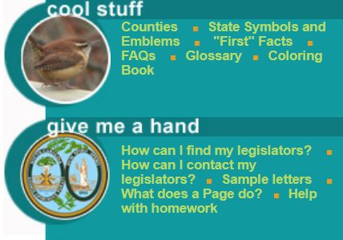
STATE CIVICS
SC Legislature Website:
Student Connection

Slide 41
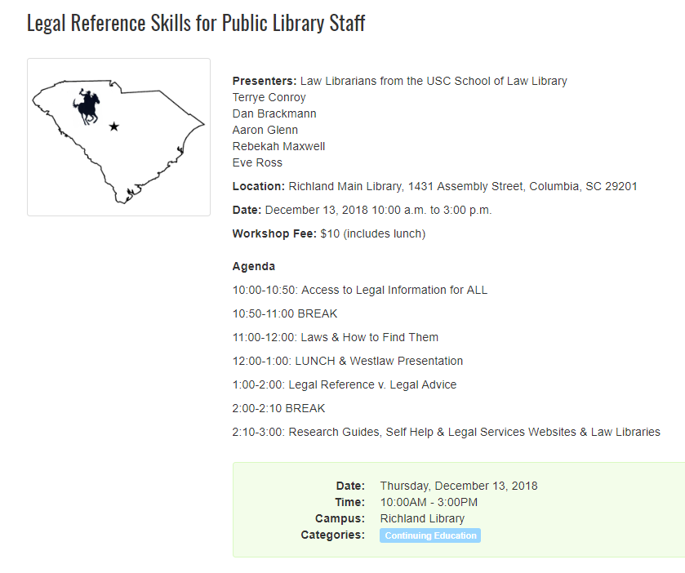
https://statelibrary.sc.libcal.com/event/4242703

Slide 42
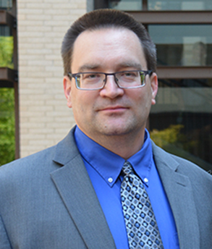
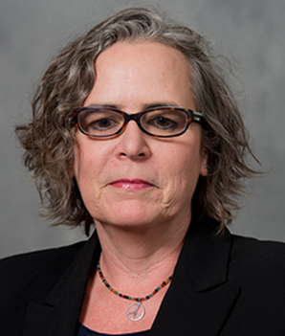

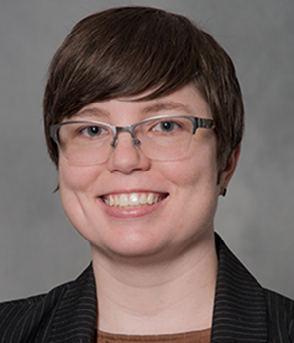



CONTACT US
brackmad@law.sc.edu | conroyt@law.sc.edu | glennaj2@law.sc.edu |  | rossea@law.sc.edu
Reference Desk: www.lawref@law.sc.edu 803-777-5902 |  |  | @UofSCLawLib

