Slide 1
SCLA Advocacy Update
Virginia Cononie & Jonathan Newton
Fall 2018

Slide 2
Today’s presentation includes...
Advocacy Agenda
National Library Legislative Day
Postcard Campaign
2019 Goals

Slide 3
Advocacy Agenda
Mission
Connect with officials at the federal, state and local level
Engage current membership with frequent and timely action opportunities
Grow our advocate base.

Slide 4
2018 Issues
Funding/Appropriations
IMLS/LSTA funding SCLA overwhelmingly supports full federal funding of IMLS for Fiscal Year 2019. South Carolina continually benefits from, IMLS, and LSTA. It is imperative to the growth of South Carolina's communities, education and libraries and should be funded. “LSTA is the only federal funding program for libraries. Most of its resources flow to each state through IMLS in the form of a population-based matching grant. Because federal LSTA funds are matched in part by state, libraries would lose both sources of revenue if LSTA funding were reduced or eliminated.” | Support funding to PASCAL SCLA supports the SC Commission on Higher Education’s budget request for $1.5 million in recurring funds for PASCAL (Partnership Among SC Academic Libraries). PASCAL serves over 239,000 students at 56 colleges and universities by providing high quality academic content, including thousands of academic journals covering all disciplines, over 290,000 academic e-books and access to over 12 million print books through its statewide rapid delivery service.

Slide 5
Telecommunications
Net Neutrality SCLA believes in Net Neutrality. It’s important to libraries because “ Libraries and librarians of every kind are dedicated to providing maximum and equitable access to information of all kinds.” ALA, 2017. We must “preserve the core principles of network neutrality articulated in the FCC’s Open Internet Order, which protects free speech online, education research, and innovation.” ALA, 2017.
Access
Supporting FASTR Act SCLA supports the passage of the FASTR Act and as ALA states, is in support of “legislation building on the Fair Access to Science and Technology Research Act (FASTR) as introduced in the 114th Congress (S.779/H.R. 1477), to assure prompt no-fee public access to published articles and other materials based upon taxpayer-funded research.”

Slide 6
2018 Goals
Connect
Engage
Grow
2019

Slide 7
Goals met.
Connection
Made connections with: SCASL, Friends of South Carolina Libraries, APLA, the State Library
Engage
Recreated Postcard campaign and included SCASL to engage school librarians.
Growth
We worked to grow our committee, interested advocates and people to who can attend NLLD and SCLLD.

Slide 8
National Library Legislative Day

Slide 9
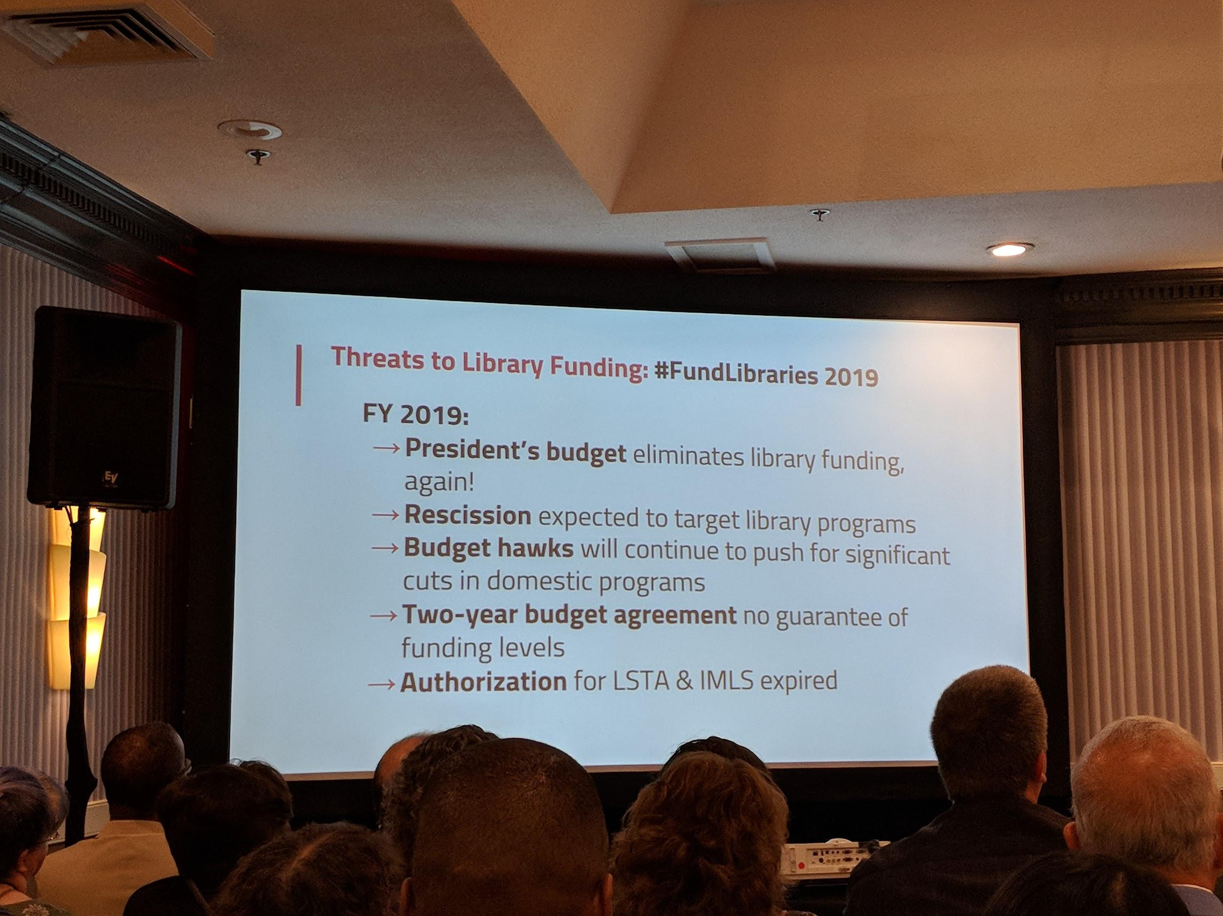
Perfectly Whelming
Appropriations
Reauthorization
Net Neutrality
(&c.)

Slide 10
Appropriations

Slide 11
Appropriation highlights
In February 2018 the White House calls for elimination of all federal funding for library services (IMLS/LSTA and IAL)
Our ask: level funding ($186.6 million)
In September 2018 the Senate Labor, HHHS, Education, and Related Agencies Subcommittee “minibus” bill is signed

Slide 12
IMLS Reauthorization

Slide 13
Reauthorization highlights
Without reauthorization, IMLS has been year-to-year since 2016
Bills introduced September 28 call for reauthorization through 2023
S. 3530 (in committee: if you are in AK, AL, GA, KY, LA, NC, SC, or VA call your senator!)
H.R. 6988 (in committee: if you’re in SC-2, call Joe Wilson!)

Slide 14
Net Neutrality

Slide 15
Net Neutrality highlights
Everybody is suing.

Slide 16
Marrakesh Treaty

Slide 17
Marrakesh Treaty
Adopted by World Intellectual Property Organization in 2013
Calls for minimum copyright limitations and exceptions for creation and distribution of works in an accessible format for the print disabled
Ratified by the US in June 2018

Slide 18
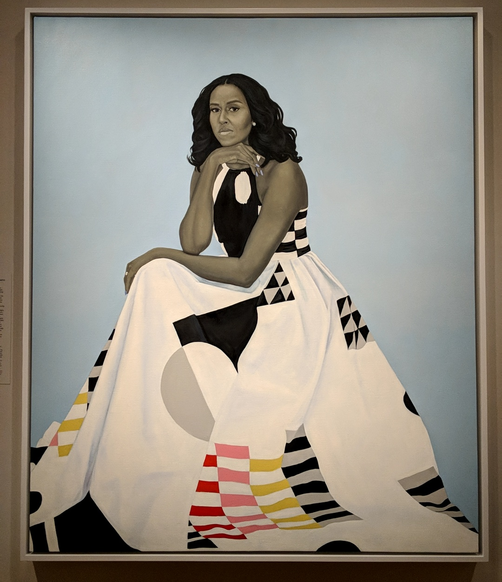
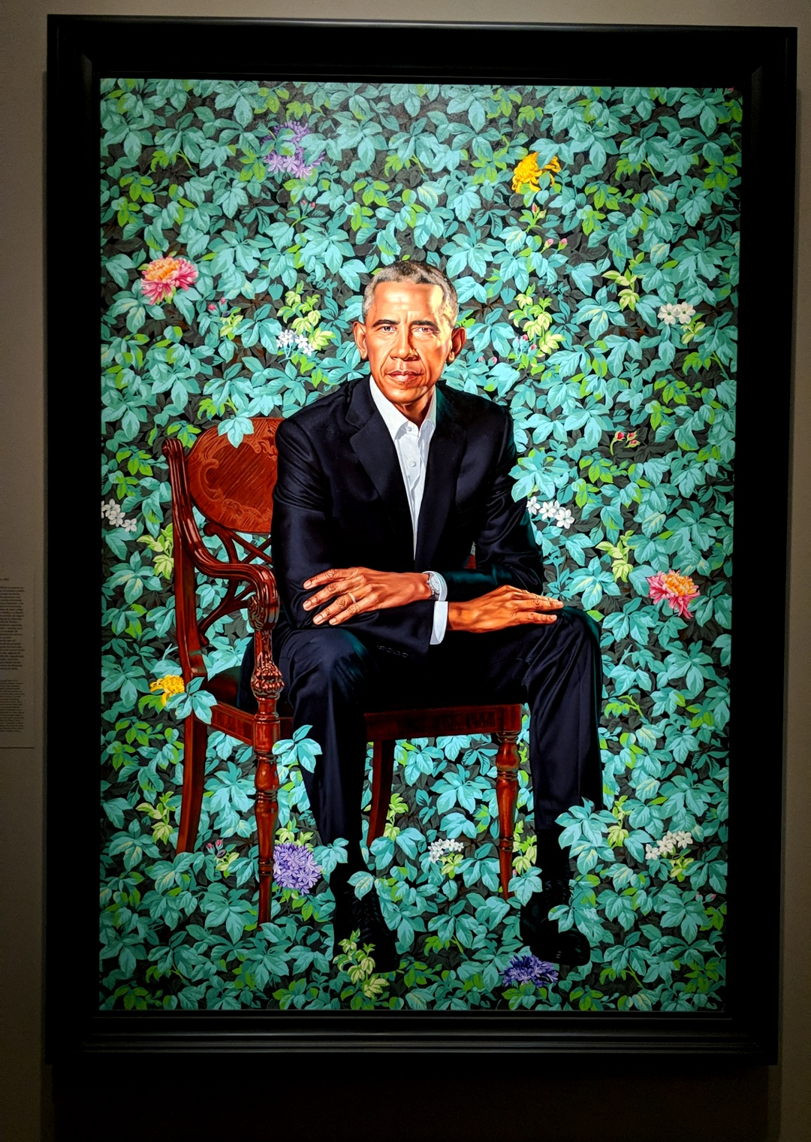
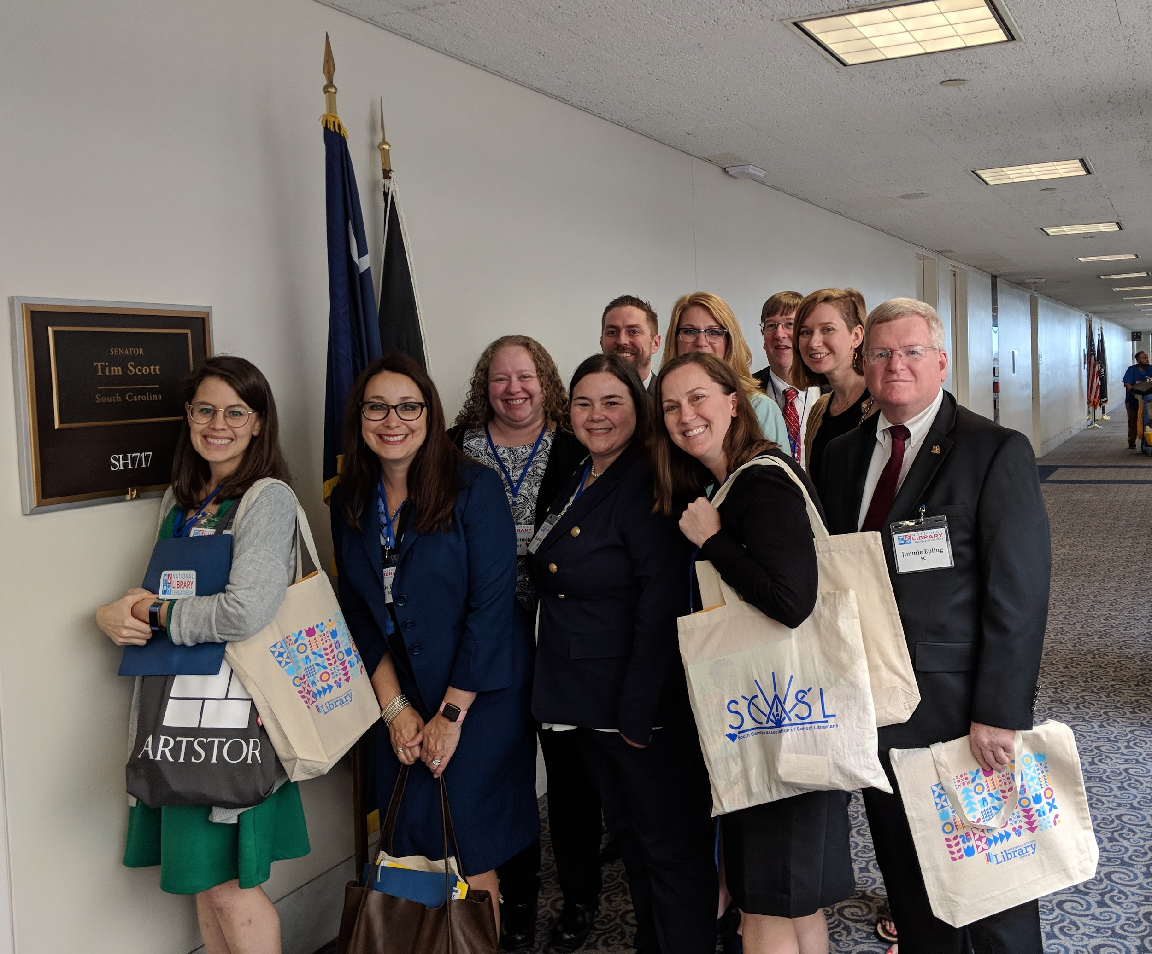
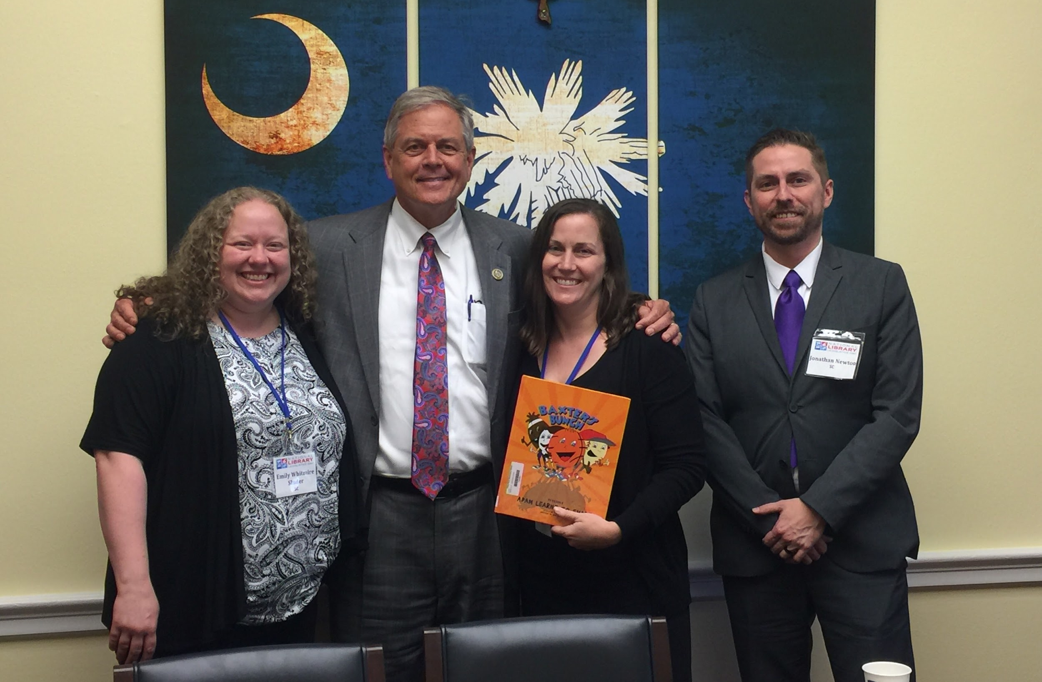
On Capitol Hill

Slide 19
Postcard Campaign

Slide 20
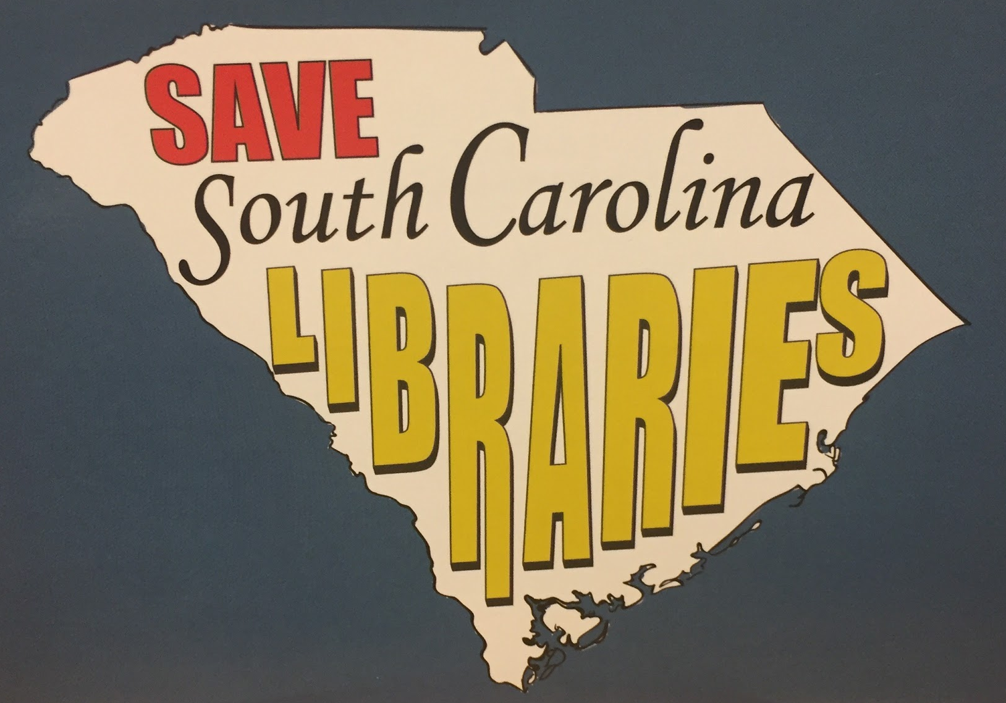
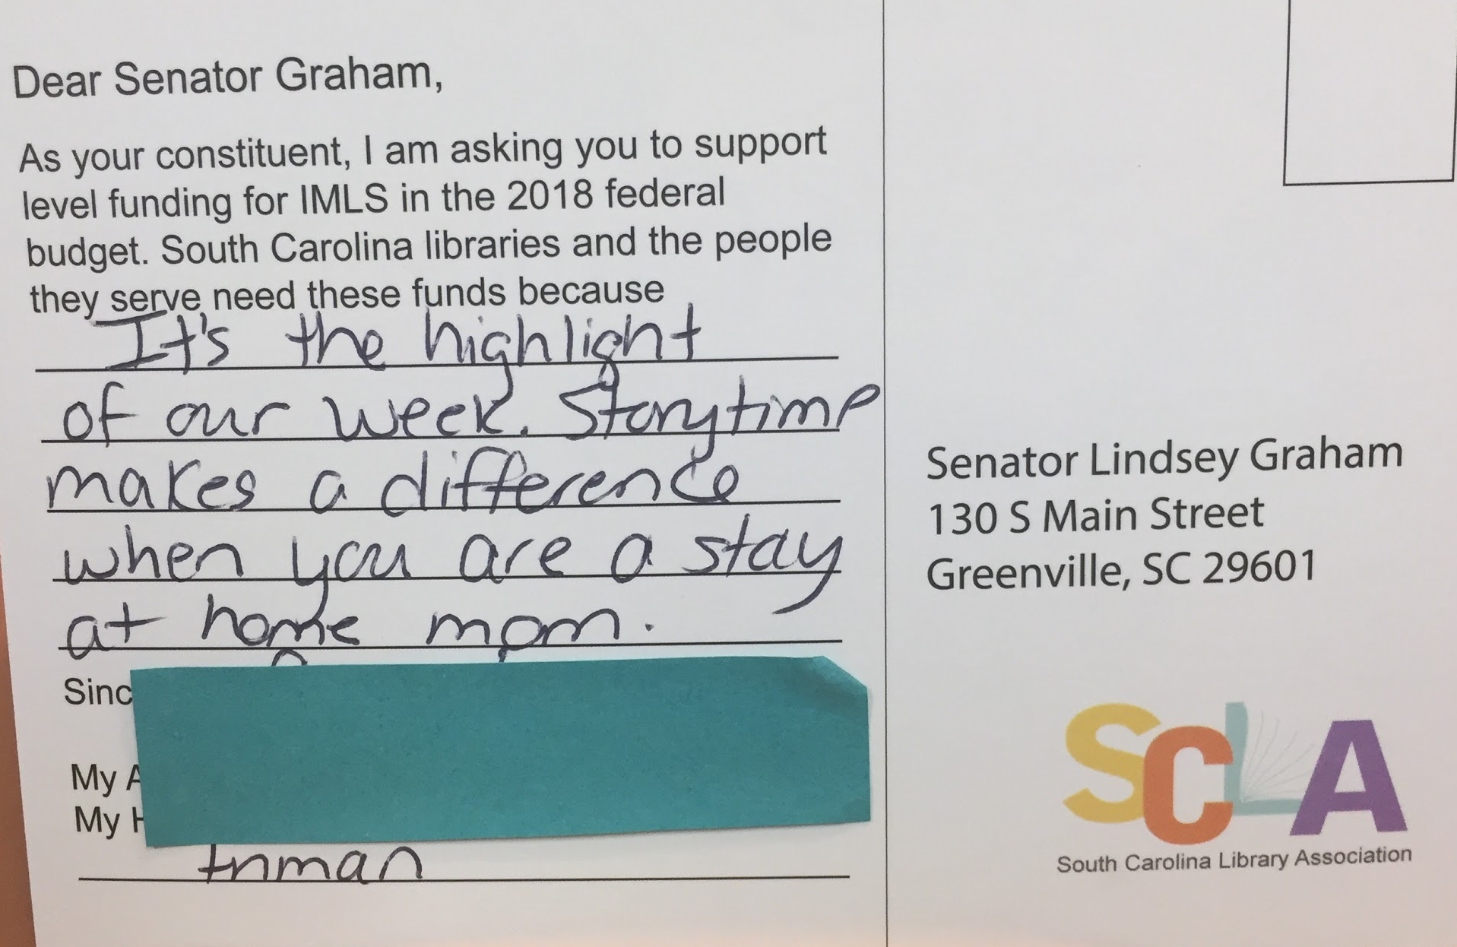
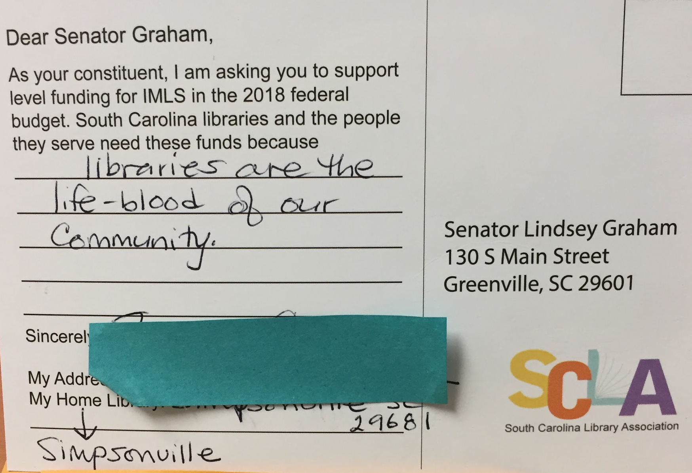
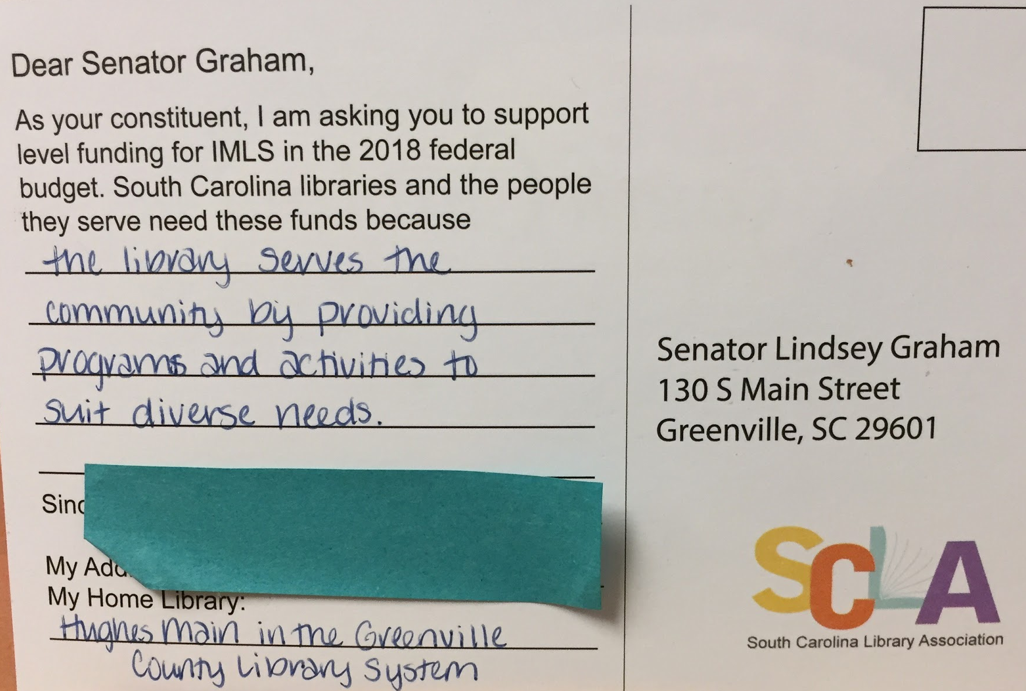
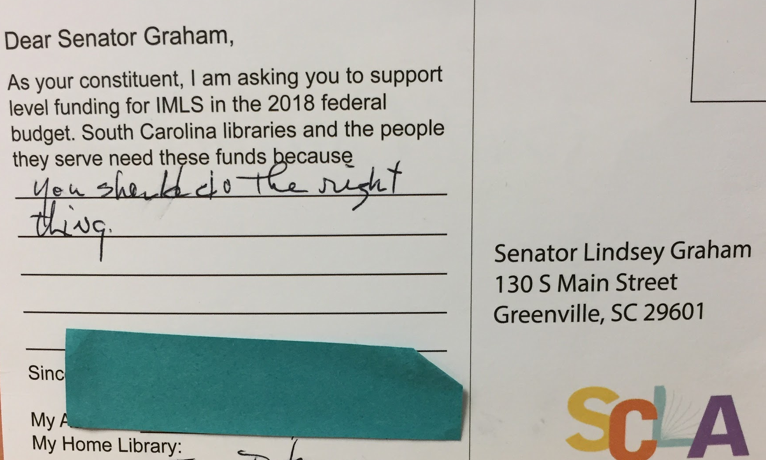
View all 2017 postcards here

Slide 21
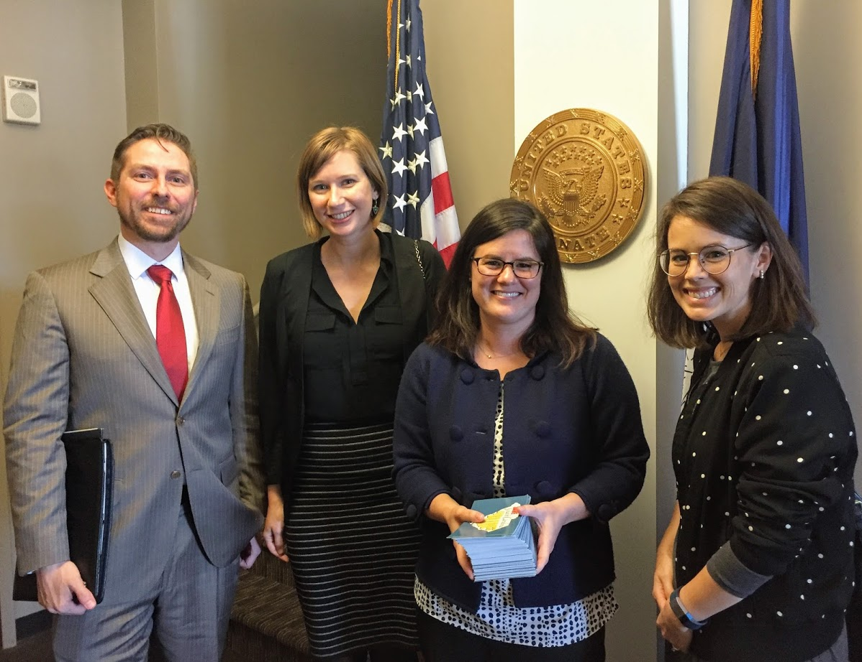
What we learned.
Give simple and direct rules
Open up the postcard campaign to send to all senators.
Provide an open canvas to let people express their ideas.

Slide 22
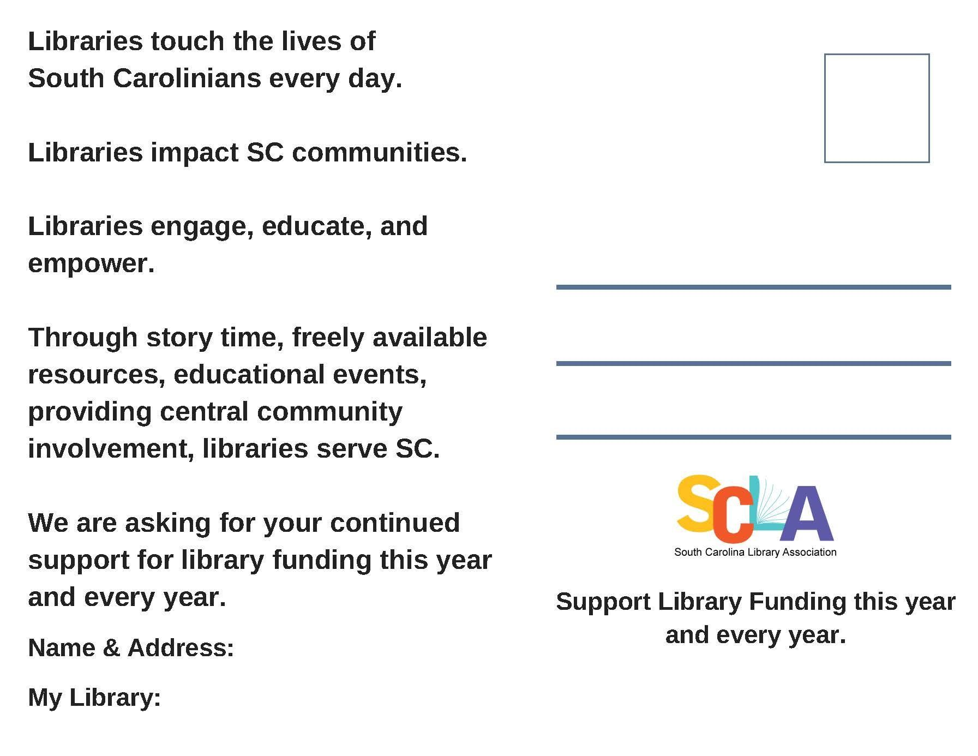
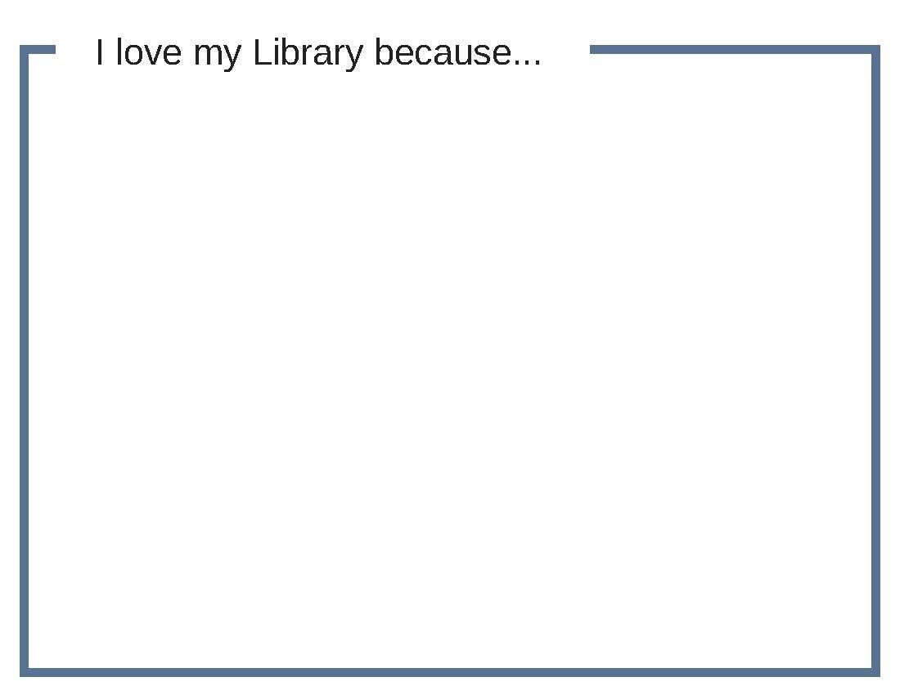
2018
Wrote out the narrative on the back for participants.
Asked them not to send them in personally.
Collecting to give in bundles to each district.
Left the front blank for more creative freedom.
Left the date off to have a longer lasting campaign.

Slide 23
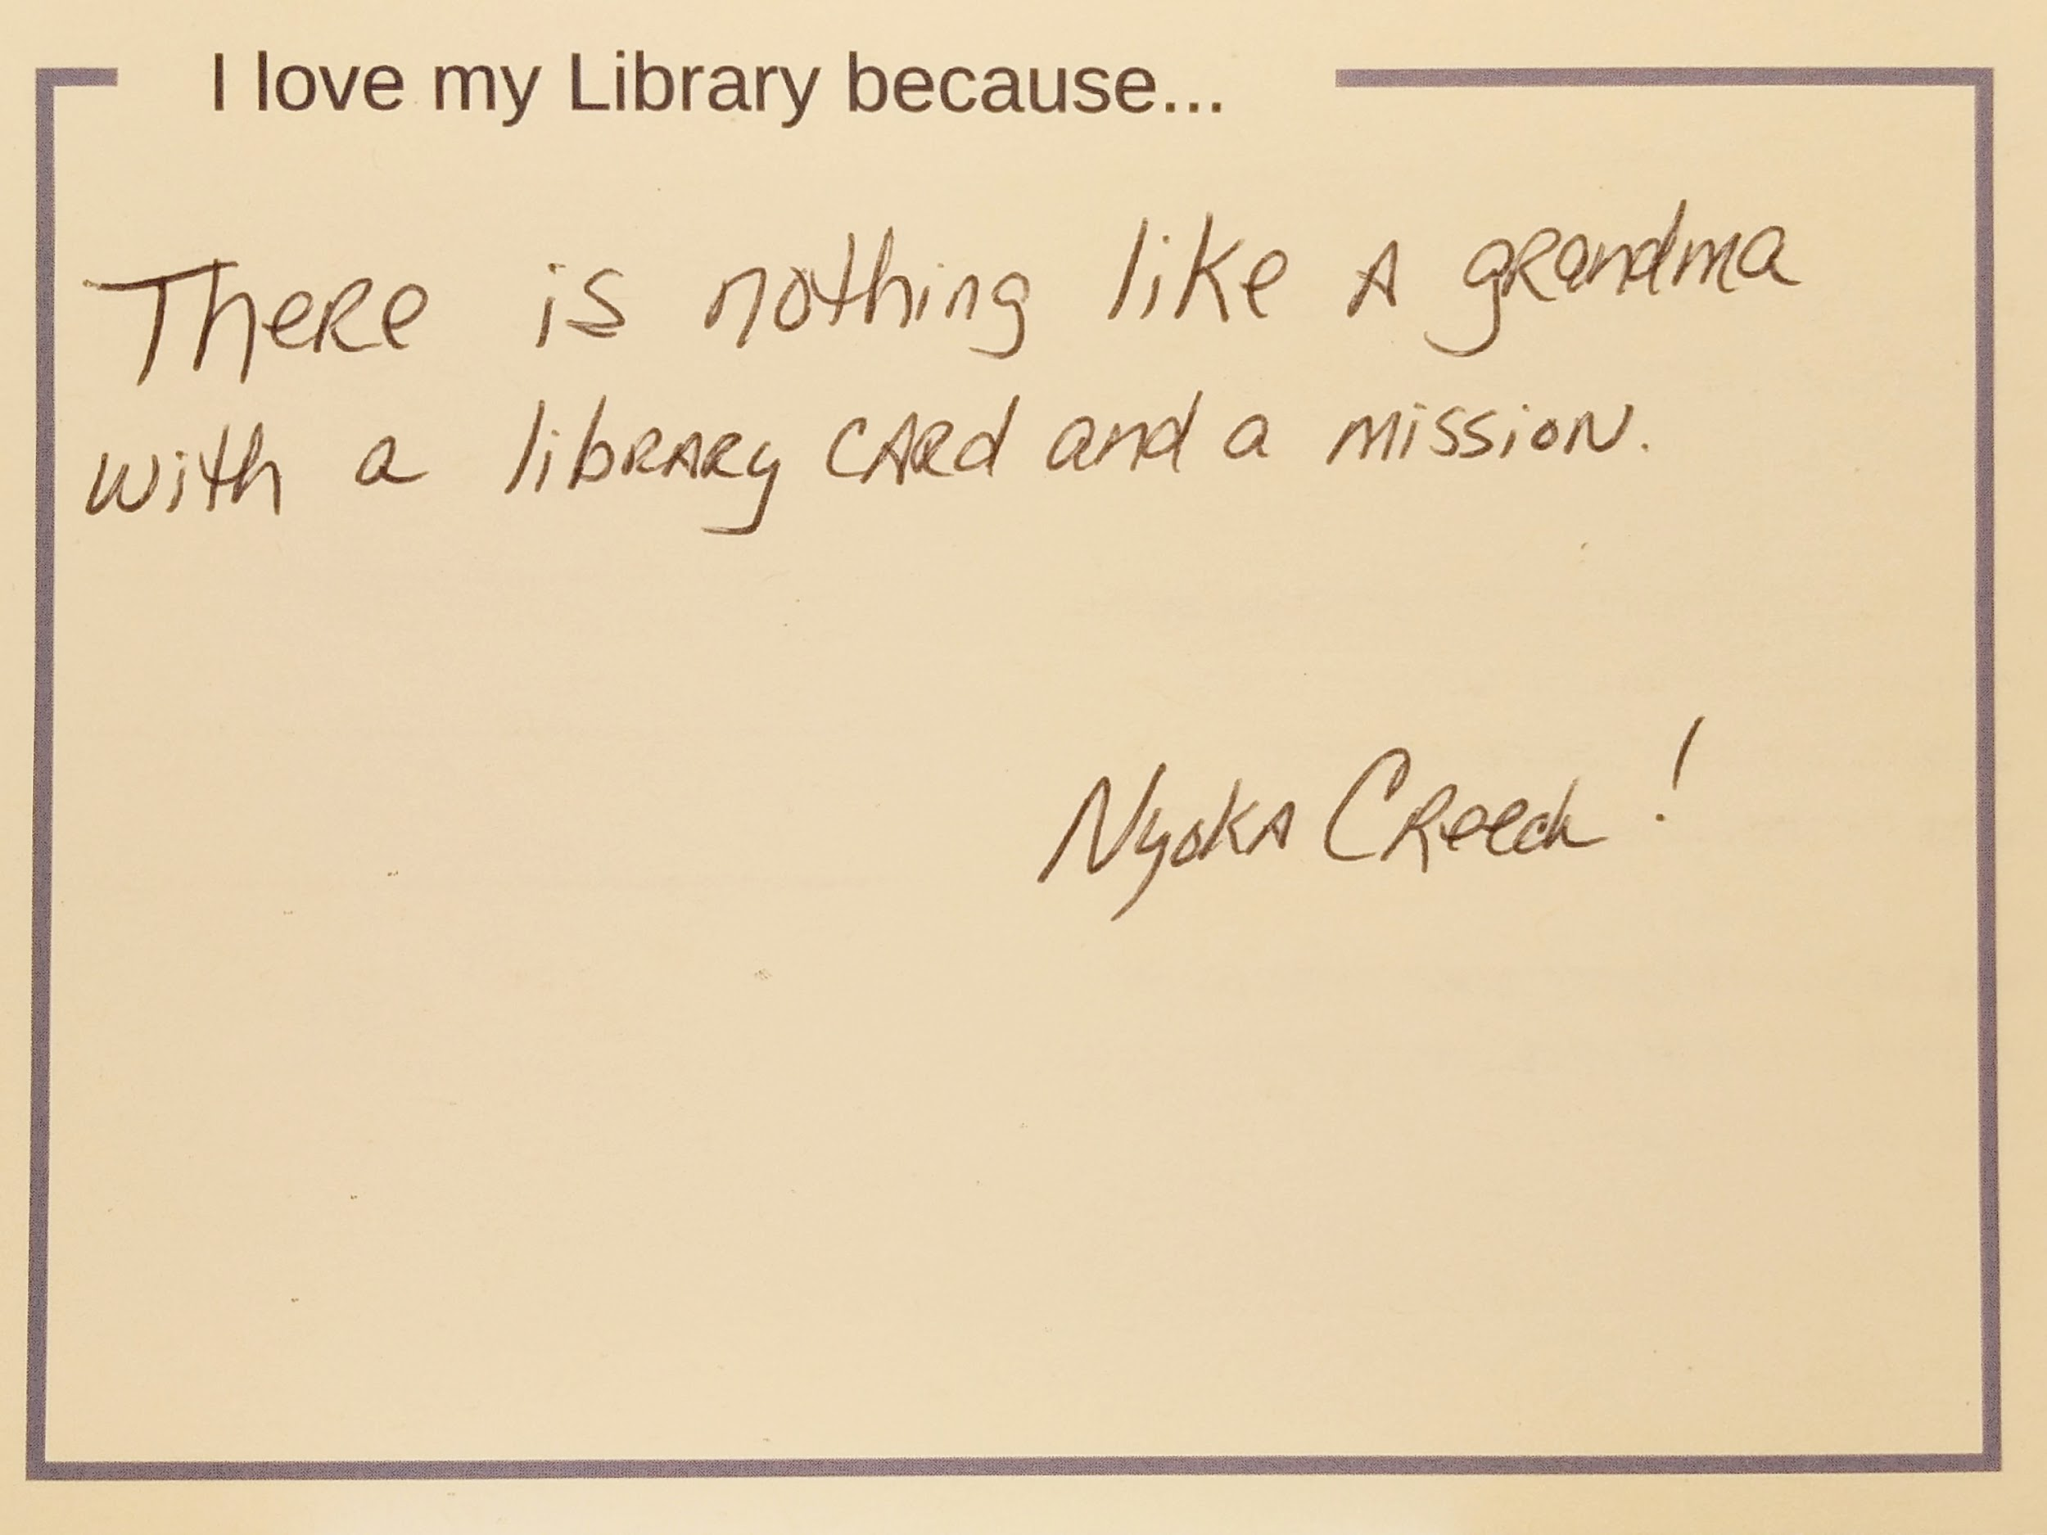
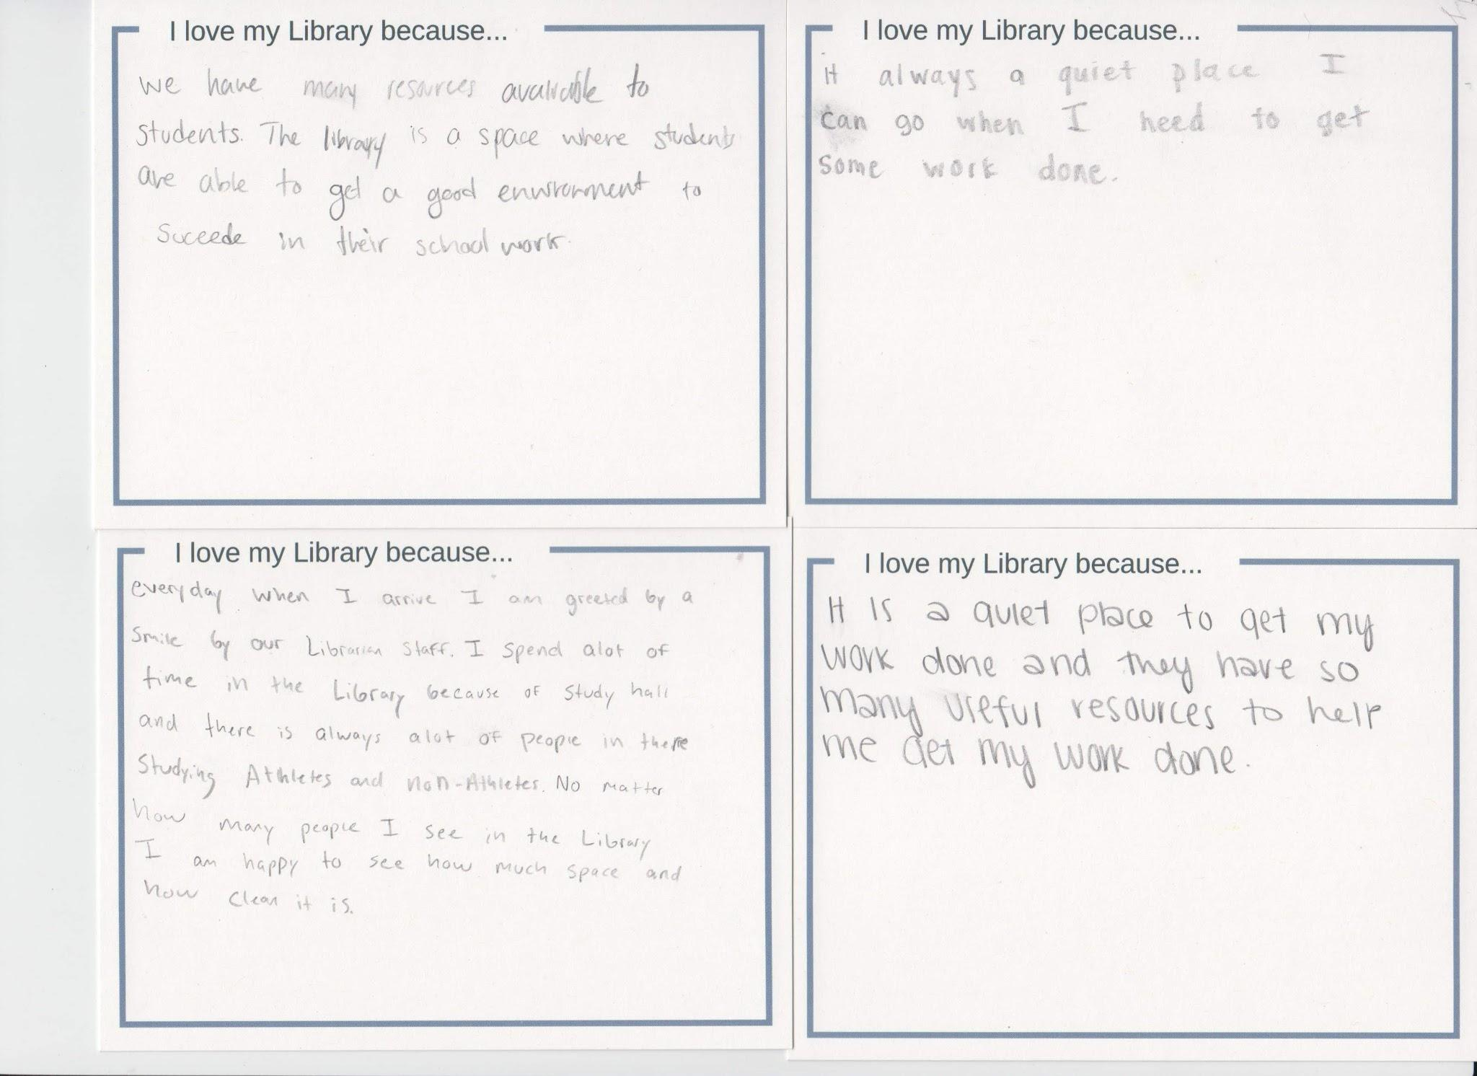
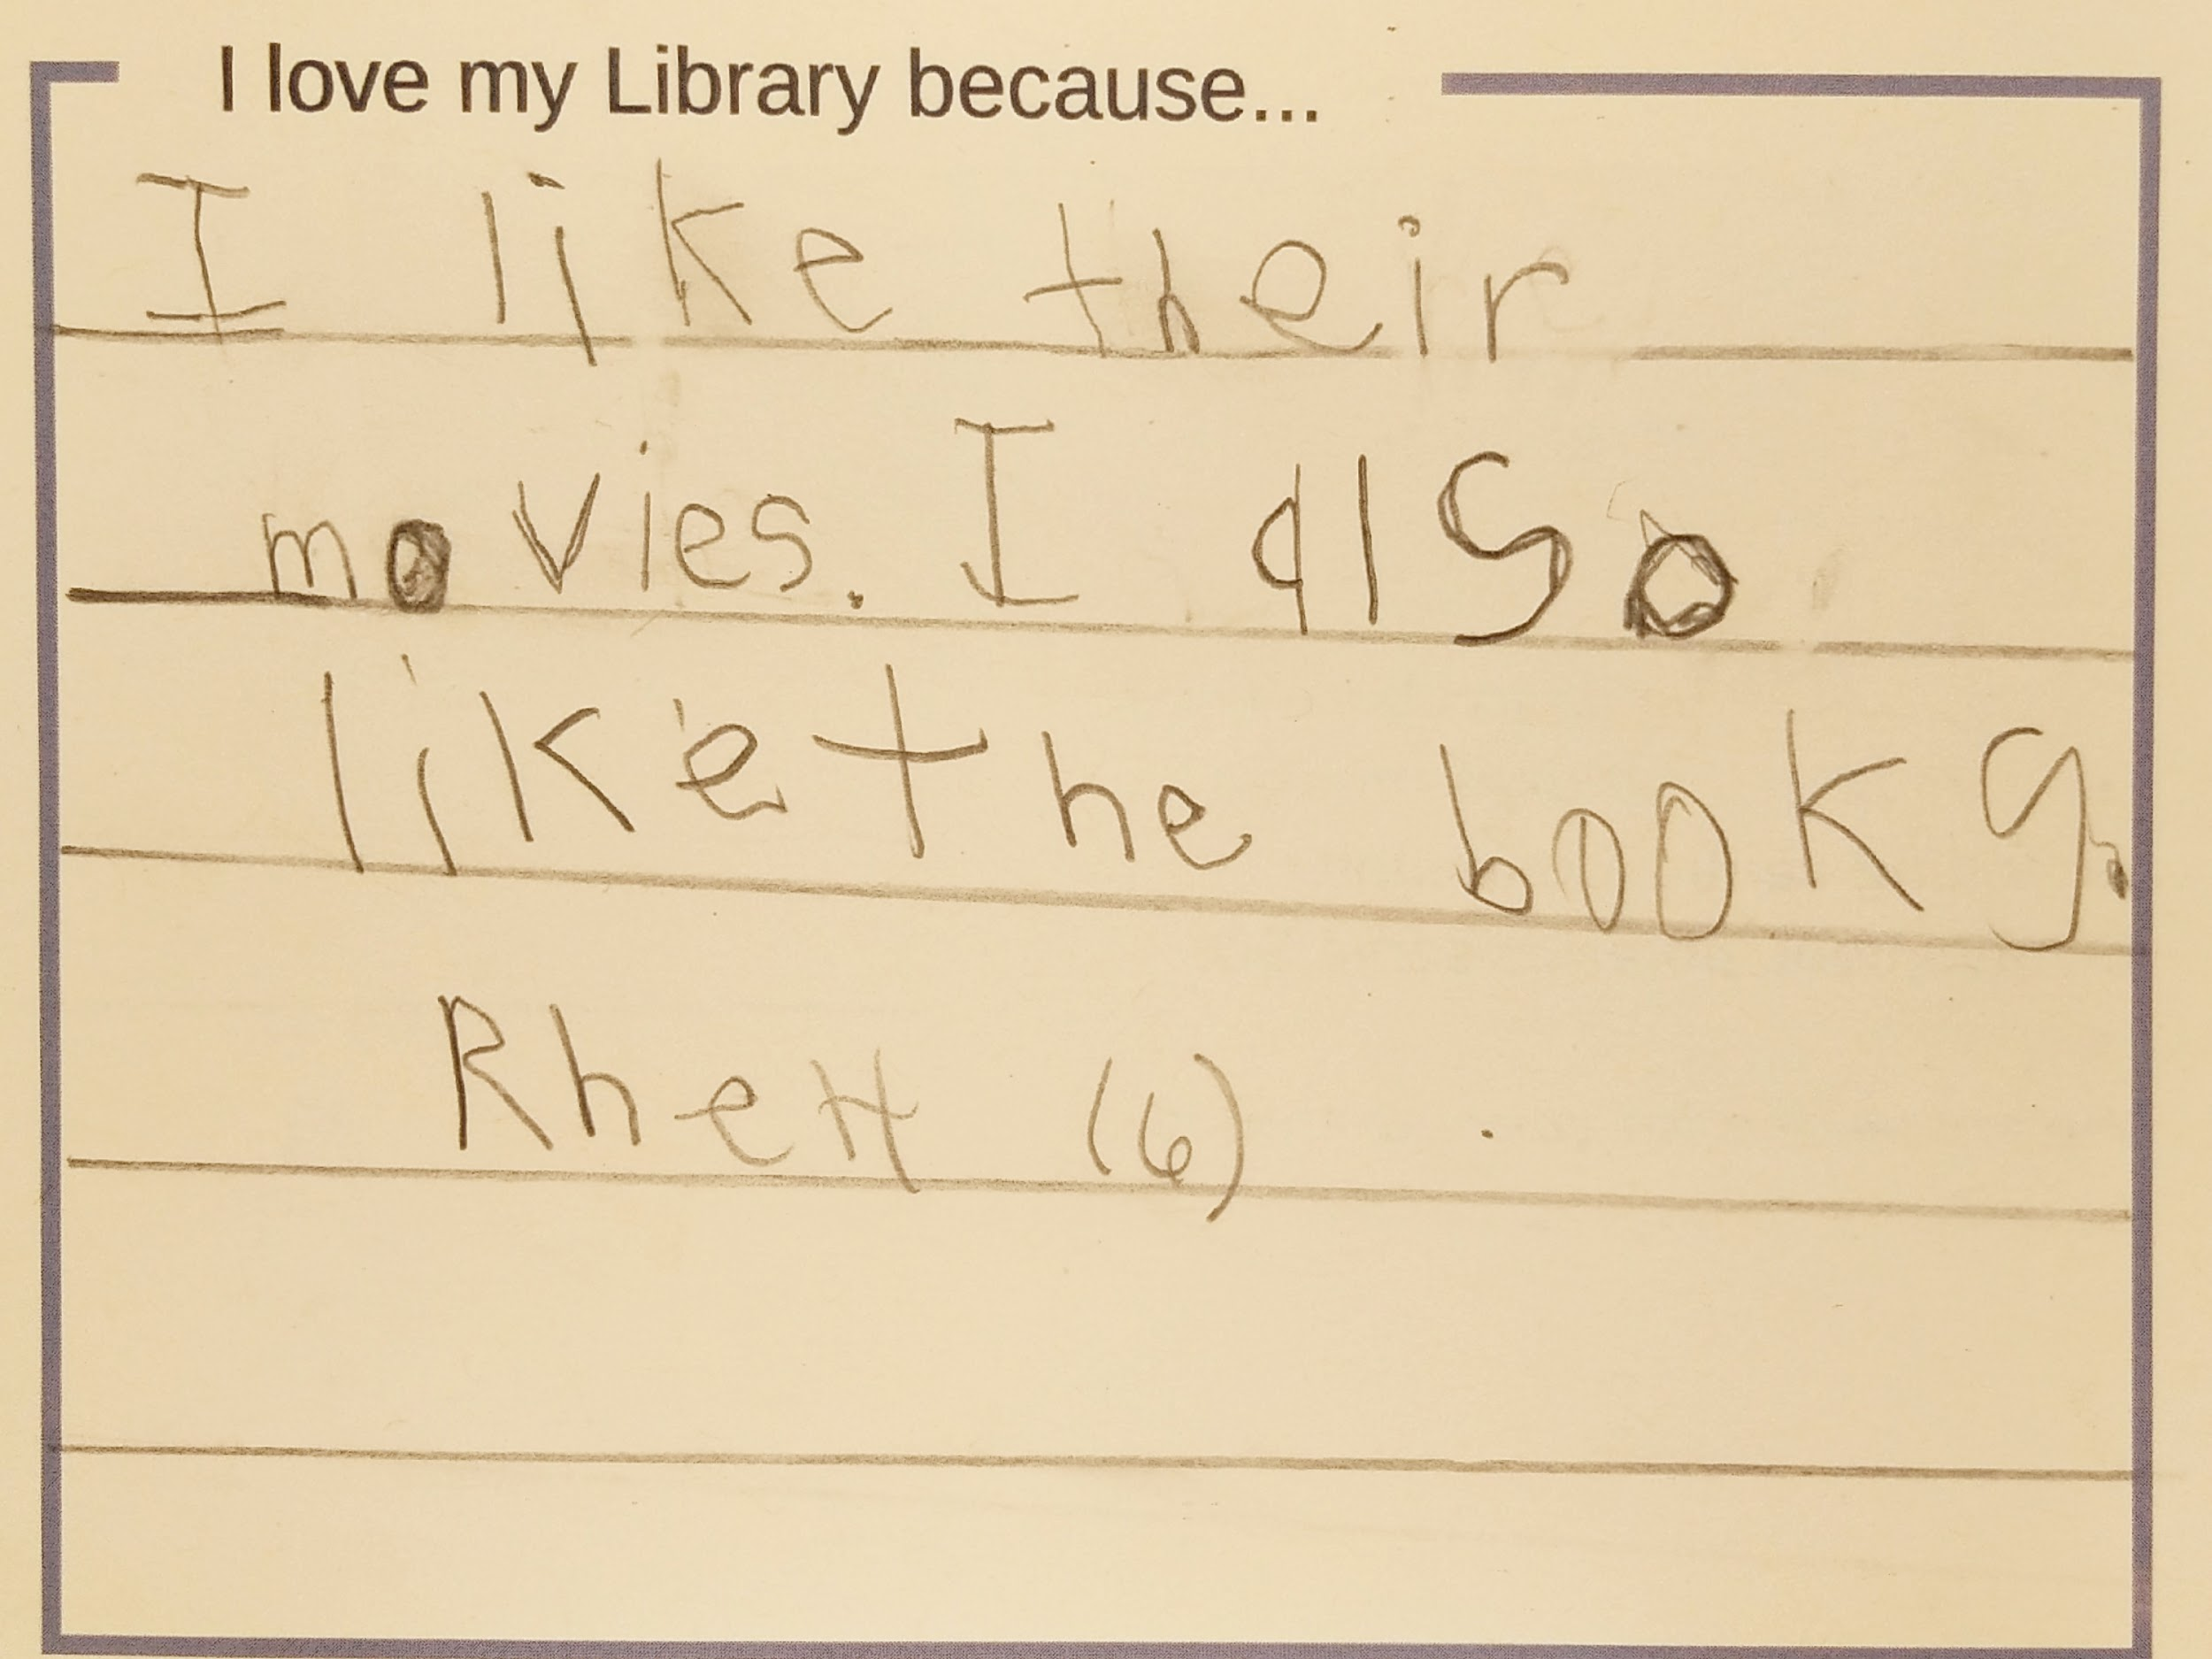
2018- “I love my library because…”

Slide 24
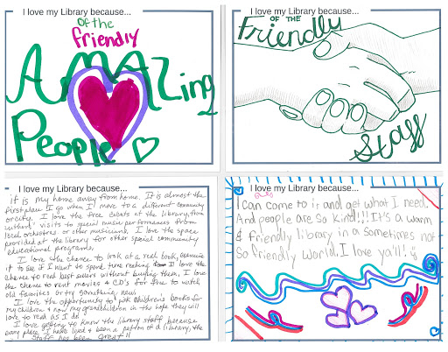
It’s a warm & friendly library in a sometimes not so friendly world.

Slide 25
Congressional Candidates
District | Republican | Democrat | Other Indicated
1 | Kate Arrington | Joe Cunningham | n/a
2 | Joe Wilson (Incumbent) | Sean Carrigan | Sonny Narang (Amer)
3 | Jeff Duncan (Incumbent) | Mary Geren | David Moore (Amer)
4 | William Timmons | Brandon Brown | Guy Furay (Amer)
5 | Ralph Norman (Incumbent) | Archie Parnell | Michael Chandler (Const)
6 | Gerhard Gressman | James Clyburn (incumbent) | Bryan Pugh (Green)
7 | Tom Rice (Incumbent) | Robert Williams | n/a
Information listed from: https://ballotpedia.org/United_States_House_of_Representatives_elections_in_South_Carolina,_2018

Slide 26
Check your
scvotes.org
Voter registration

Slide 27
2019
Goals & Plans
Postcard Campaign
Deliver to all new or current Congress Members
Collaborate
Partner with Library directors- State house visits.
SCLLD- February with SCASL
Web Engagement
Work on reaching out to advocates through Engage
Rework Advocacy Agenda for 2019

Slide 28
Take our survey
https://tinyurl.com/sclaac18
Virginia Cononie
vcononie@uscupstate.edu
Jonathan Newton
jnewton@greenvillelibrary.org

