Slide 1

So you want to start a library podcast?
SCLA/SELA Conference
October 31, 2018 – Greenville, SC
Dr. Curtis Rogers, Communications Director
Slideshare.net/crr29061

Slide 2
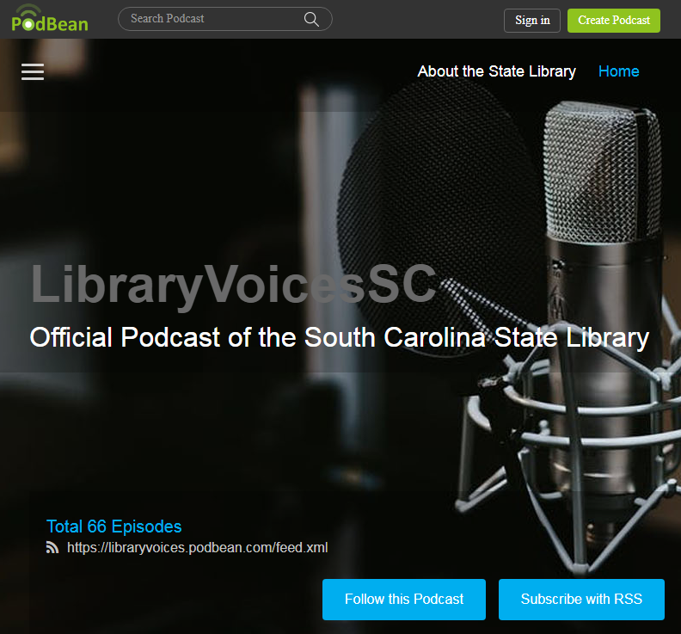
Outline
My presentation style
A brief history
Equipment
Selecting topics
Podcasting process
Editing recordings
Using a podcasting service such as PodBean
Promotion/Sharing

Slide 3
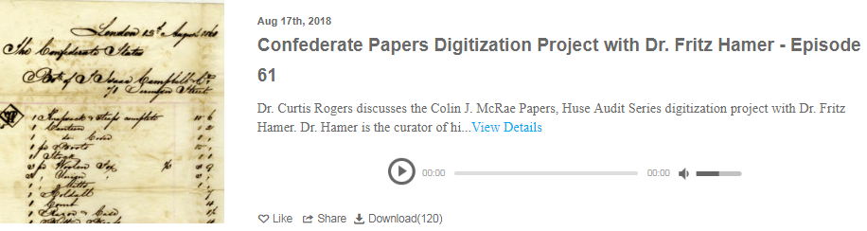
My Presentation Style
Let’s have a conversation!
I’ll talk about my experience with LibraryVoicesSC
I want you to understand just the basics so you can get started

Slide 4
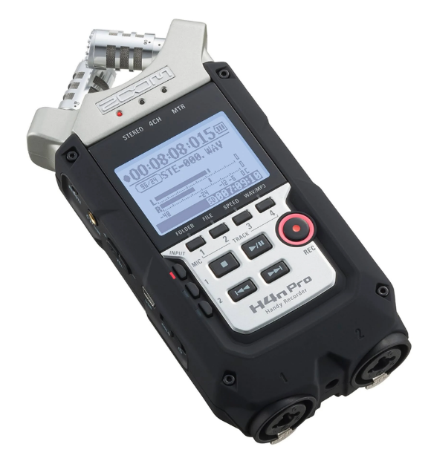
How it all started…
SCSL Staff Members
  Pamela Hoppock
  Katie Simmons
LibraryVoicesSC
PodBean
Portable Recorder
  ZOOM H4n (~$200)
Meeting Room

Slide 5
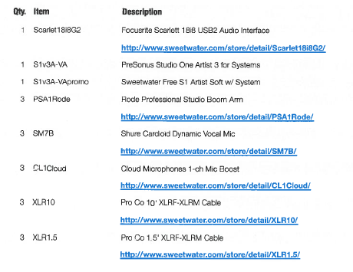

Equipment
~$2400

Slide 6
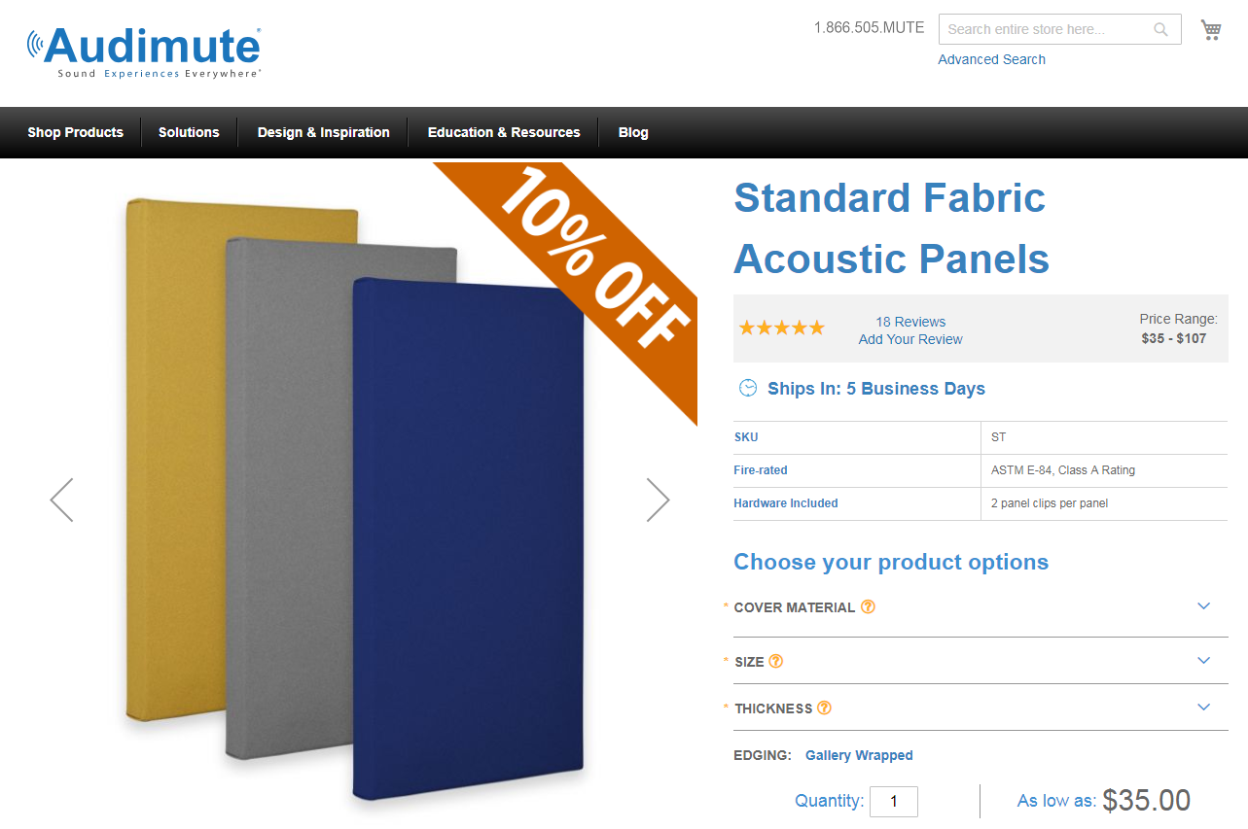

Slide 7
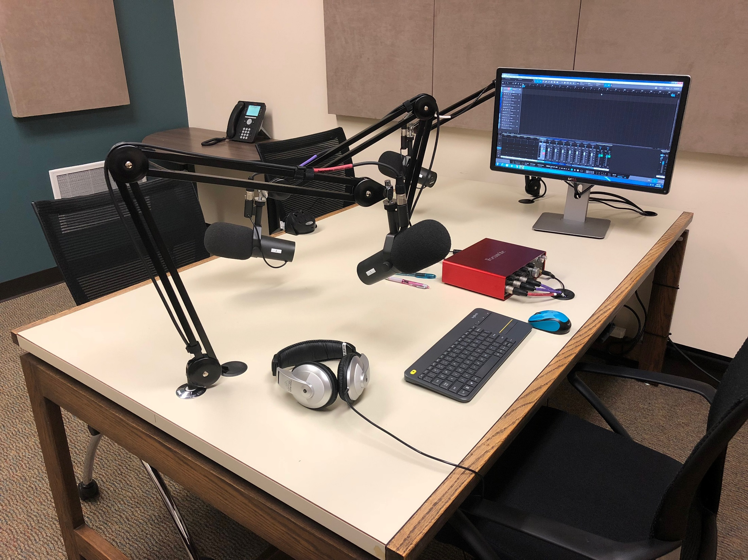

Slide 8
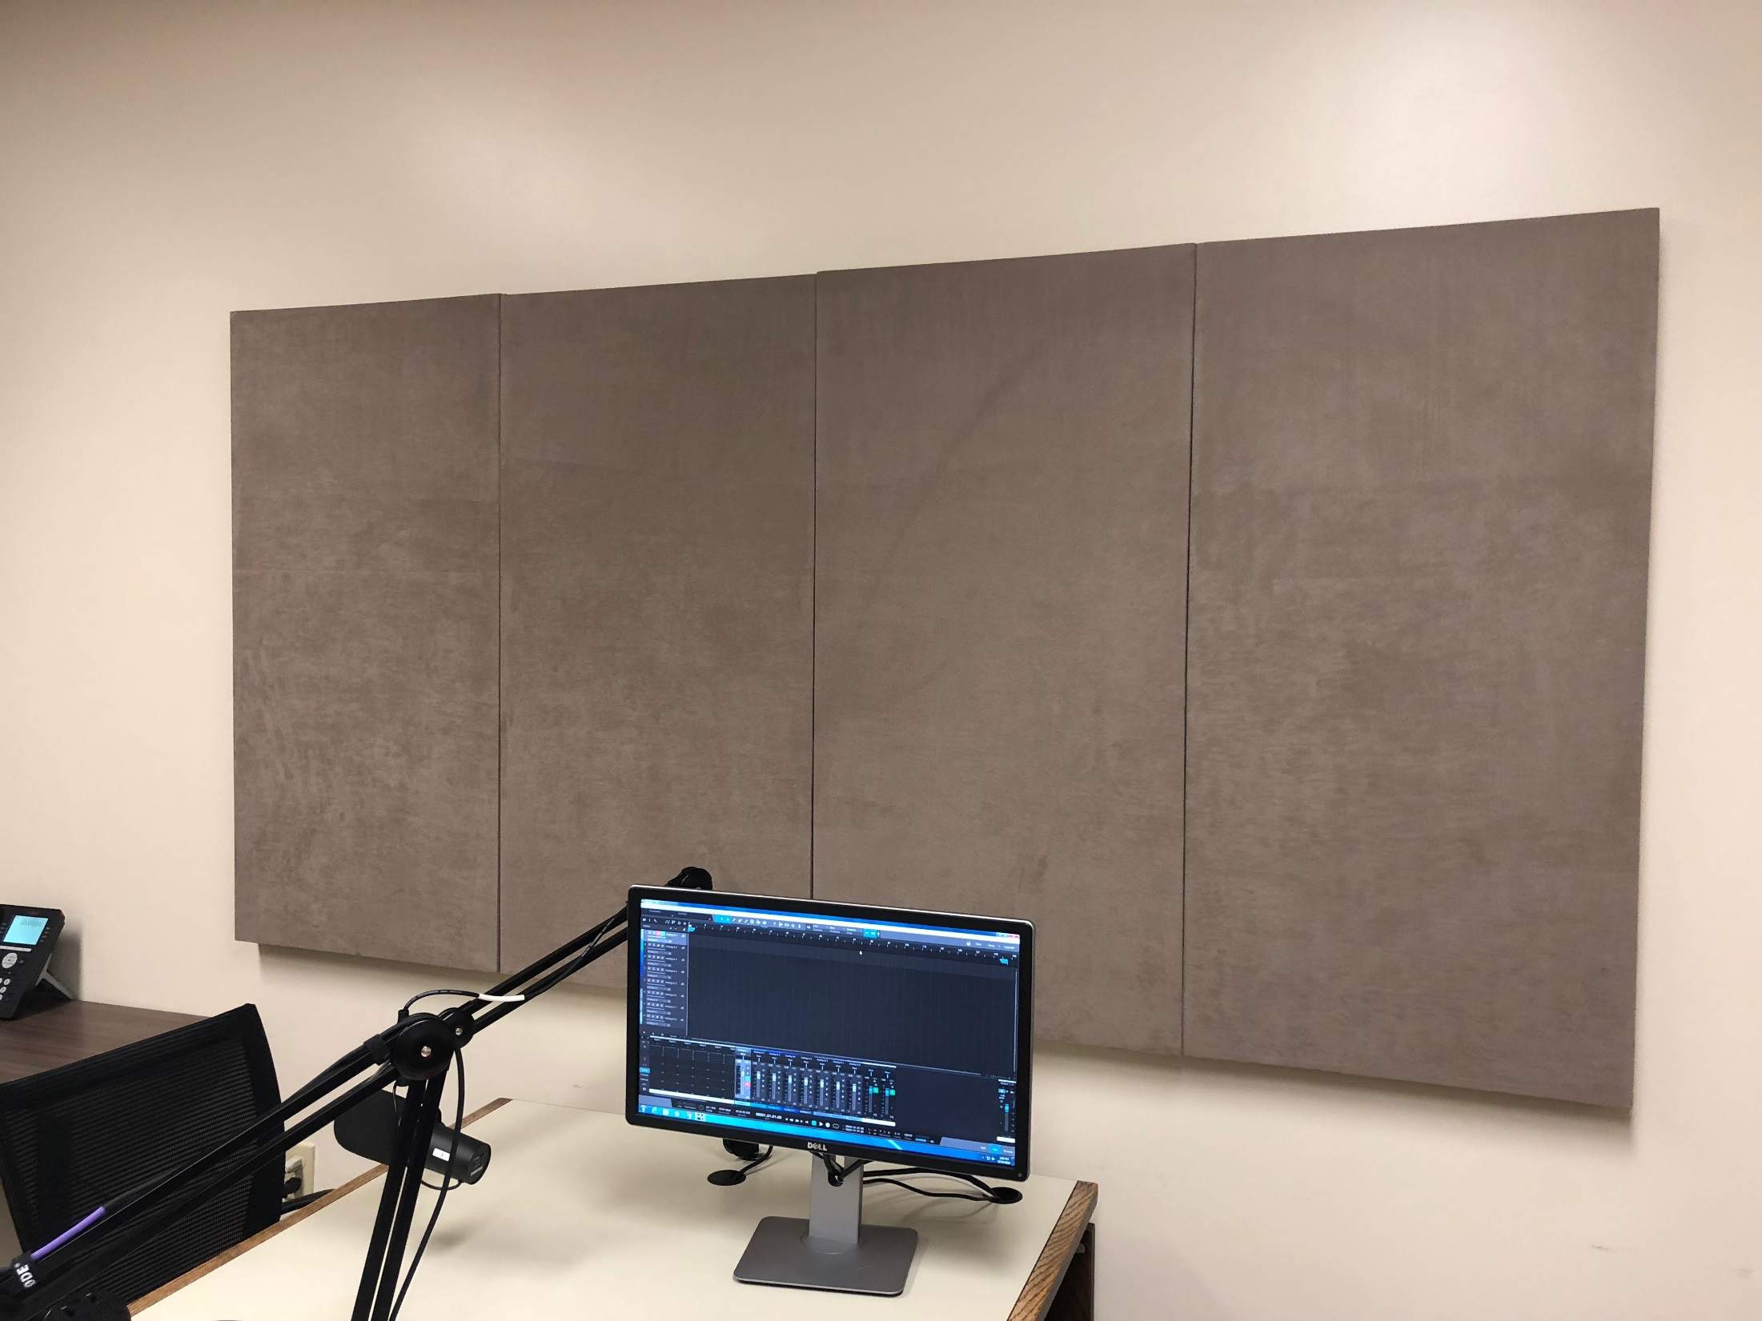

Slide 9
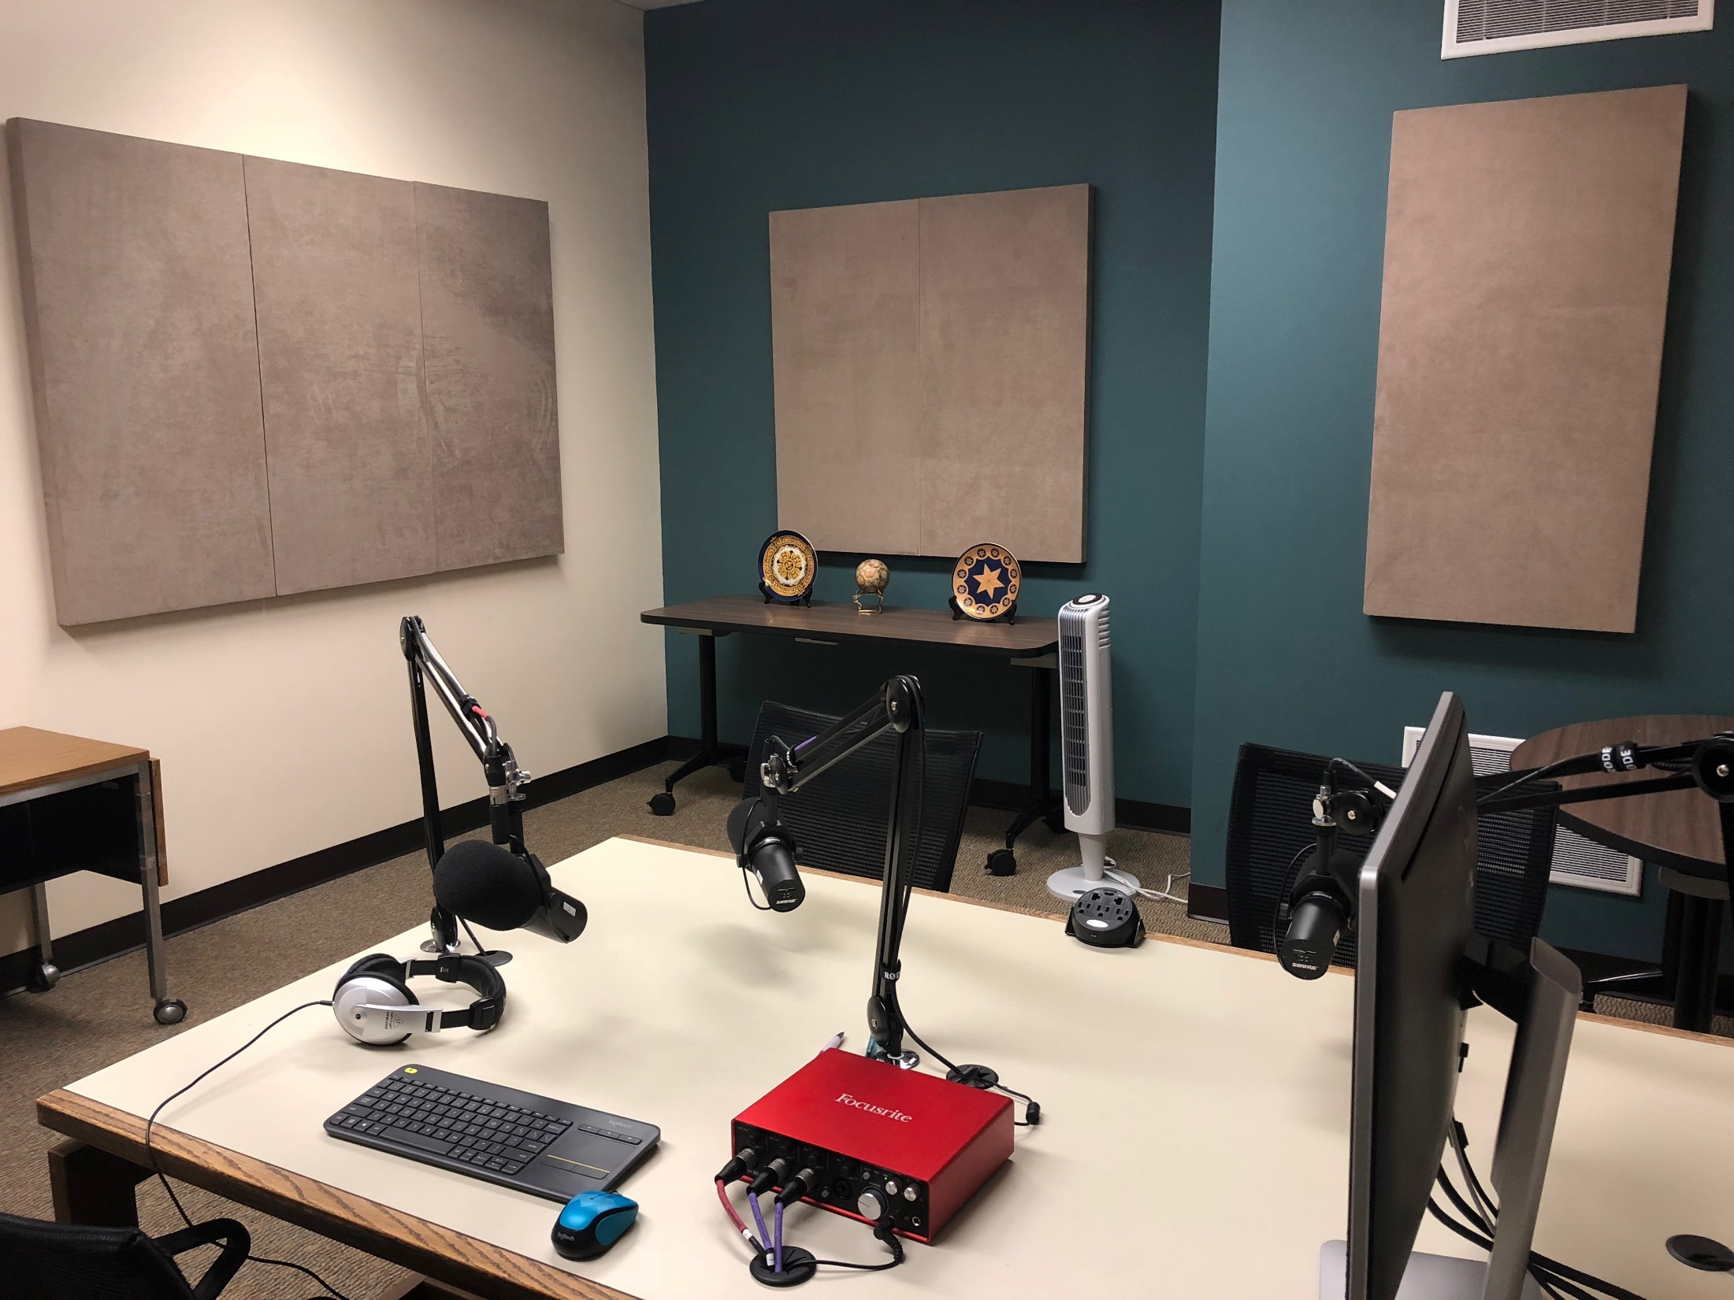

Slide 10
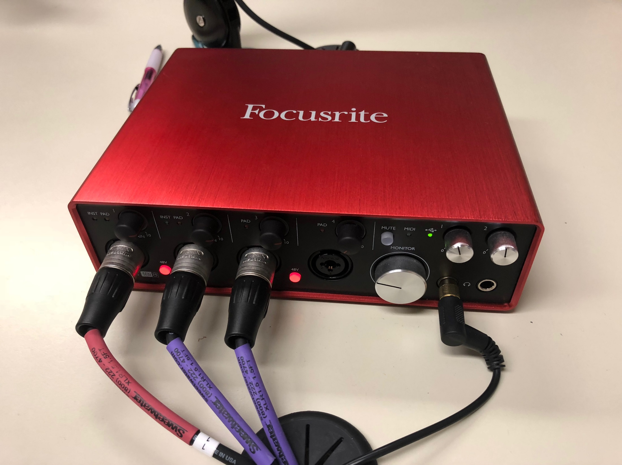

Slide 11
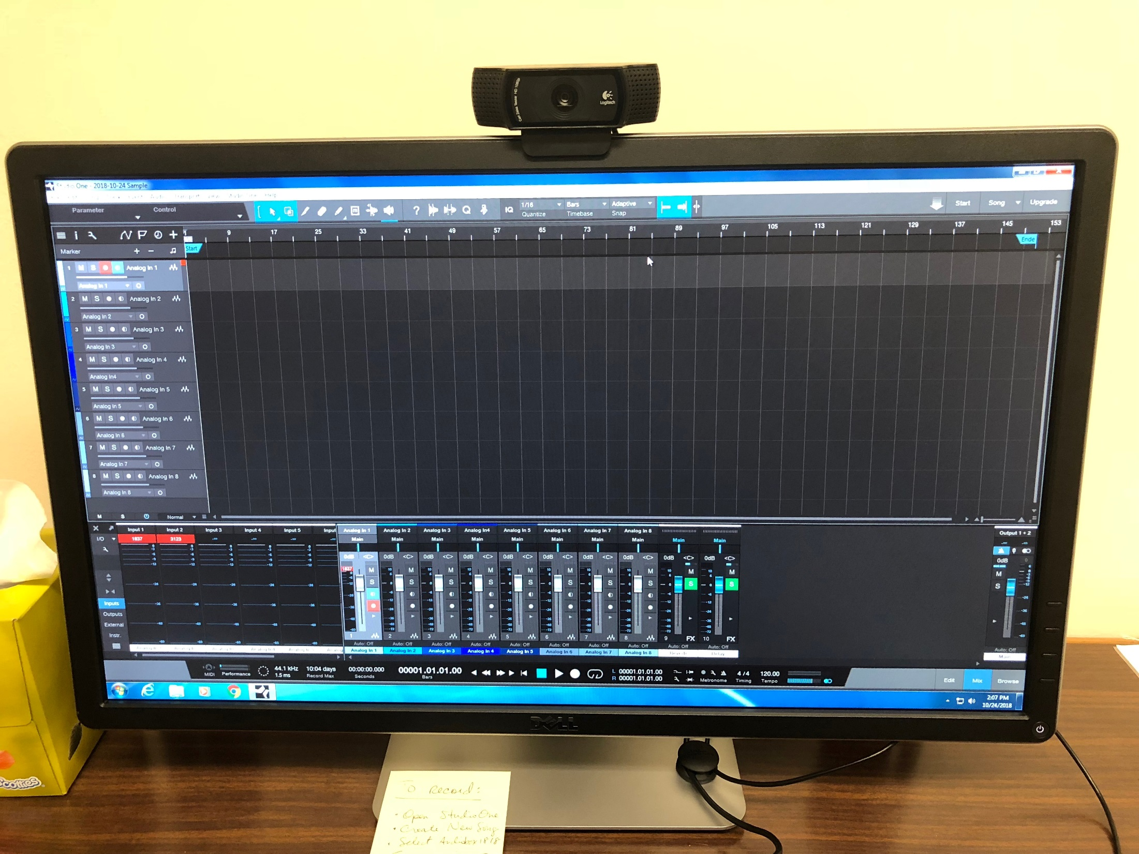

Slide 12
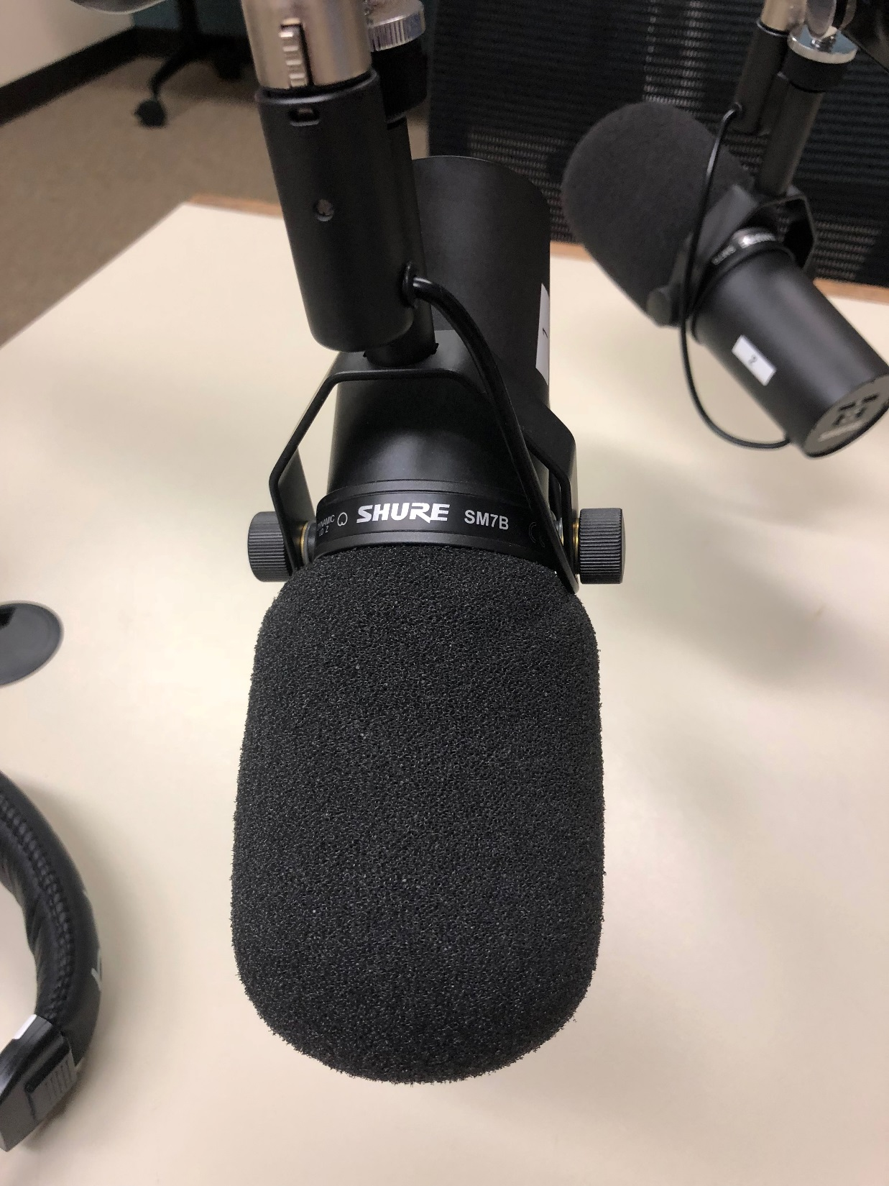

Slide 13
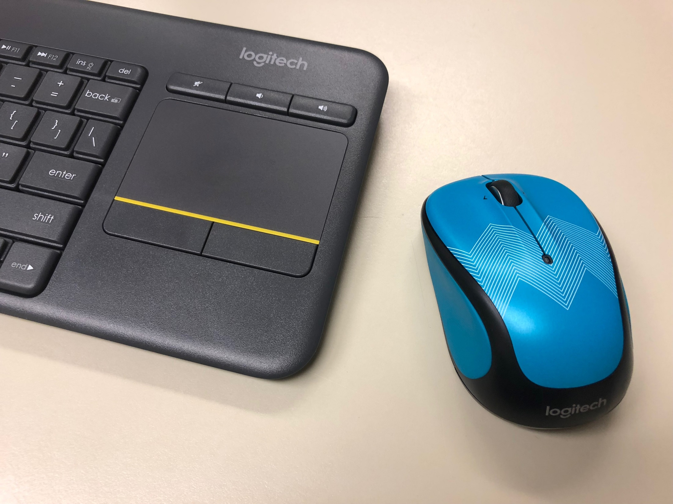

Slide 14
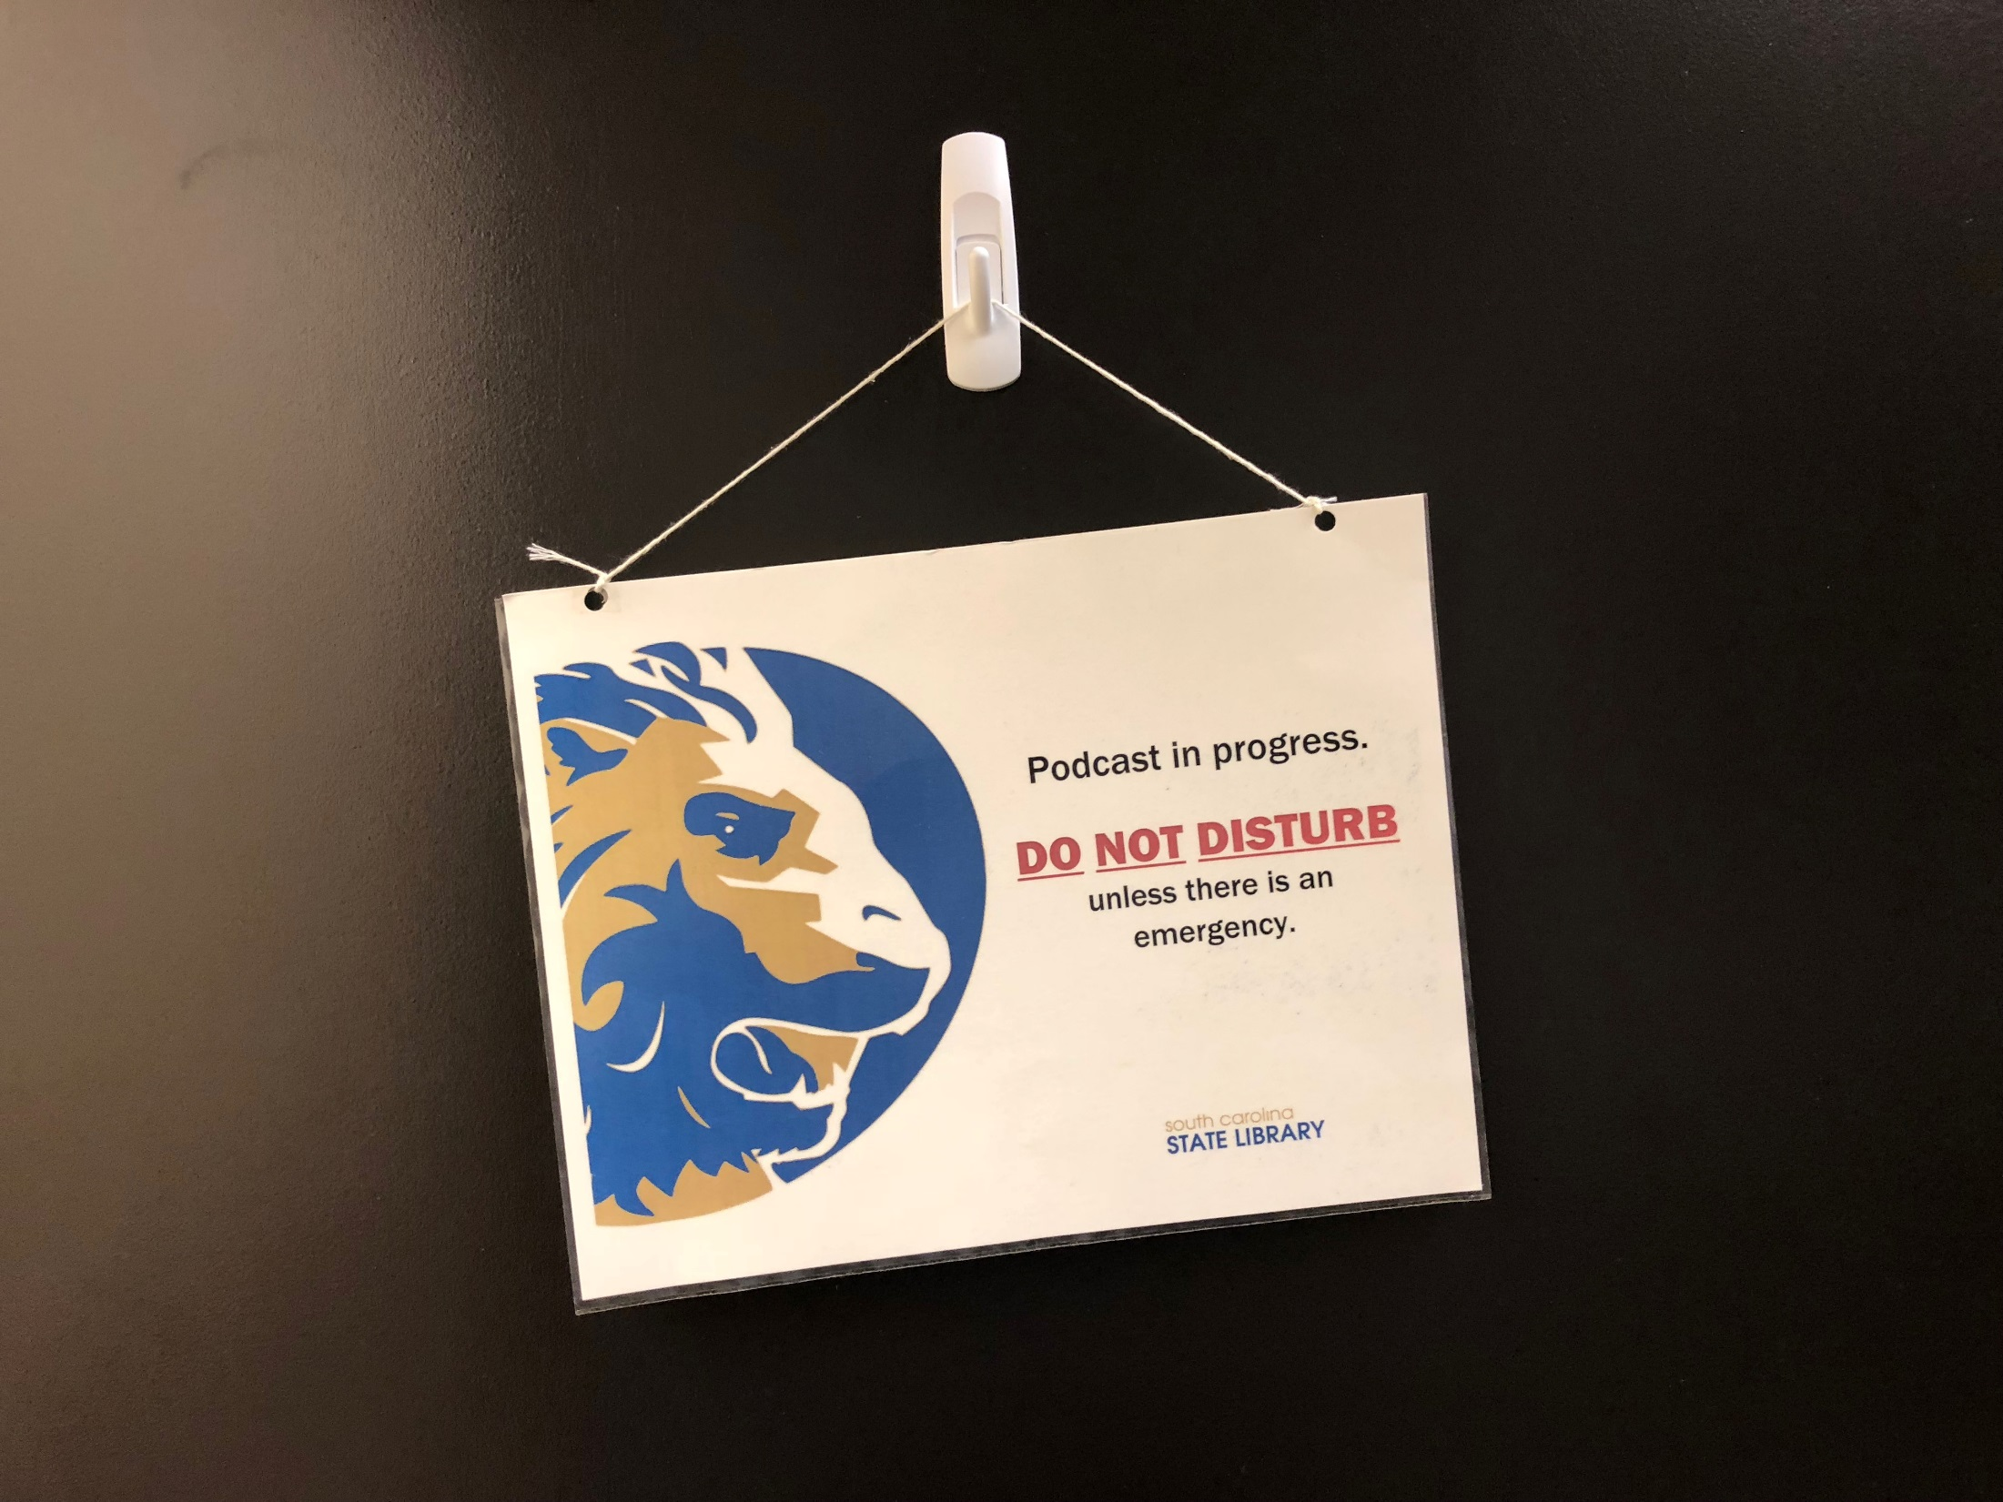

Slide 15
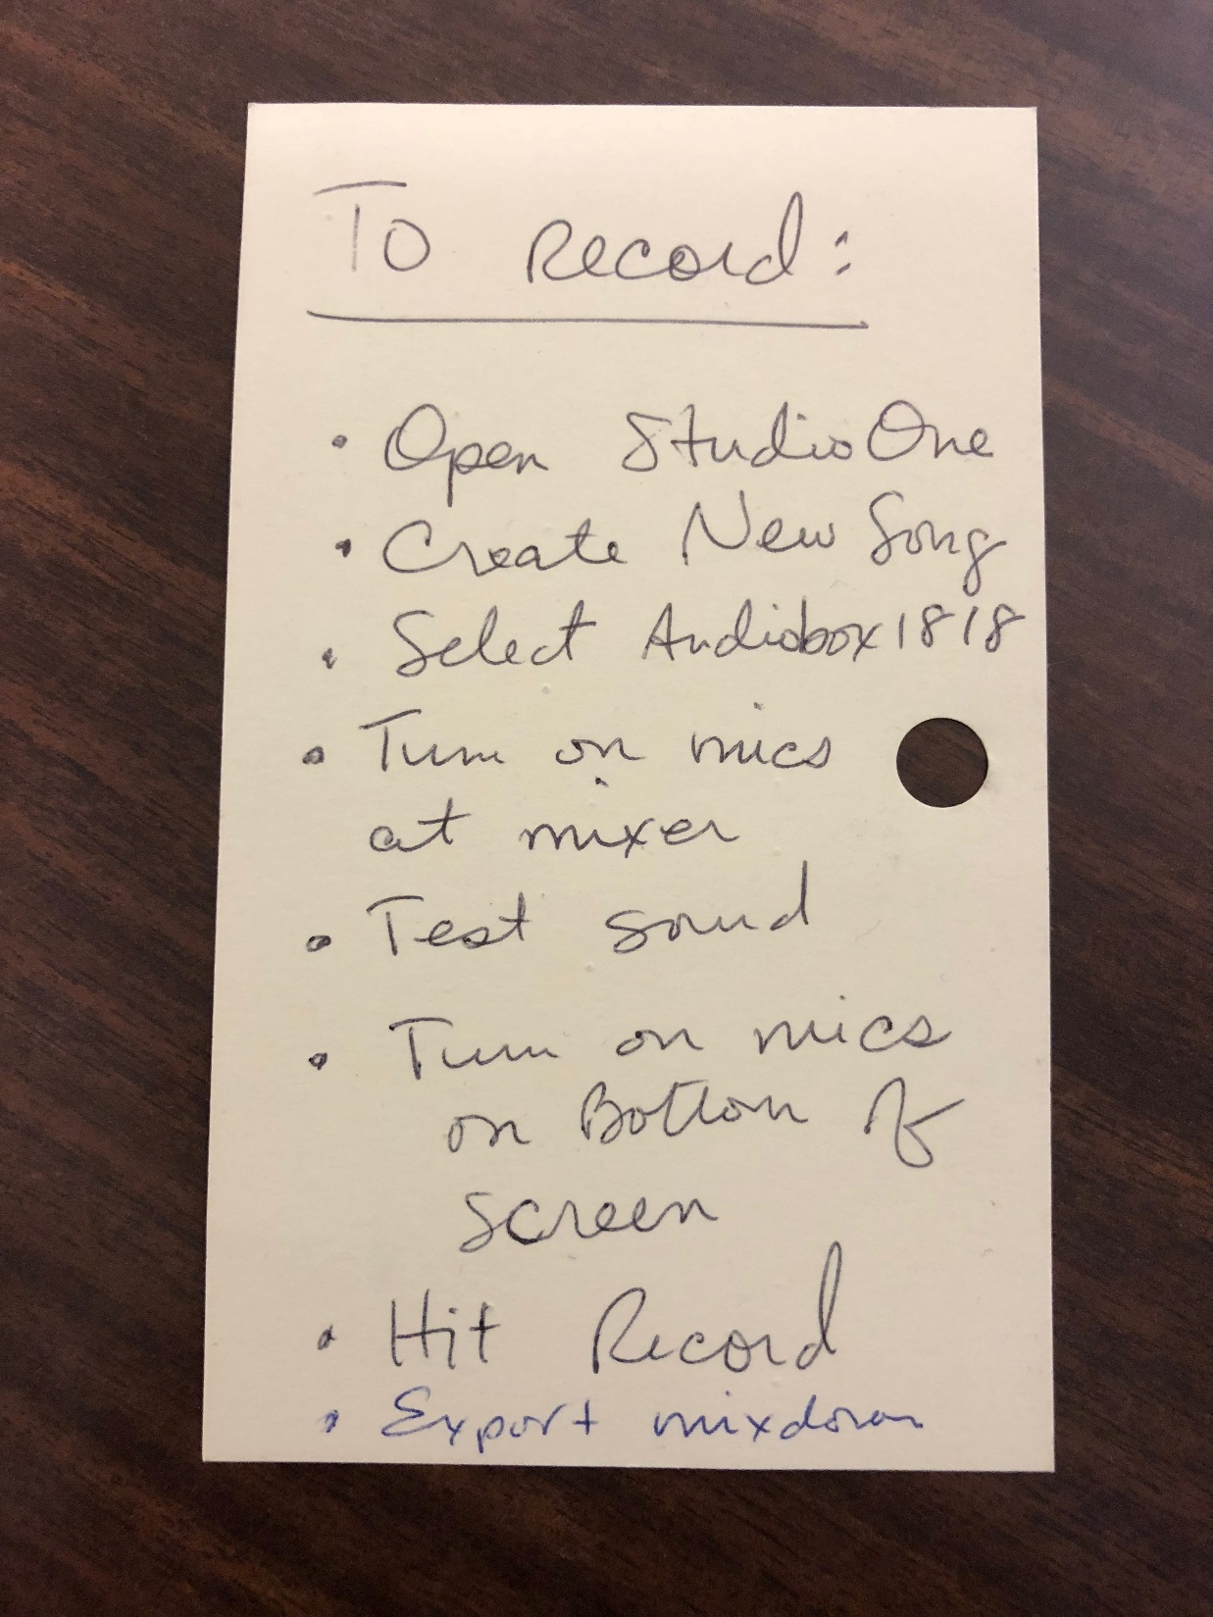

Slide 16
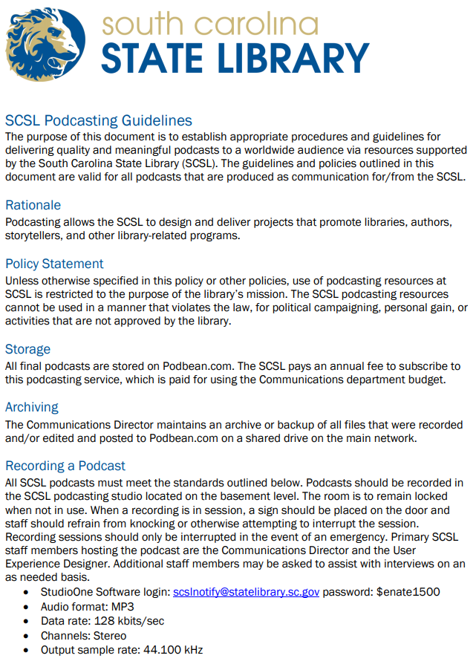
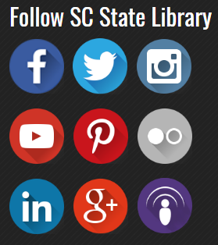
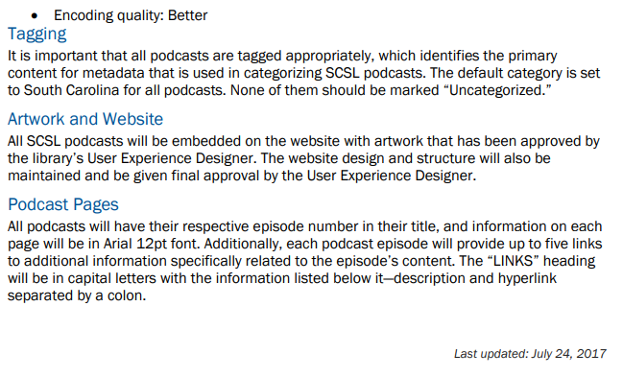

Slide 17
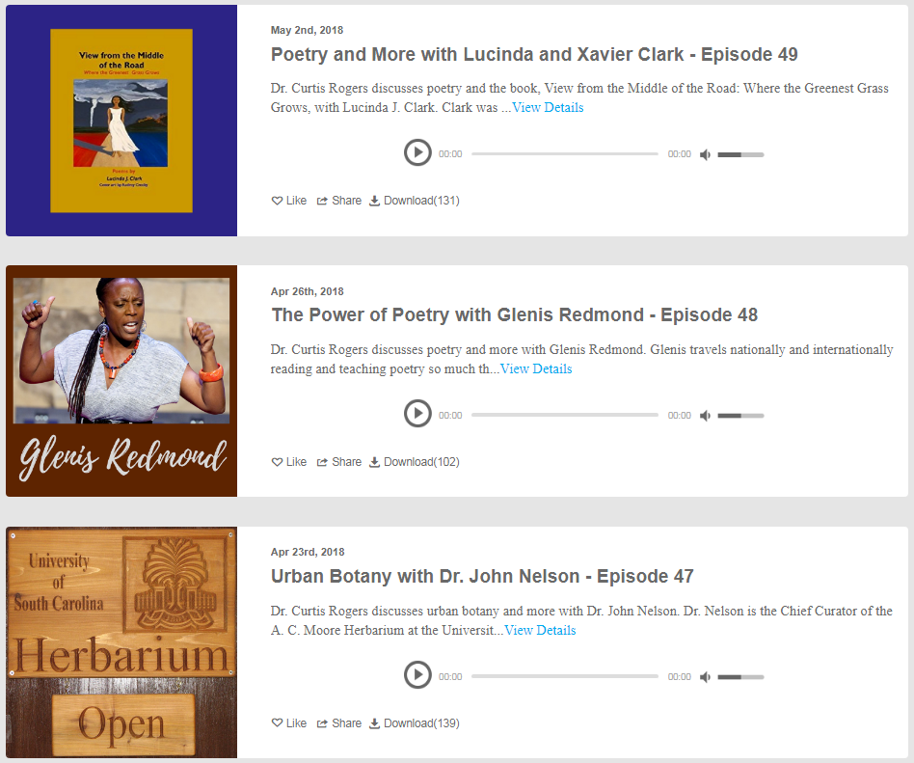
Selecting Topics
Book talks/authors
SCSL guests
Related to specific month
  April – Poetry
  October – Medical libraries
SC-specific history
Education
Genealogy
Other topics?

Slide 18
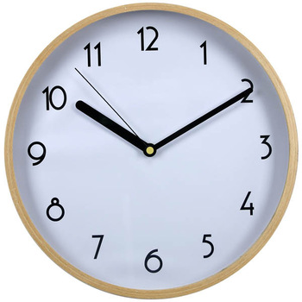
Podcasting Process
Select topic
Coordinate day and time with guest
Book podcasting studio
Get bio and info for script
Write script (next slide)
Ensure that it’s a casual conversation
HIT RECORD AND MAKE SURE MICS ARE ON! ☺
Production (Audacity)
Post and share and promote

Slide 19
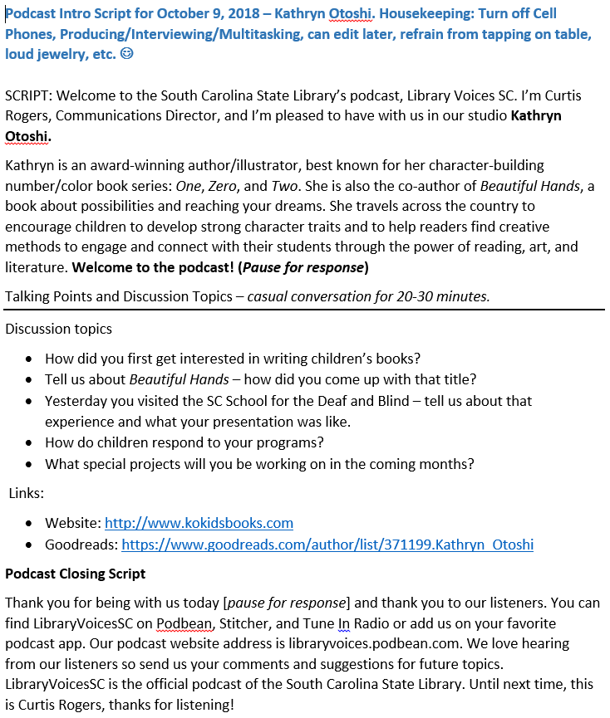

Slide 20
Editing Recordings
Audacity software – free to download
Intro and Exit music
Music for your podcast – Podsafe music
  https://create.blubrry.com/manual/creating-podcast-media/podsafe-music/
How to Record and Edit a Podcast in Audacity (Complete Tutorial)
  https://www.youtube.com/watch?v=xl-WDjWrTtk&vl=en

Slide 21
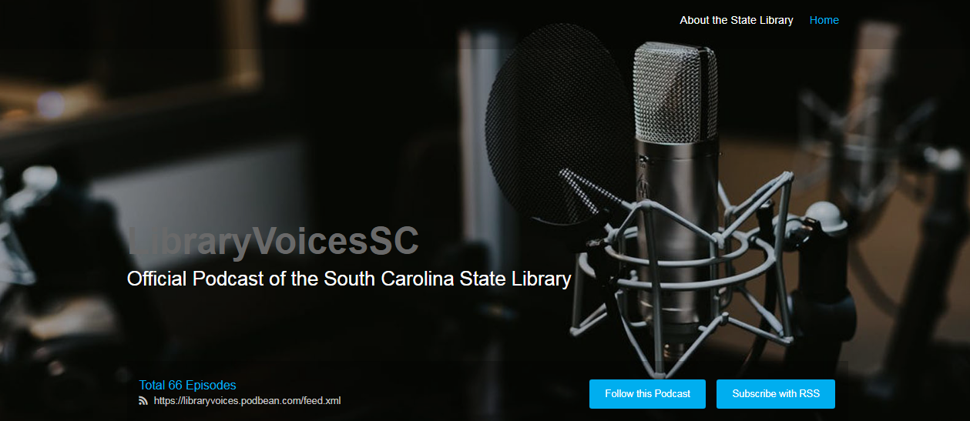
PodBean annual subscription: $108

Slide 22
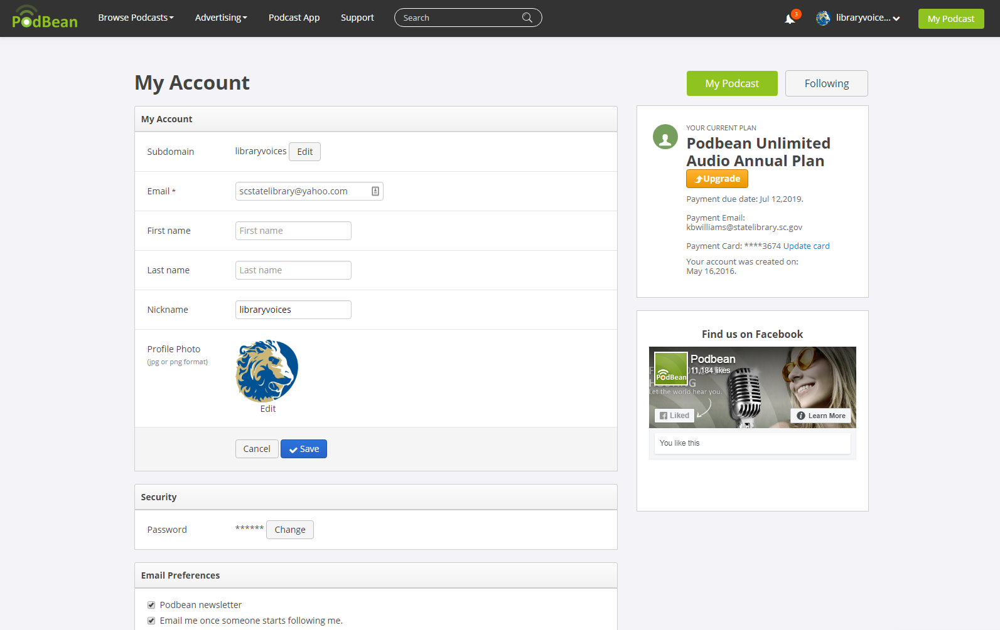

Slide 23
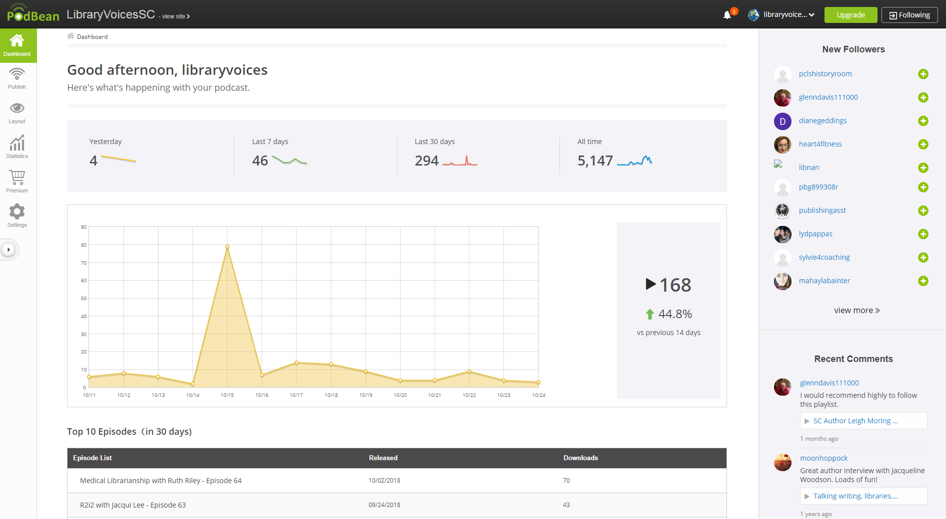

Slide 24
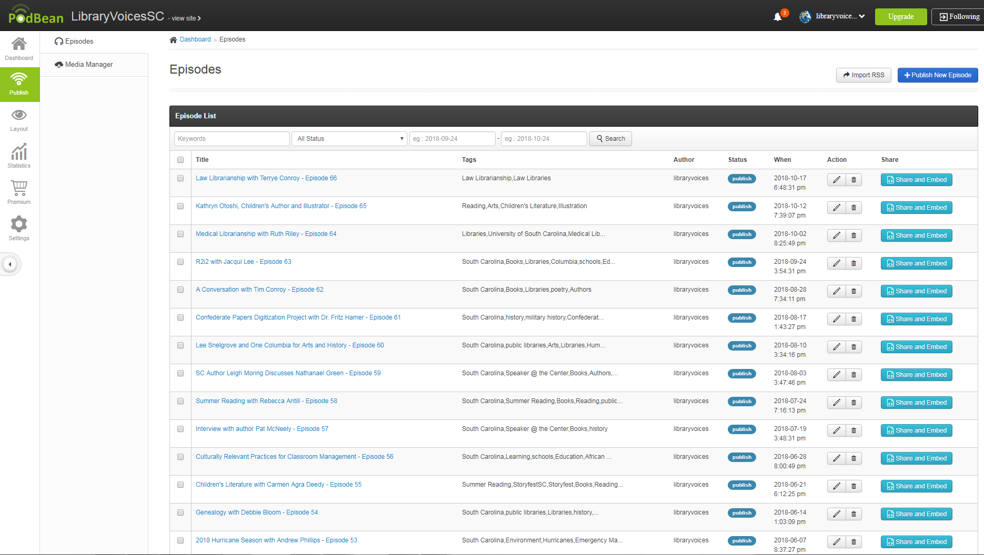

Slide 25
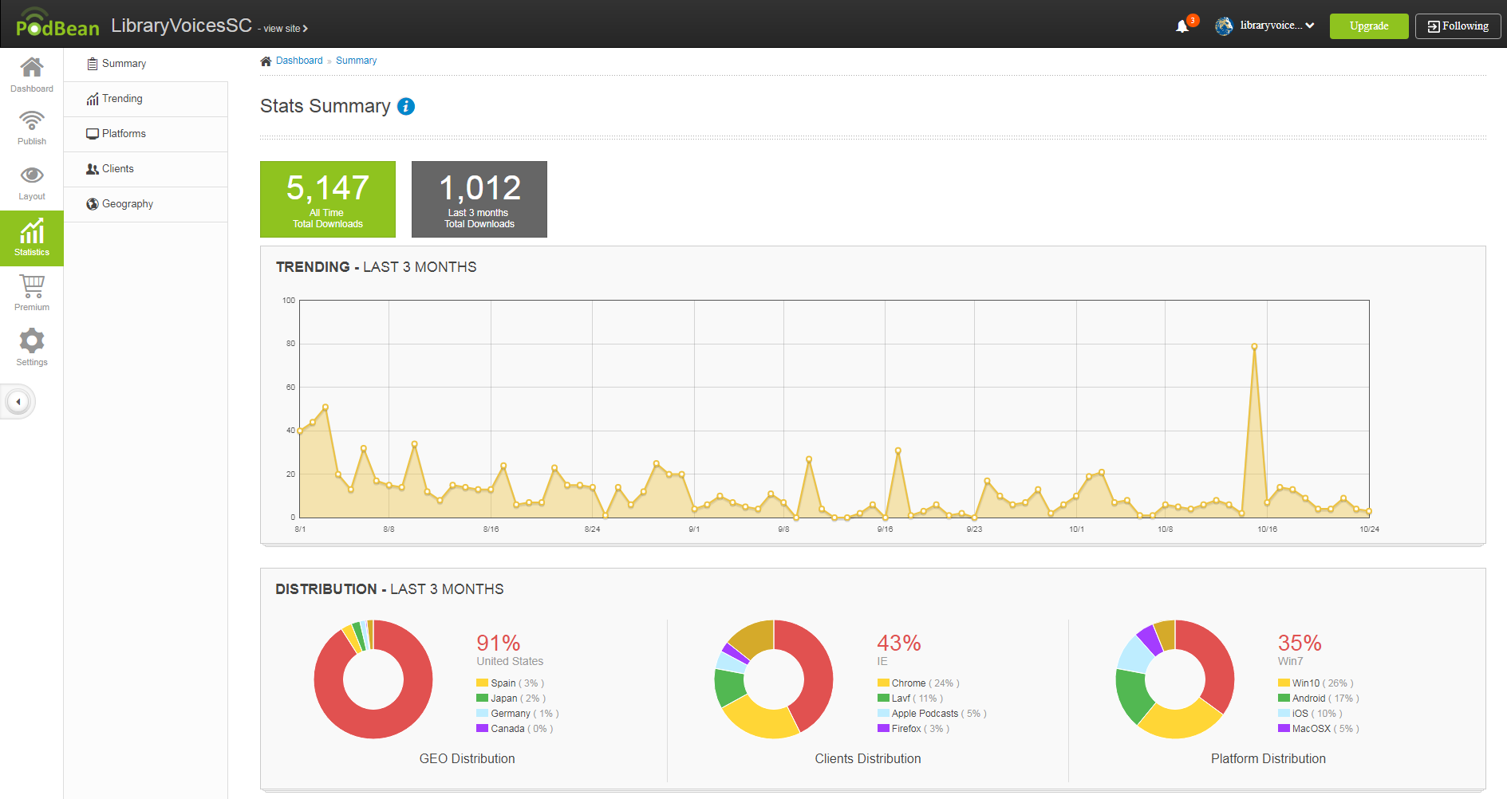

Slide 26
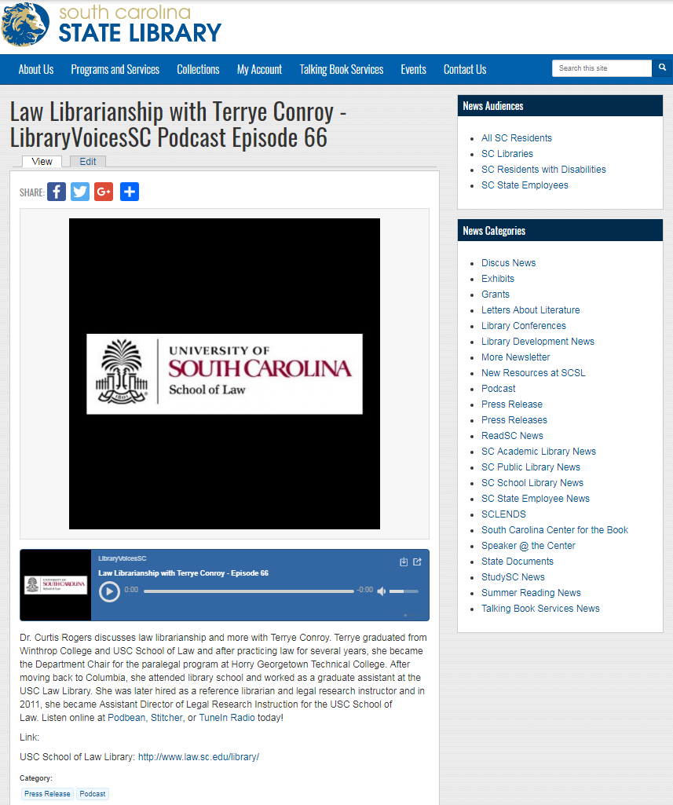
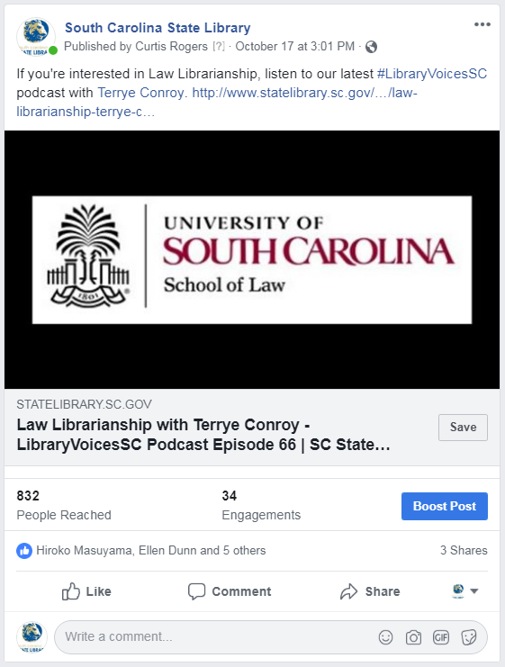

Slide 27
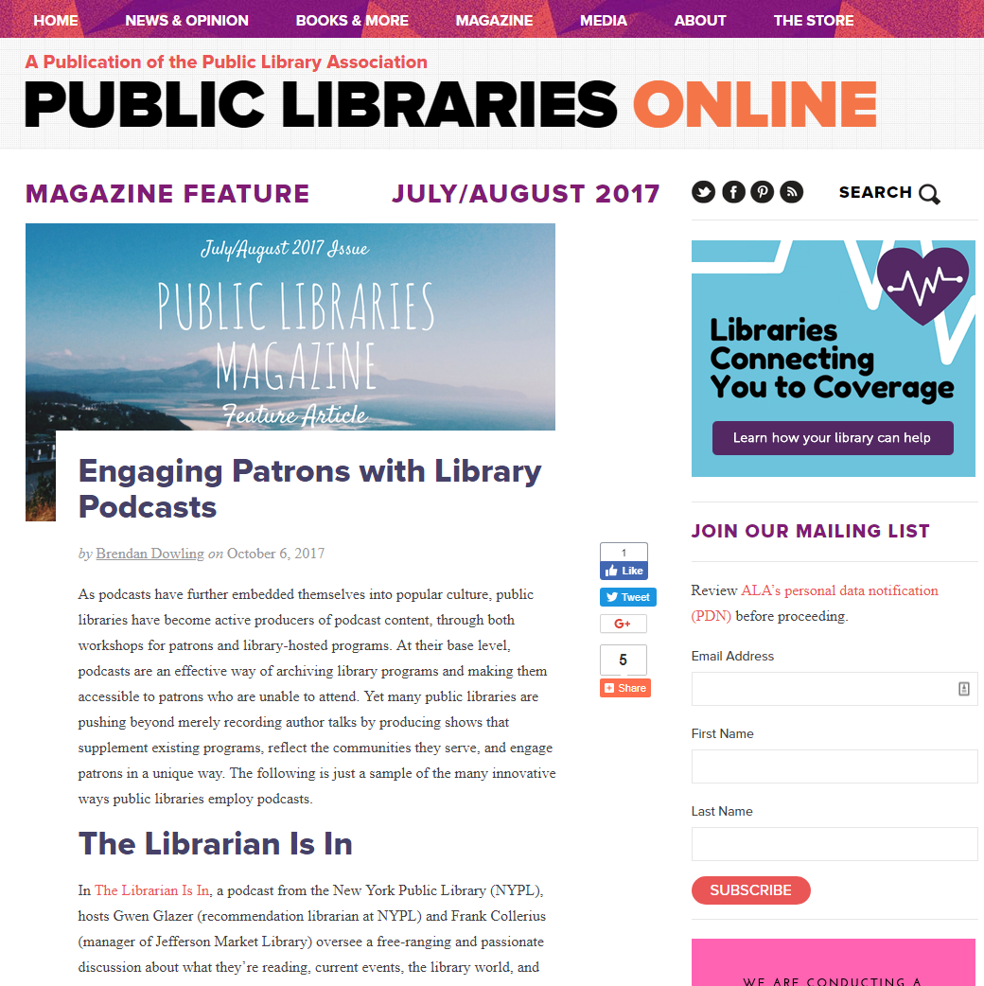
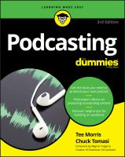
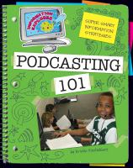

Slide 28
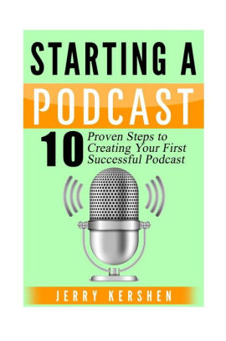
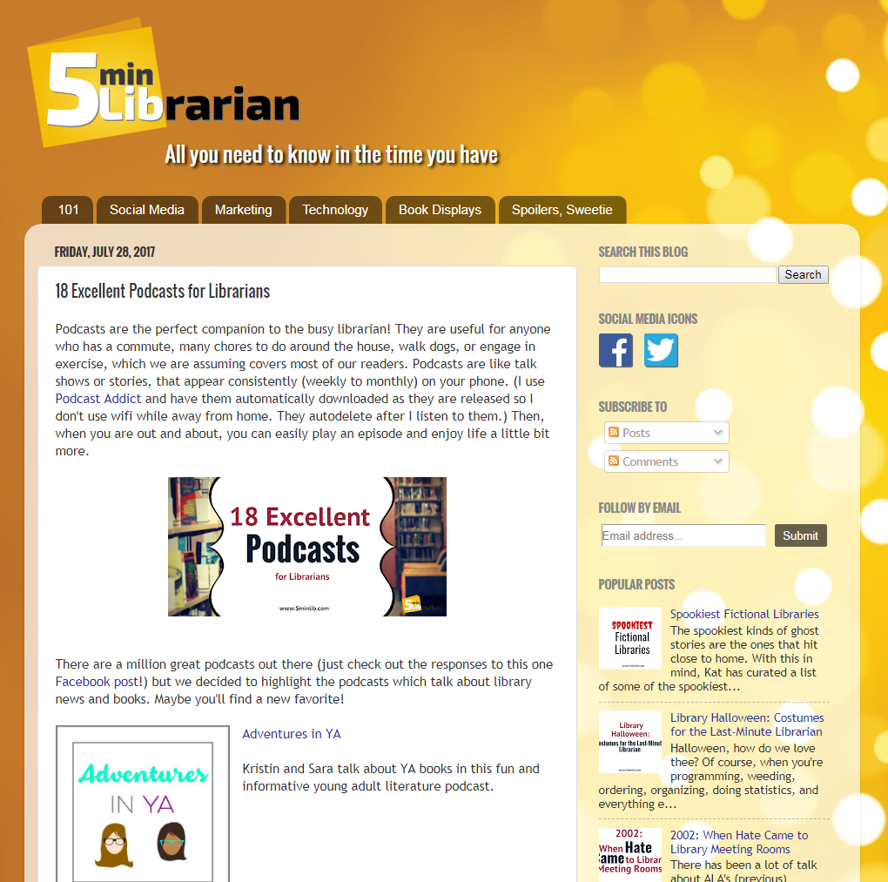


Slide 29


Thank you!
Dr. Curtis Rogers
Communications Director
crogers@statelibrary.sc.gov
(803) 734-8928
Slideshare.net/crr29061

