Slide 1
Libraries Creating Healthier Communities
Rieta Drinkwine, Director
Taylor Atkinson, Assistant Director
SELA/SCLA 2018

Slide 2
Intros

Slide 3
Our Journey Together
Overview
Community
Healthcare
Library
Implementation
Rebranding & Marketing/PR
Key Initiatives
Facility Partners

Slide 4
Defining Healthier Communities
Third Spaces
Culture of health - accessibility & trustworthiness (https://www.brookings.edu/blog/up-front/2017/03/30/how-public-libraries-help-build-healthy-communities/)
Holistic - mind, body, soul

Slide 5
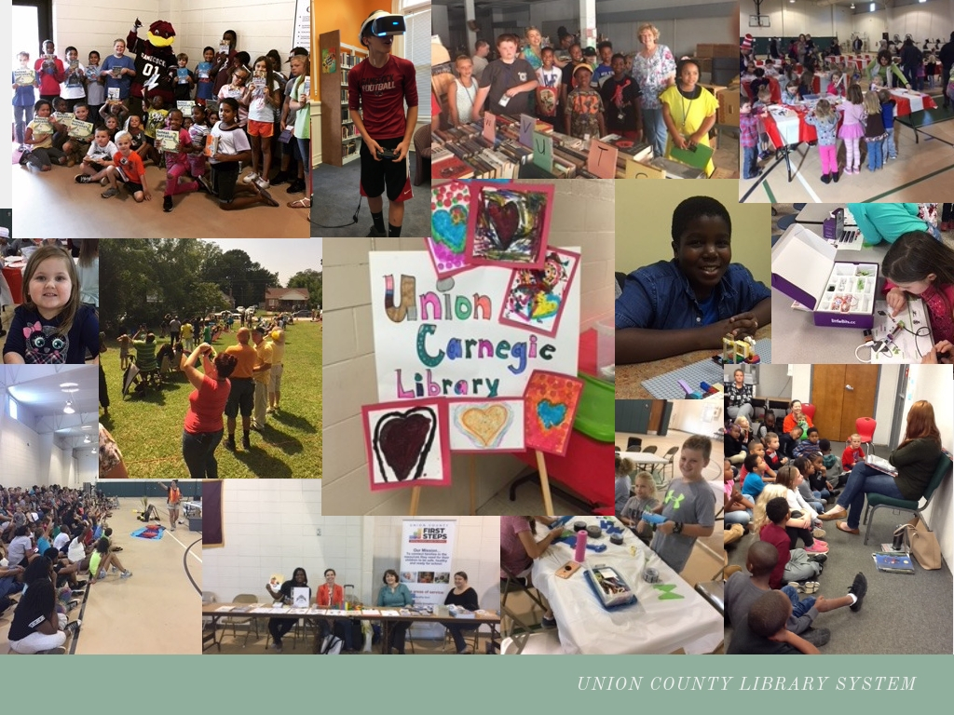
Our Community

Slide 6
Our Community
27,700 residents ; 512 square miles
1 in 3 poverty rate among kids
1 in 5 adults at or below 3rd grade reading
1 in 4 kids does not graduate high school in 5 years

Slide 7
Data Sources
DHEC - BMI report
Workforce Development
Census Quickfacts
SC Education Oversight Committee
Kids Count

Slide 8
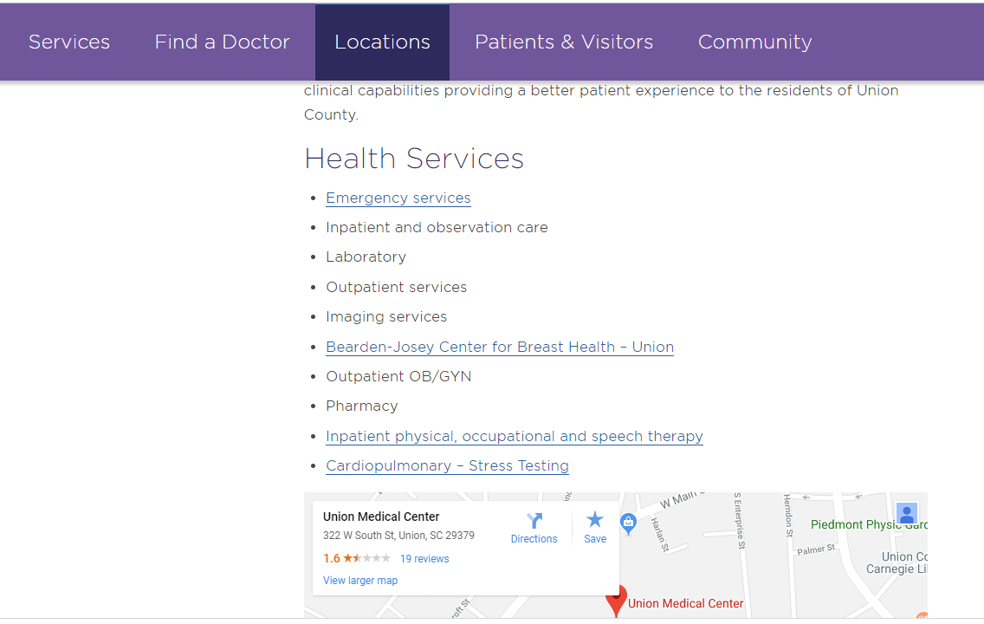
Healthcare

Slide 9
Healthcare
7 Doctors at hospital
1 Pediatrics & 1 OB/GYN
Hospital & 1 clinic
Limited services at hospital
State Mental Health Facility
Tri-county service area

Slide 10
Library
Town Hall Meetings
Networking
Staff / Board Meetings
Dr. Sharon Morris (Gorman, Rokeach, and Morris)
Rebranding

Slide 11
Rebranding

Slide 12
From Theory to Action : Key Initiatives

Slide 13
Facility Partners & Design
First partnership facility of its kind in the state
“In health care and other areas, libraries are combining the access and trust characteristics of a third place with a hub role in the community – using partnerships with other institutions to connect people with services and help.” -- How public libraries help build healthy communities

Slide 14
Funding Sources
SC State Library LSTA - Mental Health First Aid
Catawba Farm and Food Coalition - Dept. of Agriculture’s Office
Healthcare Foundation - Story Corners
Eat Smart Move More
Union County First Steps

Slide 15
Questions?

