Slide 1
Making Your Web Presence User-Friendly
Kathy Snediker
University of South Carolina
SCLA/SELA Conference 2018

Slide 2
Homepage: Busy and confusing
Navigation: Inconsistent and disorganized

Slide 3
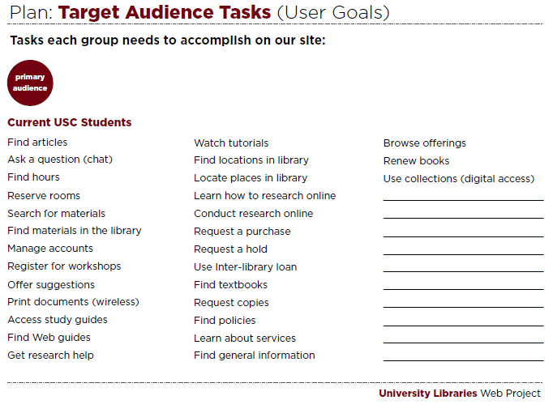
University Libraries Web Project

Slide 4
University Libraries Web Project

Slide 5
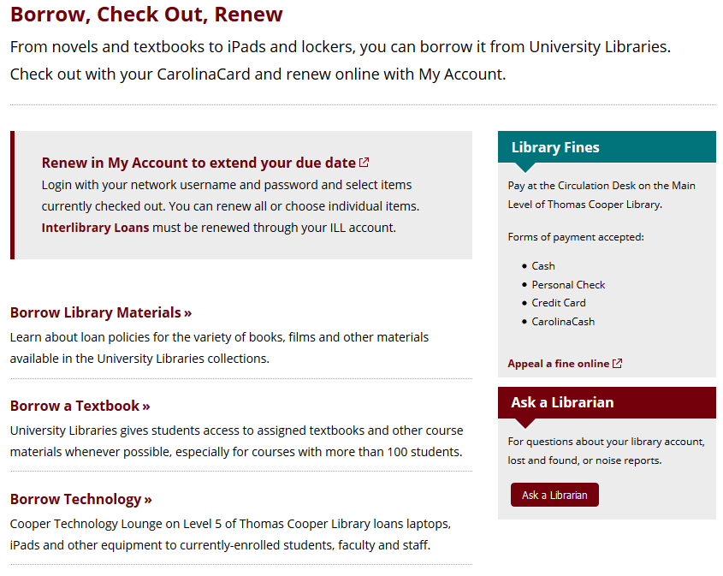
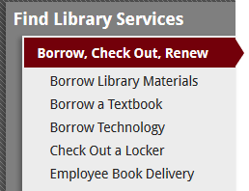

Slide 6
Lessons learned
Everything can’t be important because then nothing is important

Slide 7
Content organization
Pick one way to emphasize info and use it sparingly
Inverted pyramid: most important > least important
Limit to need-to-know information

Slide 8
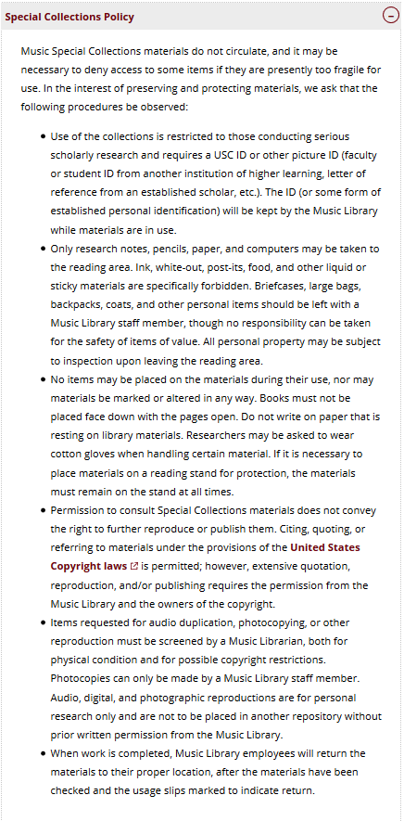
Went from this on the old site…
… to this on the new site!

Slide 9
Lessons learned
Everything can’t be important because then nothing is important
Design for the user, not for you or your organization

Slide 10
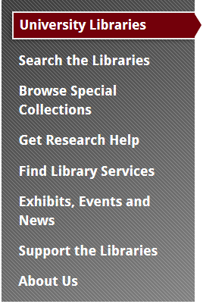
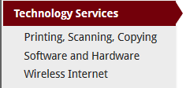
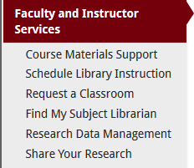

Slide 11
Lessons learned
Everything can’t be important because then nothing is important
Design for the user, not for you or your organization
It isn’t helpful if they won’t read it

Slide 12
On an average web visit, viewers read what % of words?
28%
(at most)

Slide 13
Proxy Cards
If you would like to allow your graduate assistant to check out items to your account, then you may request a proxy card for that student…Proxy cards are issued for one semester.
23 words
35 words

Slide 14
Lessons learned
Everything can’t be important because then nothing is important
Design for the user, not for you or your organization
It isn’t helpful if they won’t read it
Consistency is key

Slide 15
Lessons learned
Everything can’t be important because then nothing is important
Design for the user, not for you or your organization
It isn’t helpful if they won’t read it
Consistency is key
Keep mobile in mind

Slide 16
Let’s practice
Off Campus Access
To access online resources remotely, you will be asked to login with your network username and password. To get full text access when utilizing the Multi-Search box, be sure to click the Login for Full Access link. All other online resources will prompt you to login at appropriate points.

Slide 17
Let’s practice
Off Campus Access
To access online resources remotely, you will be asked to login with your network username and password. To get full text access when utilizing the Multi-Search box, be sure to click the Login for Full Access link. All other online resources will prompt you to login at appropriate points.
Off campus access requires your network username and password.

Slide 18
Let’s practice
Remote Access Outside the U.S.
Access to library resources is restricted while working from some countries outside of the United States. In these instances, you may be required to download and use the University's Virtual Private Network (VPN) to gain access to library subscription content. The VPN is made available via University Technology Services (UTS).

Slide 19
Let’s practice
Remote Access Outside the U.S.
Access to library resources is restricted while working from some countries outside of the United States. In these instances, you may be required to download and use the University's Virtual Private Network (VPN) to gain access to library subscription content. The VPN is made available via University Technology Services (UTS).
For access from a foreign country, you may need to download and install a virtual private network (VPN) client which is available at no cost from the university.

Slide 20
Questions?

